Slide 1

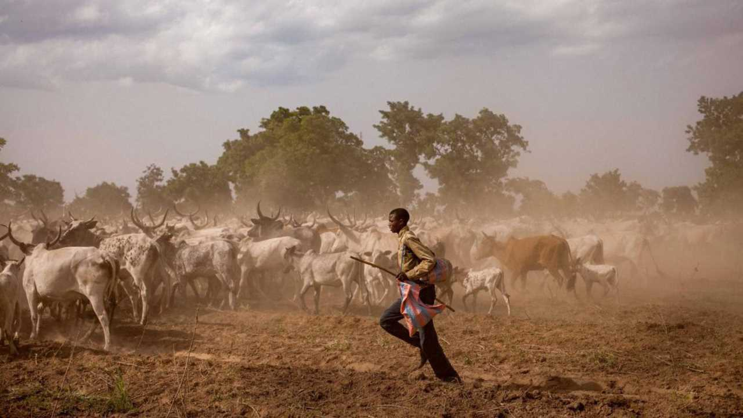


Films on Challenges & Opportunities in Rangelands
UN International Year of
Rangelands and Pastoralists
2026
Togo
@Giles Coulon
https://iyrp.info
Notes:
The films in this compilation total 90 minutes and can be show as one set 1.5h for films and 30 min for discussion or shown as two sets of films (two ~50 min film events with time for discussion). Or some films can be removed to fit a shorter time length.
Welcome everyone and Happy International Year of Rangelands and Pastoralists! The Global Alliance for Rangelands & Pastoralists (GA4RP) invites everyone to celebrate the IYRP with us. The Global Alliance is the group that worked with the Government of Mongolia over the past decade to promote and support the designation of the UN 2026 International Year of Rangelands and Pastoralists (IYRP). The IYRP aims to raise awareness of the vital importance of rangelands and pastoralists as their frontline custodians. We recognize the indispensable benefits rangelands provide for supporting the livelihoods and socio-ecological resilience of hundreds of millions of people, conserving bio-cultural diversity, restoring degraded lands, fostering sustainable food systems, and advancing climate action.
A great way to celebrate this monumental year is through greater knowledge and connectivity with our pastoralists and rangeland peoples around the world. This is an opportunity to learn about people and places that do not often receive much attention. To hear their stories, and understand their way of life a little bit better. We think that film is an excellent way to do that.

Slide 2
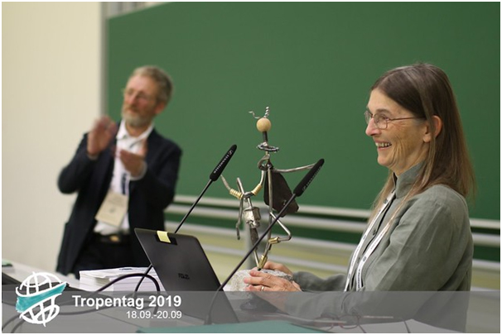
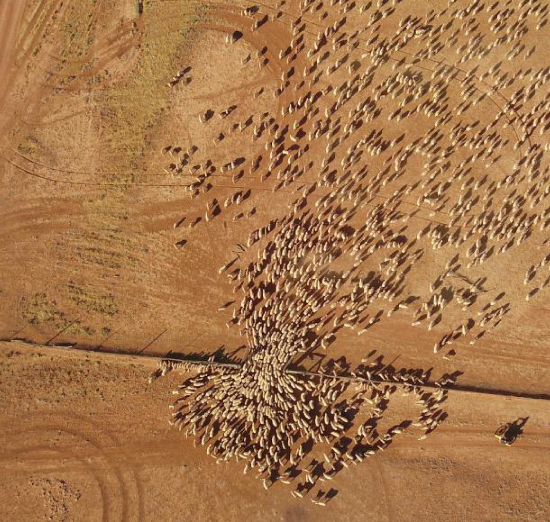
Perspectives on Pastoralism
We are grateful to Ann, who leads by example and is a dedicated, passionate advocate for rangelands and pastoralists.
Film Festival (PPFF)
Started by Ann Waters-Bayer and Margareta Lelea
3 editions (2019, 2022, 2025)
Using film to inform the general public about rangelands & pastoralists
Film viewings around the world
Australia
©Wendy Sheehan
Notes:
Film is an amazing way to convey story and emotion, and create a deeper understanding. Dr Ann Waters Bayer, a rangelands and pastoralists researcher, is a huge proponent of the use of film to share stories of these lands and people and was a co-founder of the Perspectives on Pastoralism Film Festival (PPFF) with Margareta Lelea. The Perspectives on Pastoralism Film Festival has had three editions. And, since the initiation of the PPFF, pastoralism and rangeland film events have taken place around the world. We are continuing that effort in the 2026 IYRP as people around the world celebrate together.

Slide 3
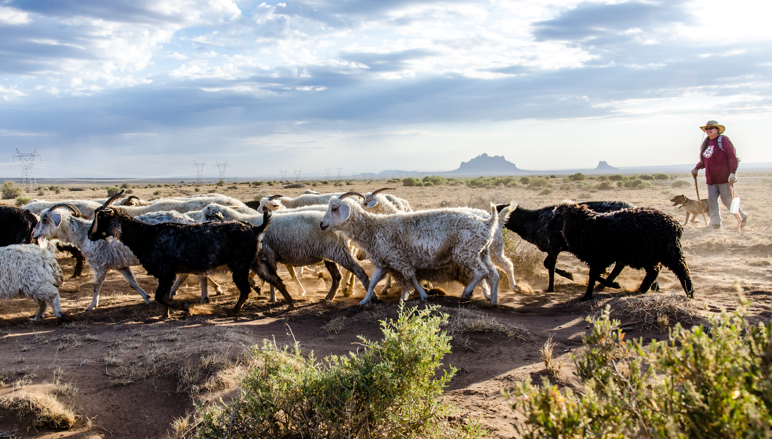

Challenges and Solutions in Rangelands
Pastoralists as knowledge keepers
USA
©Michael Benanav
Notes:
With that, we invite you to join us on a world tour to learn about the challenges faced by rangelands and pastoralists and the opportunities they see for the future.

Slide 4
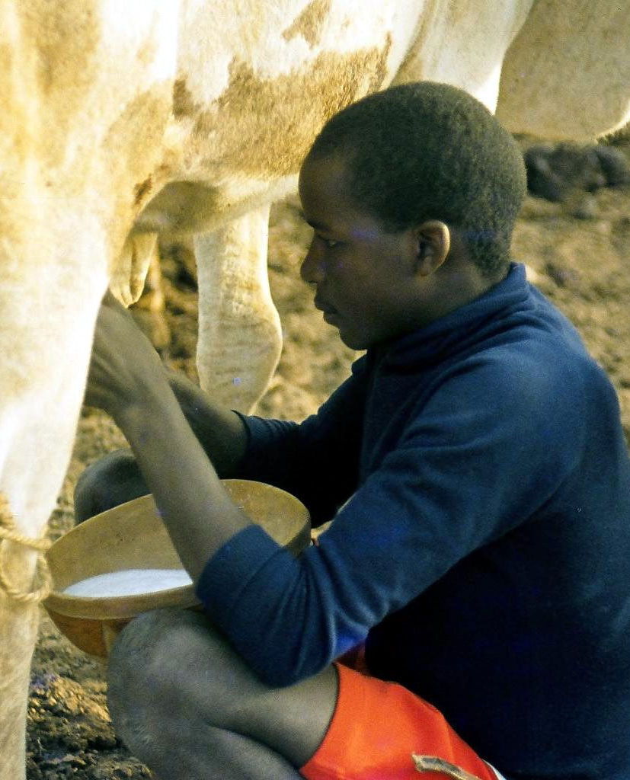
Global
Title: Let’s Not Export Our Problems
Film maker: Switch asbl
Year made: 2019
Length: 2 min
YouTube link
Nigeria
© Wolfgang Bayer

Slide 5
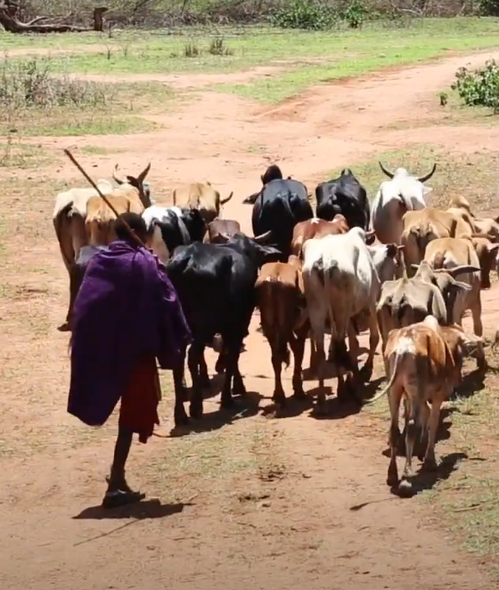
Tanzania
Title: Olosho: Maasai Community Land Rights struggle in Loliondo, Tanzania
Film maker: Elie Chansa & Pingo’s Forum IWGIA
Year made: 2020
Length: 11 min
YouTube link
Tanzania
© Elie Chansa

Slide 6
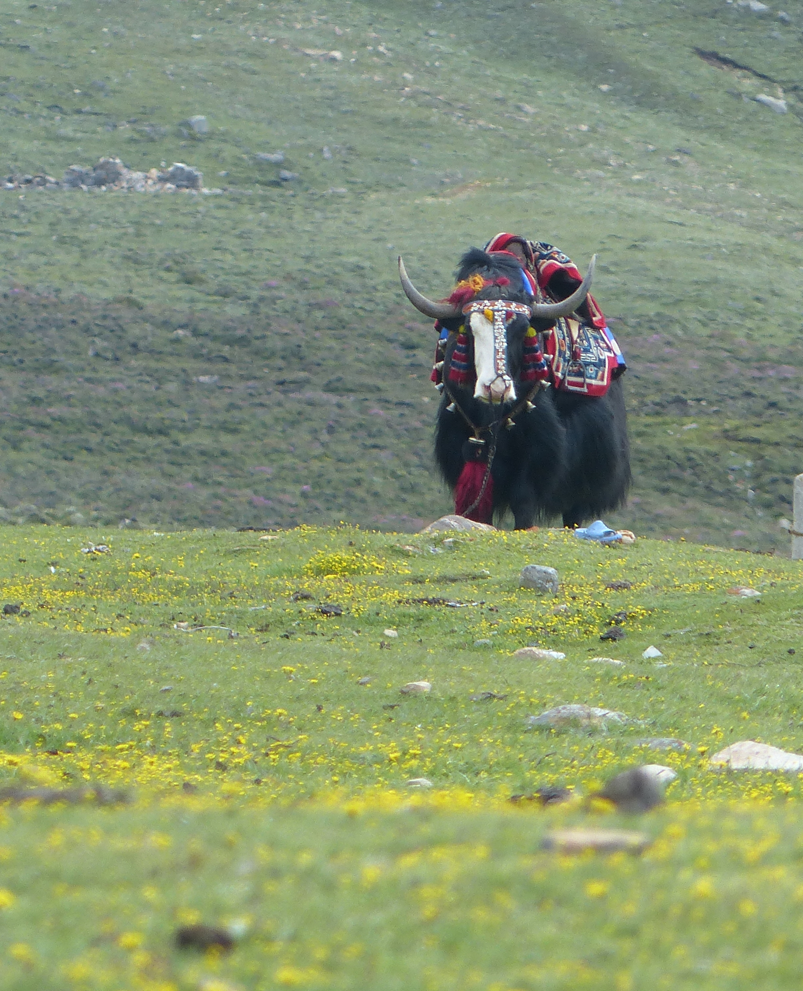
India
Title: Living in the Mountains of Ladakh
Film maker: Patrick Augenstein
Year made: 2023
Length: 3 min
YouTube link
India
© Rashmi Singh

Slide 7
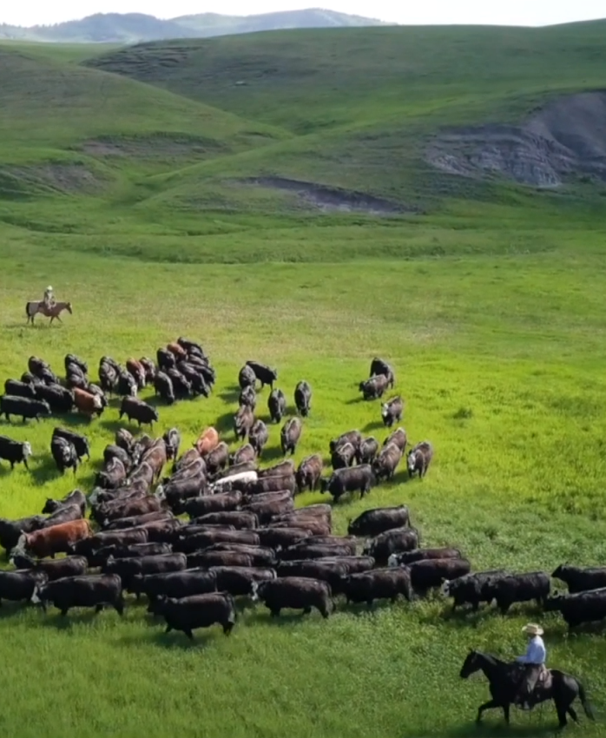
Canada
Title: Guardians of the Grasslands
Film maker: Sarah Wray
Year made: 2021
Length: 13 min
YouTube link
Canada
© Sarah Wray

Slide 8
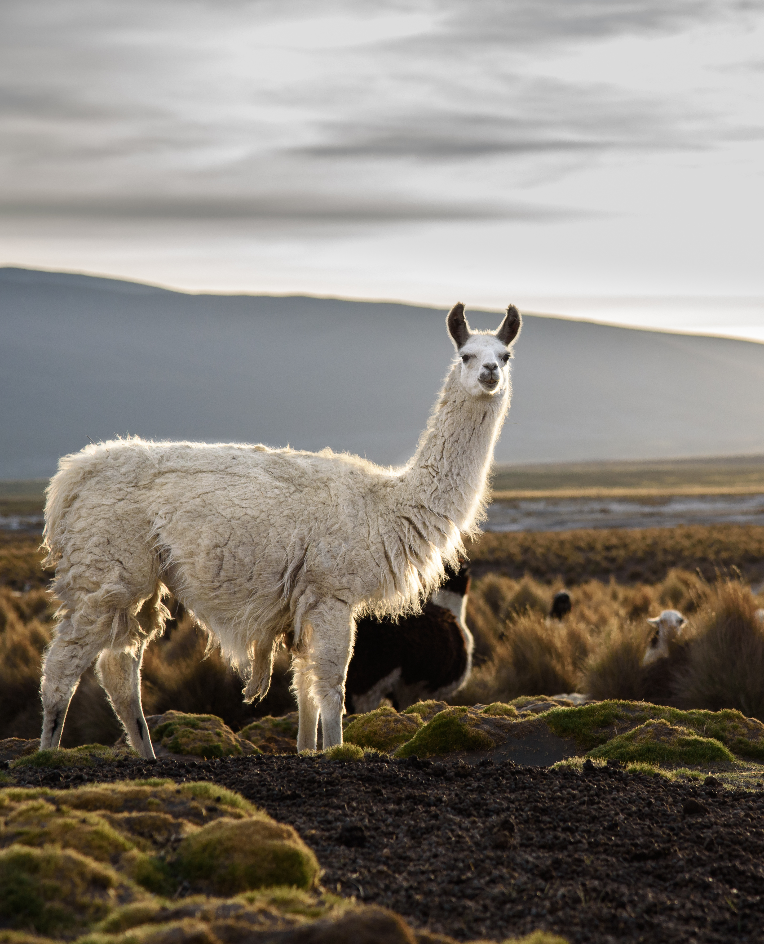
Bolivia to Argentina
Title: Caravanas de las Alturas
Film maker: Bibiana Vilá
Year made: 2019
Length: 7 min
YouTube link
Bolivia
© Michael Benanav

Slide 9
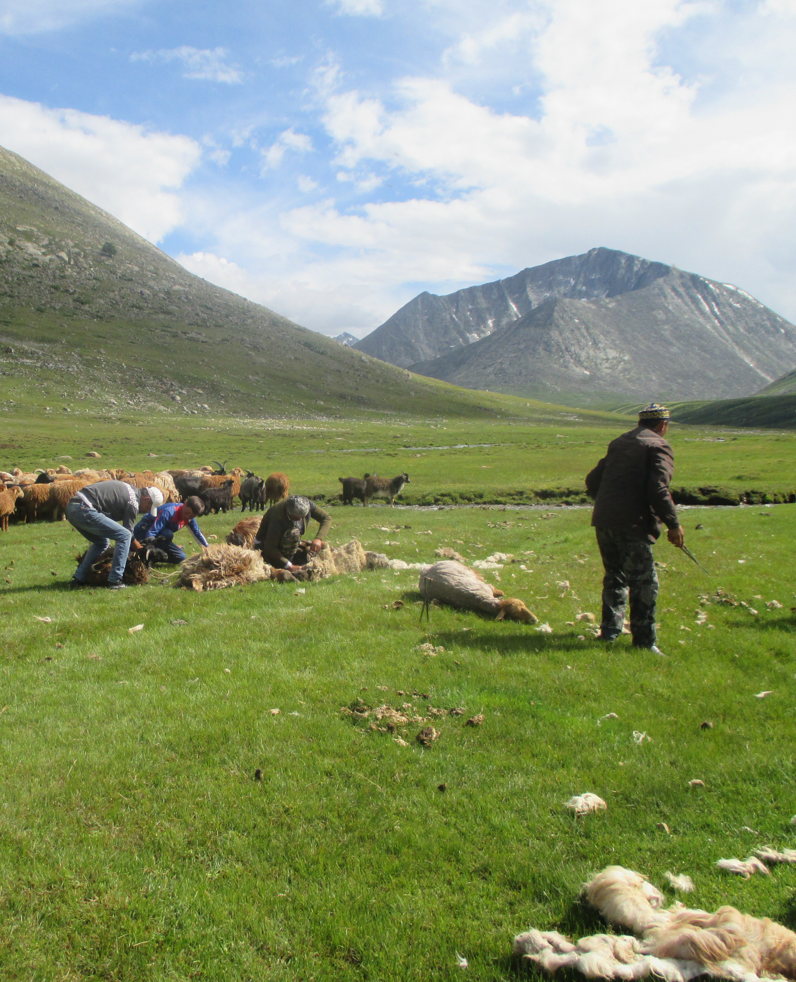
Mongolia
Title: Tes River Mongolians
Film maker: Namuulan Gankhuyag & Tseelei Enkh-Amgalan
Year made: 2019
Length: 9 min
YouTube link
Mongolia
© Hijaba Ikhanbai

Slide 10
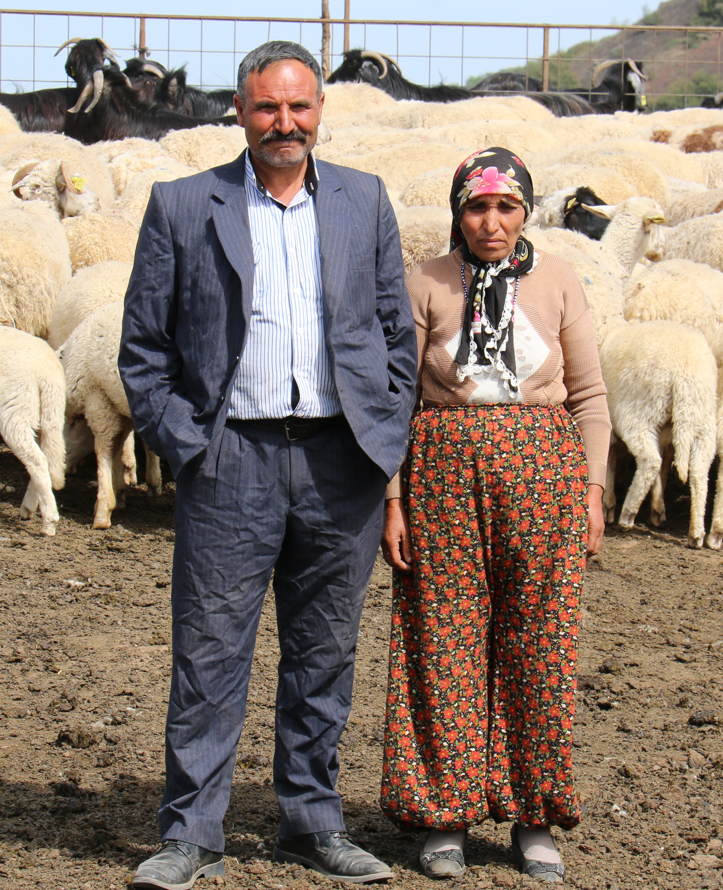
Türkiye
Title: The Last of Their Kind: Turkey’s Nomads
Film maker: Nevin Sungur & Gunnar Köhne
Year made: 2022
Length: 13 min
Vimeo link
Türkiye
© Engin Yilmaz

Slide 11
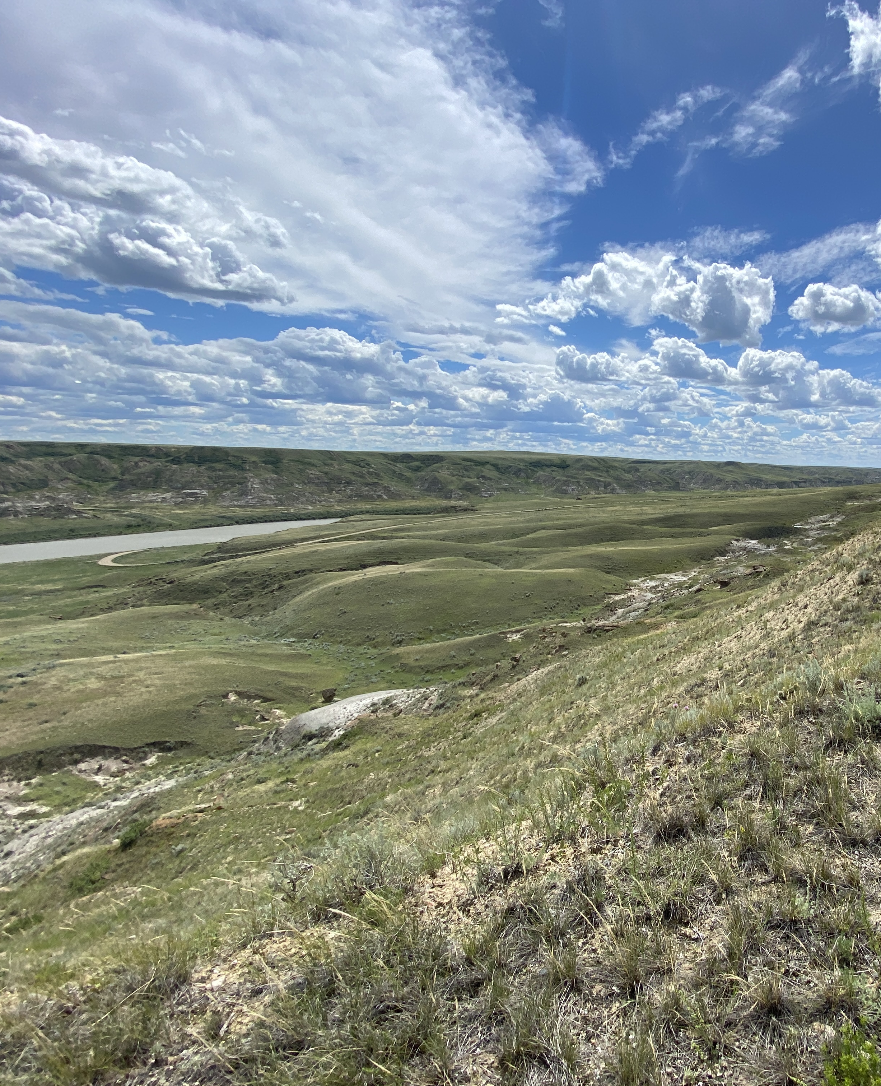
North America
Title: The Central Grasslands: the Backbone of North America
Film maker: Cornel Lab of Ornithology
Year made: 2025
Length: 6 min
Vimeo link
USA
© Darin Sherritt

Slide 12
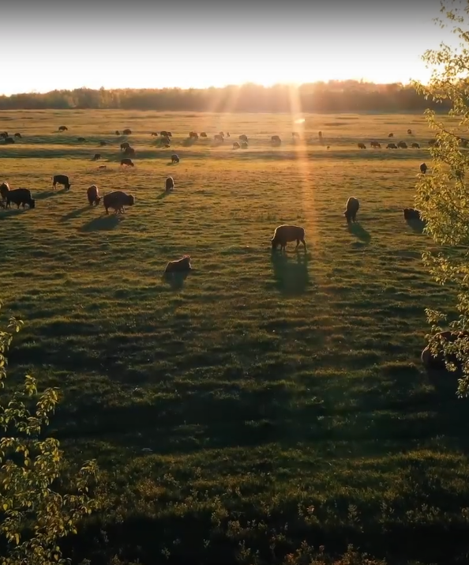
Canada
Title: Singing Back the Buffalo
Film maker: Tasha Hubbard
Year made: 2024
Length: 2 min
YouTube link
Canada
© Tasha Hubbard

Slide 13
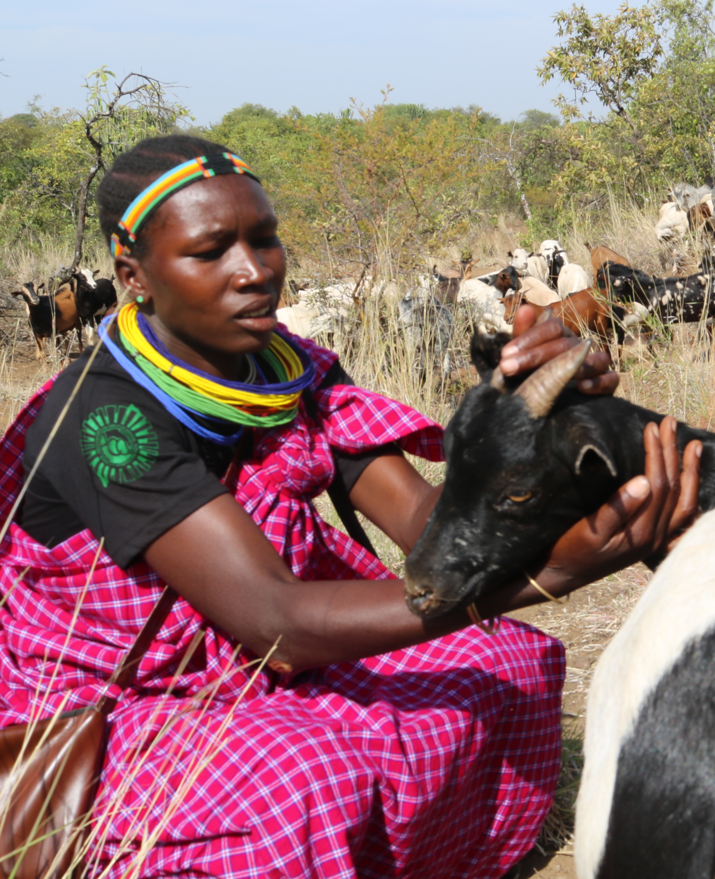
Uganda
Title: The Turkana
Film maker: Loren Cardeli
Year made: 2019
Length: 3 min
Vimeo link
Uganda
© Hannah Longole

Slide 14
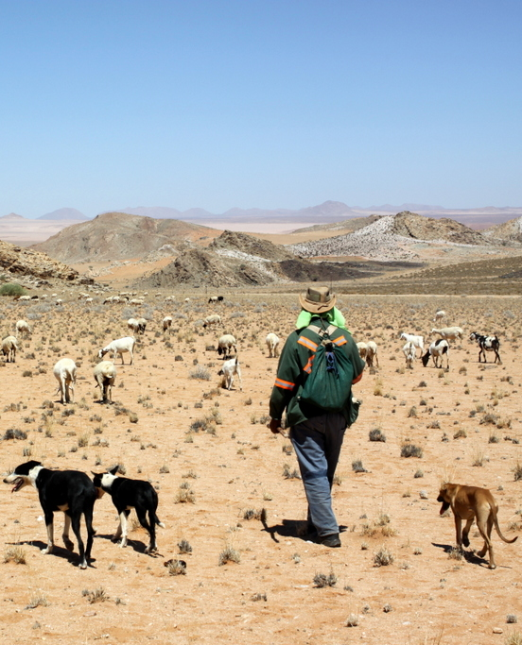
South Africa
Title: Living on Faith in a Changing Climate
Film maker: Clement Cupido
Year made: 2021
Length: 13 min
YouTube link
South Africa
© Clement Cupido

Slide 15
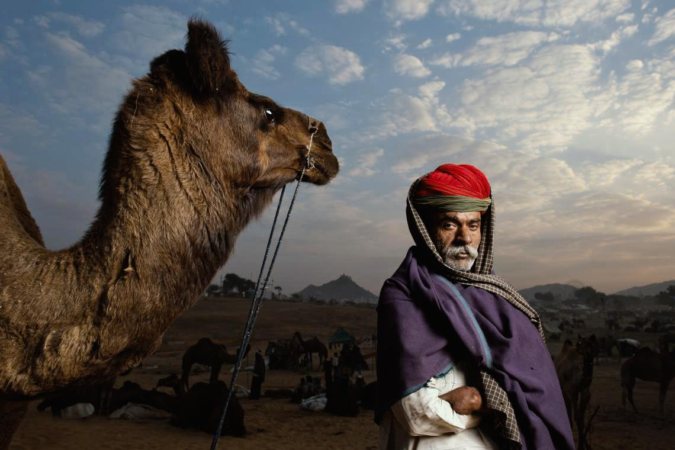
India
Title: The Dangar Strife – An Age-Old Ecosystem under Duress
Film maker: Siddharth Kulkarni
Year made: 2023
Length: 5 min
YouTube link
India
© Kaylan Varma

Slide 16
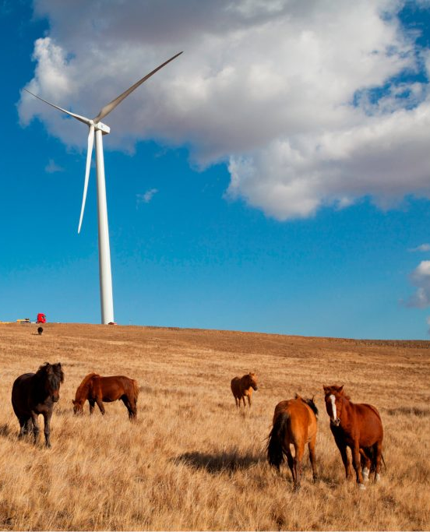
Global
Title: Pastoralism is the Future
Film maker: Misereor (Saverio Krätli), CELEP (Ann Waters-Bayer), VSFB (Koen van Troos) & Cartoonbase
Year made: 2022
Length: 3 min
YouTube link
Mongolia
© Leopold Olbi

Slide 17
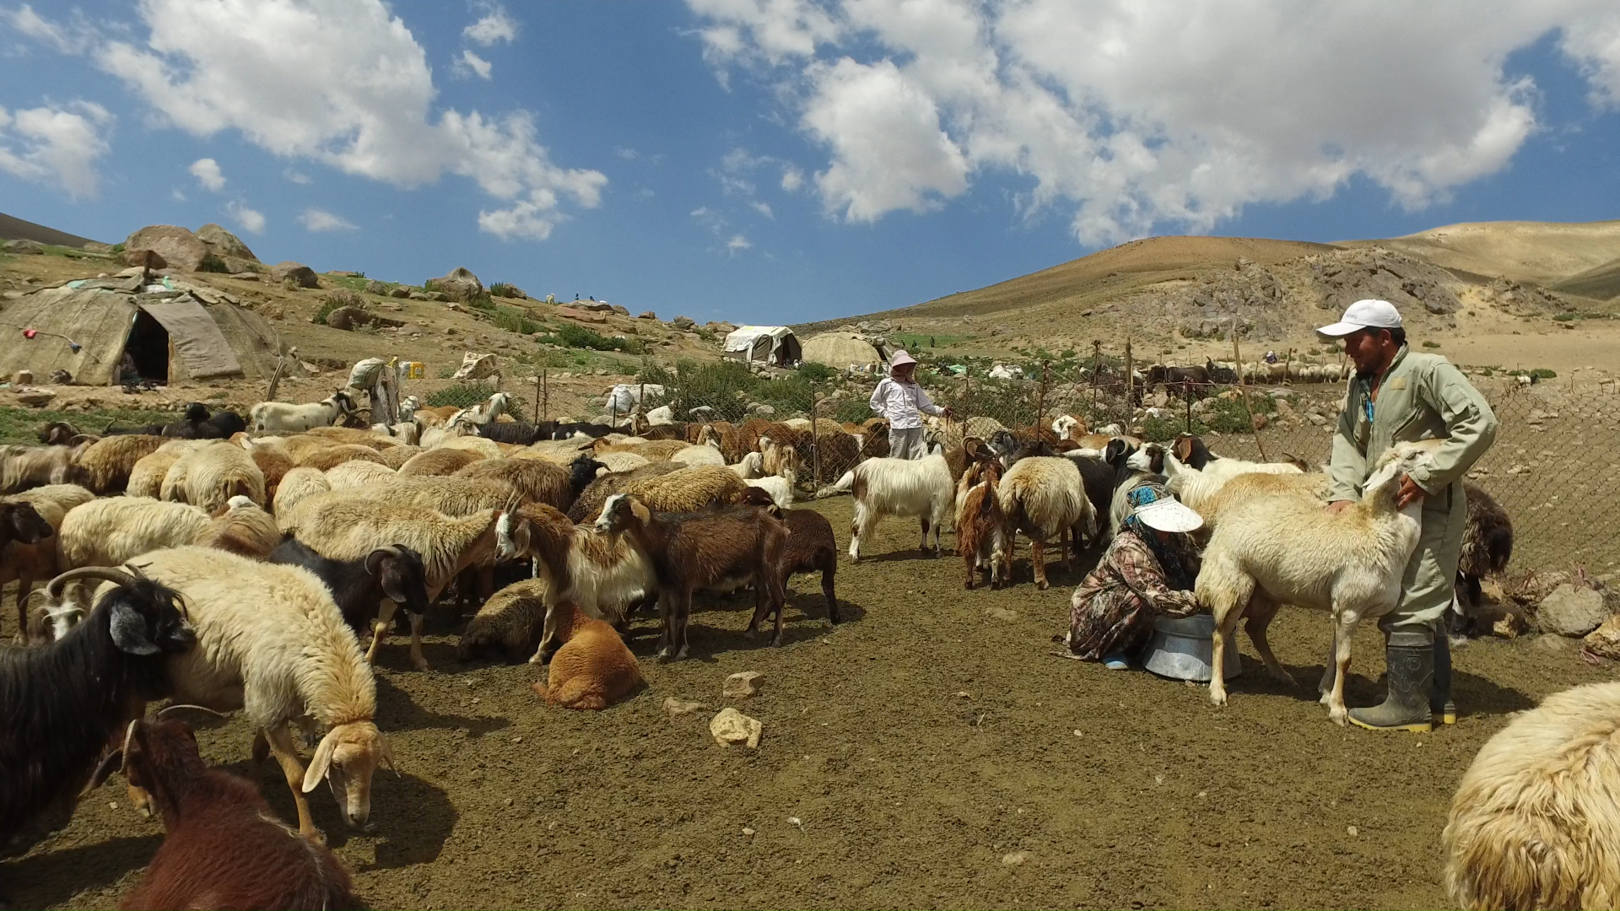
Rangelands and Pastoralists:
What are the challenges and opportunities?
Iran
©CENESTA
Notes:
This is a slide you can use or tailor for whoever is speaking (you could give a bit of information and a photo of their operation or the landscape, if you have time). I usually give them 10 min to talk about their life and livelihood if they do not have a film and then recommend asking the questions below.
Suggested questions for the pastoralist that would be good to share with them beforehand:
What are key challenges you face as a pastoralist or land manager?
What is something beautiful about rangelands that other people may not think about?
What are some reflections you have thinking about the films and similarities or differences to other pastoralists in the world?

Slide 18
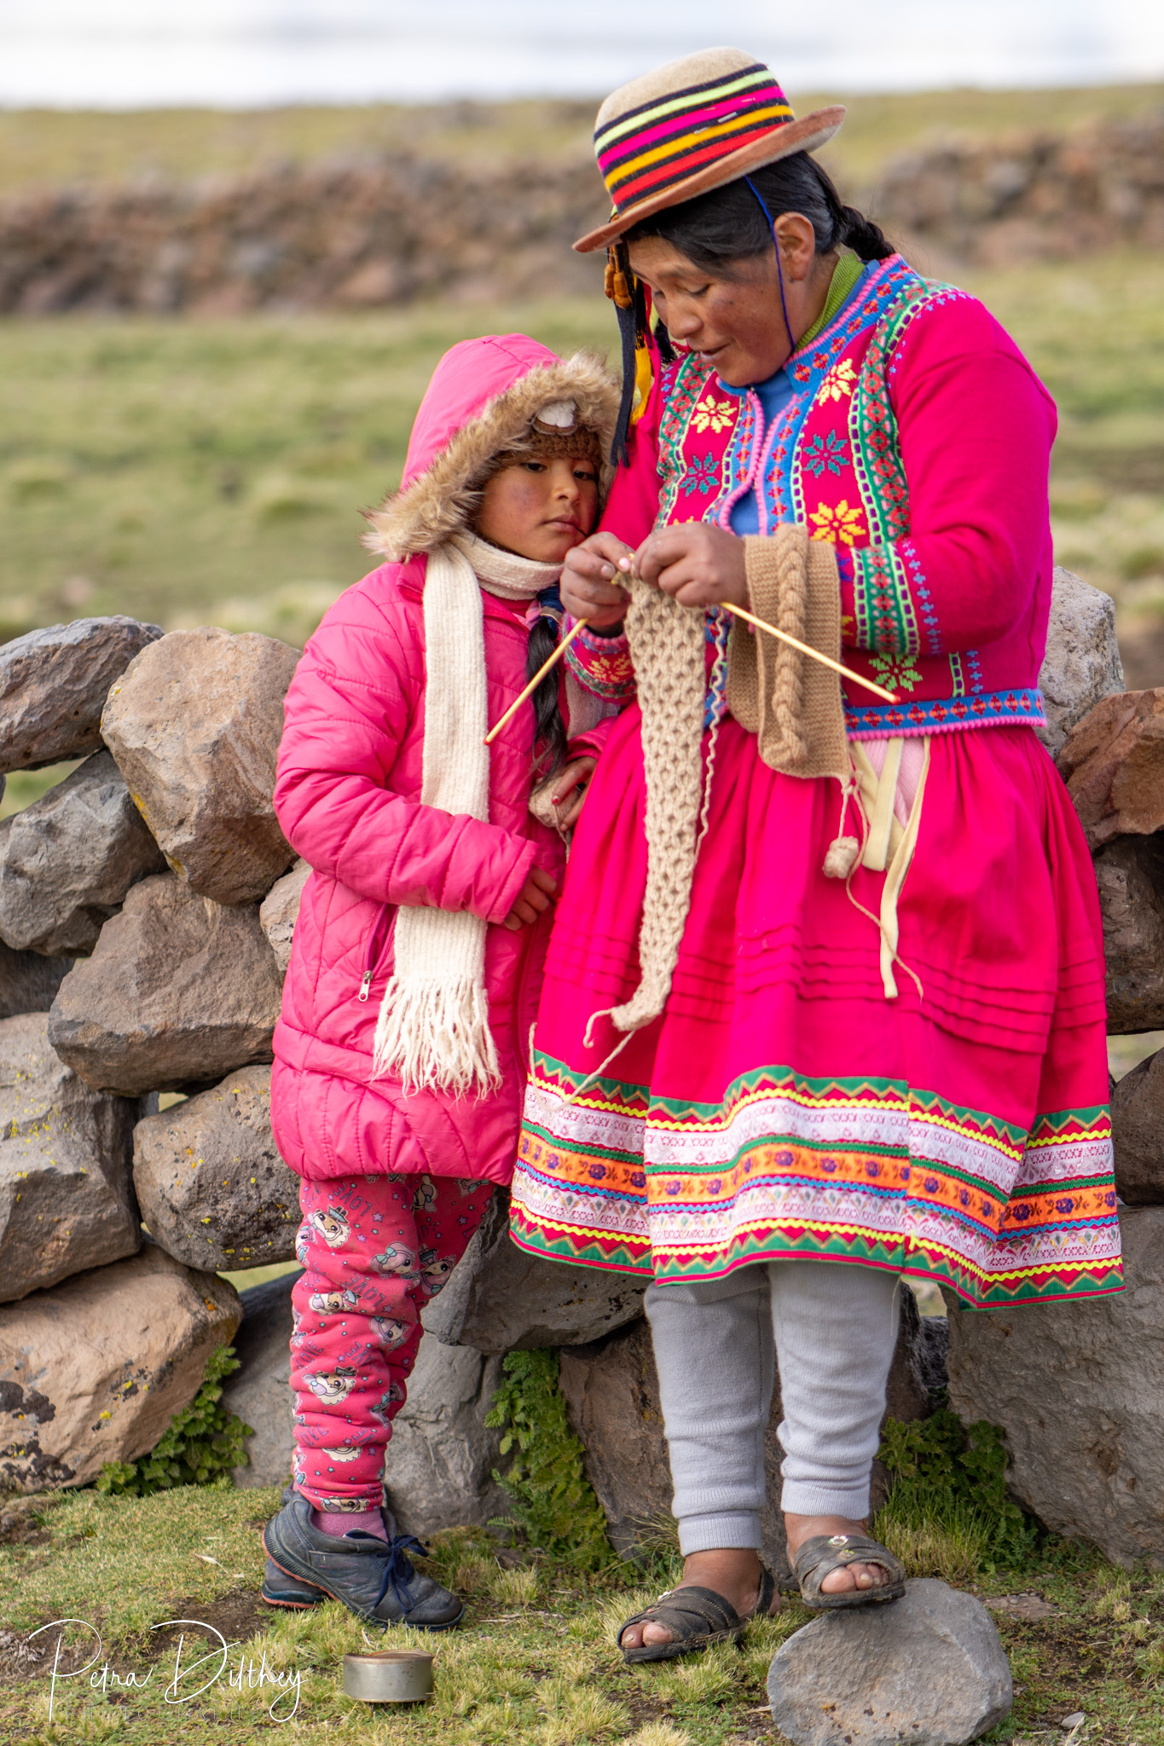
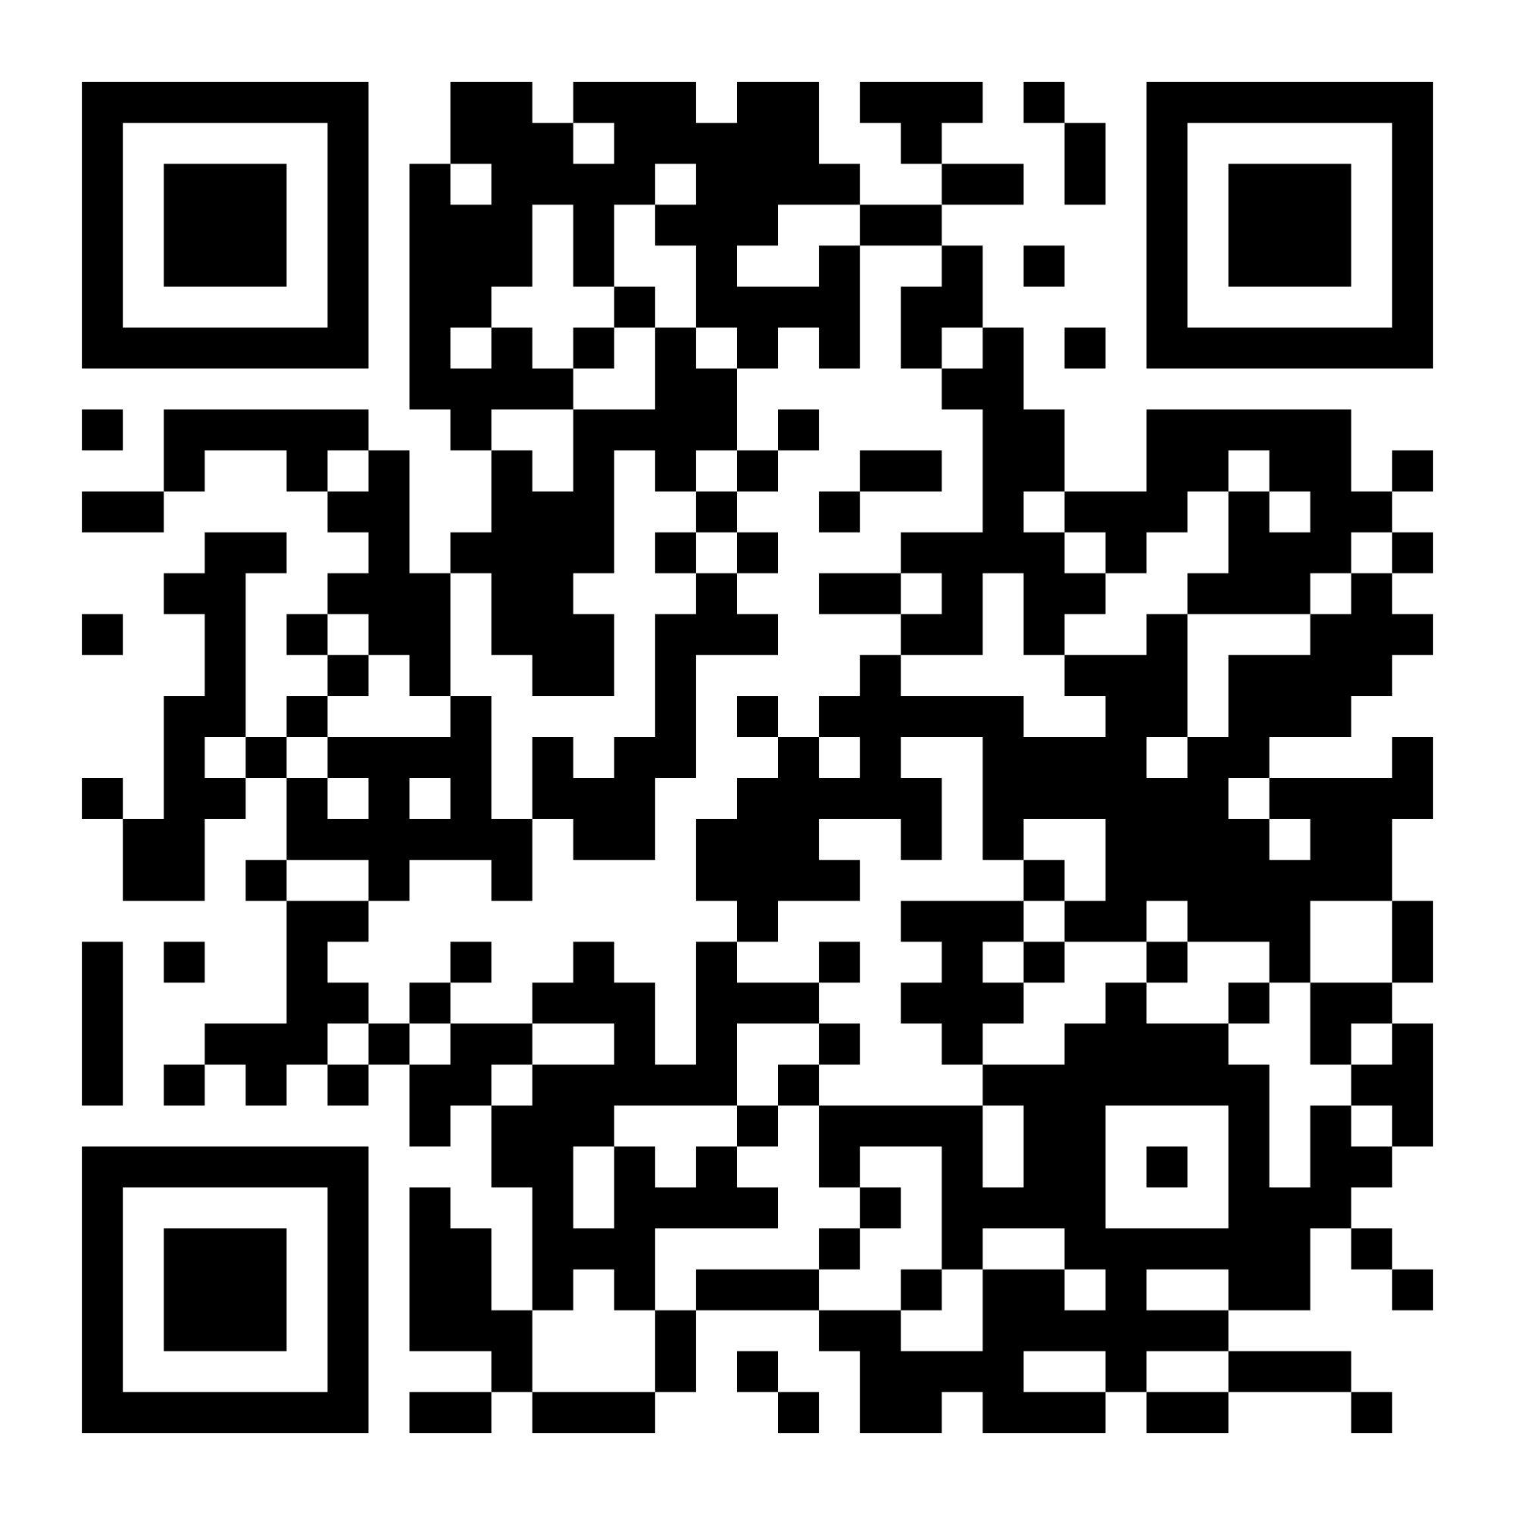
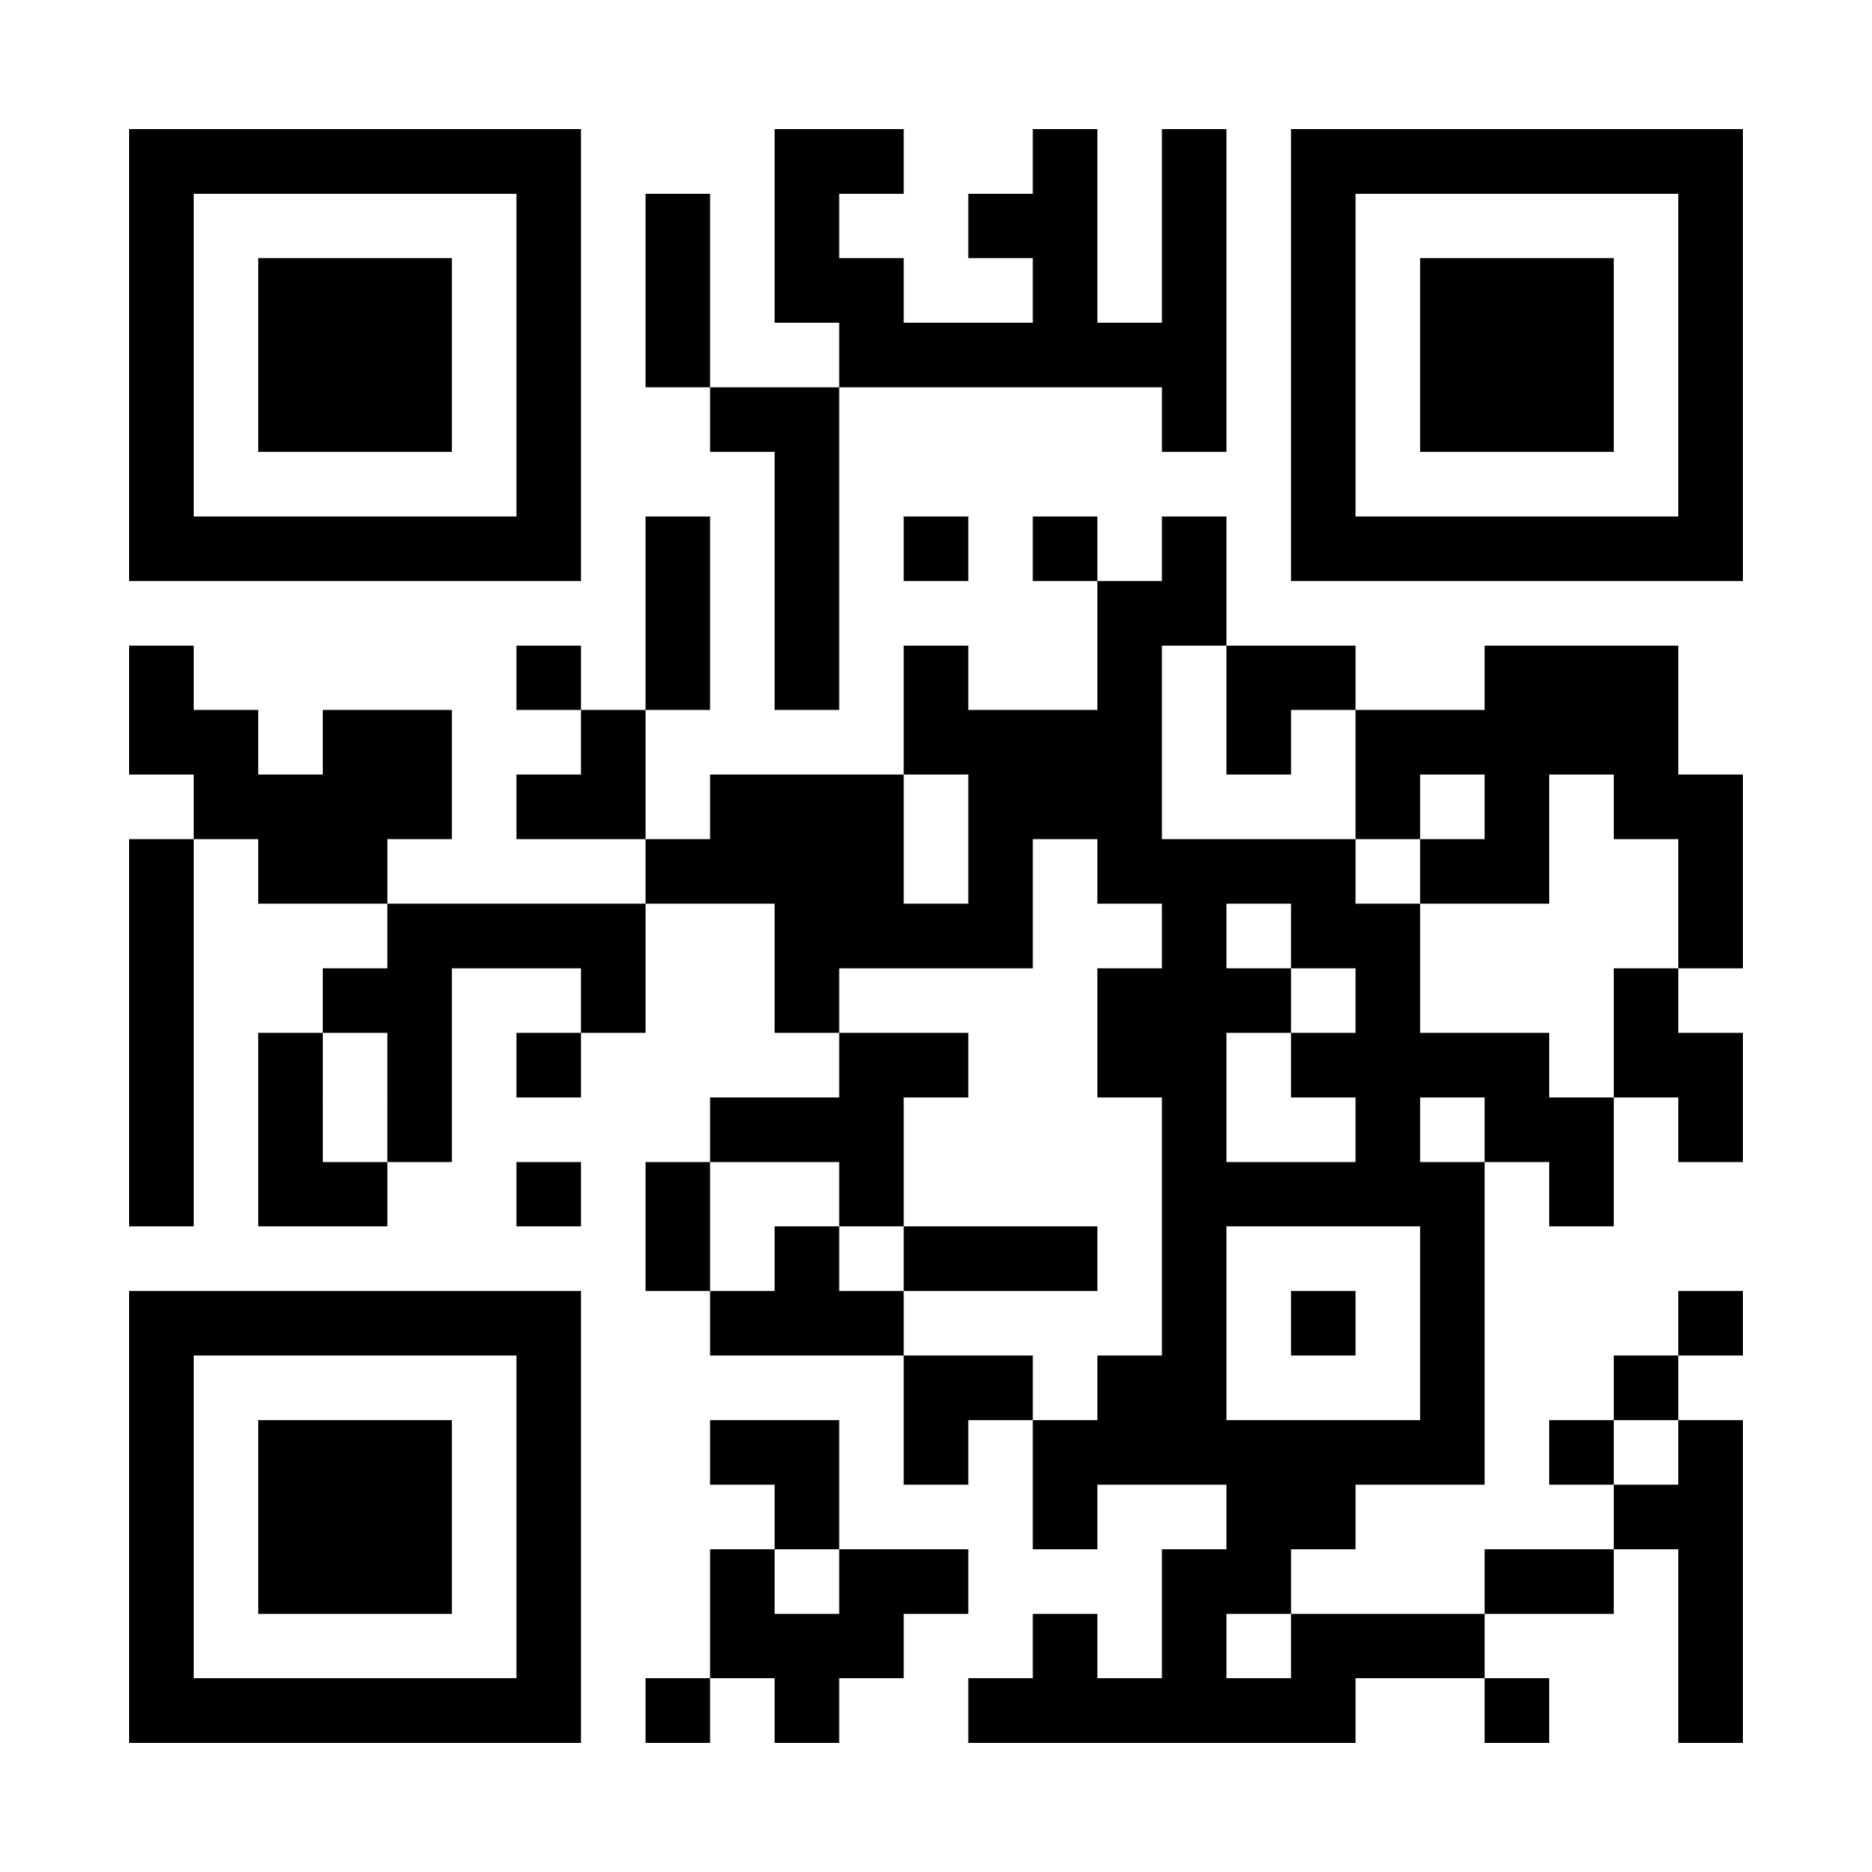
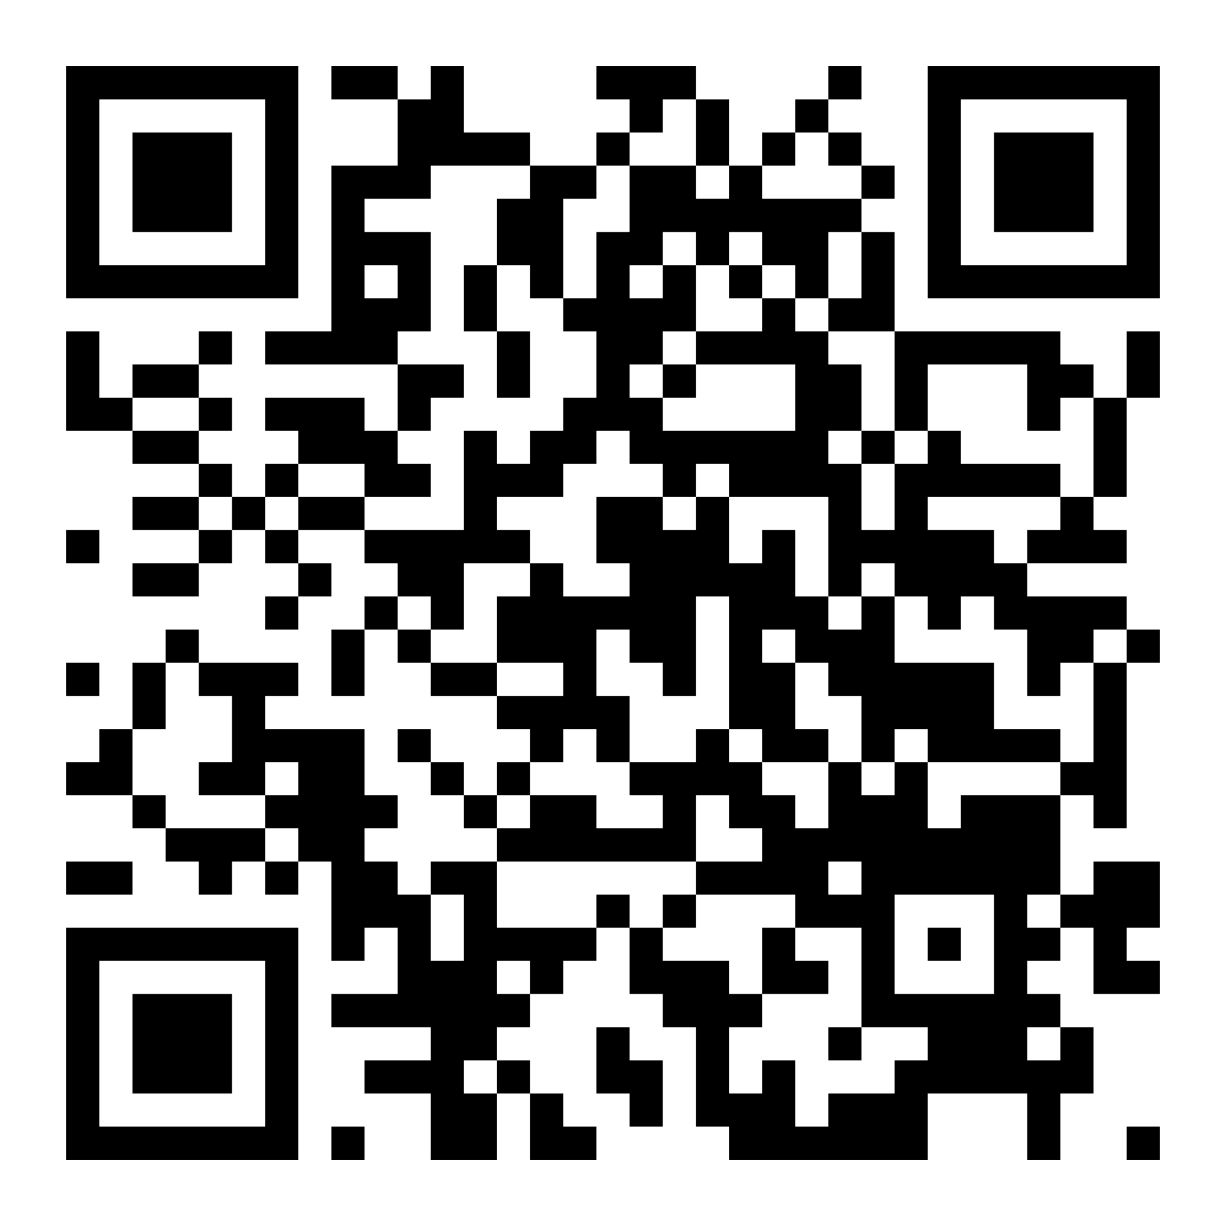
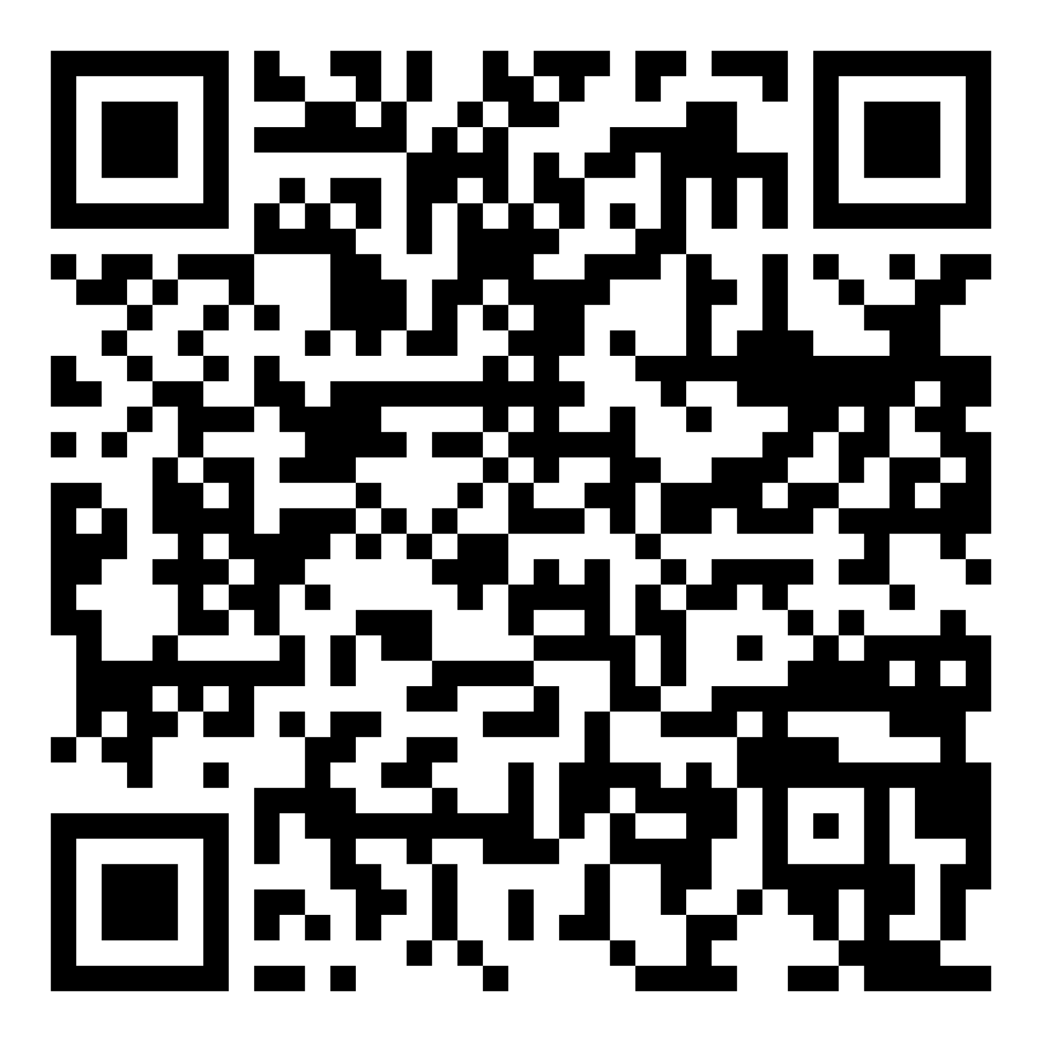
Learn More!
Perspectives on Pastoralism Film Festival
IYRP Regional web pages
Global Alliance for Rangelands & Pastoralists YouTube channel
Global Pastoralism Video Map
Peru
© Petra Dilthey
Notes:
If you are inspired and want to learn more, we encourage you to check out these resources where you can further explore the world of rangelands and see through the eyes of pastoralists.
Depending on your screen and location, you might want to delete the QR codes as they may be too small/too close to work properly. This page could alternatively be printed out and provided as people walk in and out of the viewing room.
Perspectives on Pastoralism Film Festival: https://www.pastoralistfilmfestival.com/
-collection of films on their website: https://www.pastoralistfilmfestival.com/films/
IYRP Regional Pages on website (scroll down to the second half of the iyrp.info website for each of the 11 regional pages with videos and photos featured at the bottom of the regional pages): https://iyrp.info/
IYRP YouTube Channel: https://www.youtube.com/@GA4RP_IYRP2026/featured
Global Pastoralism film map: https://umap.openstreetmap.fr/en/map/videos-on-pastoralism_1355465#2/25.003879/-15.356471

Slide 19
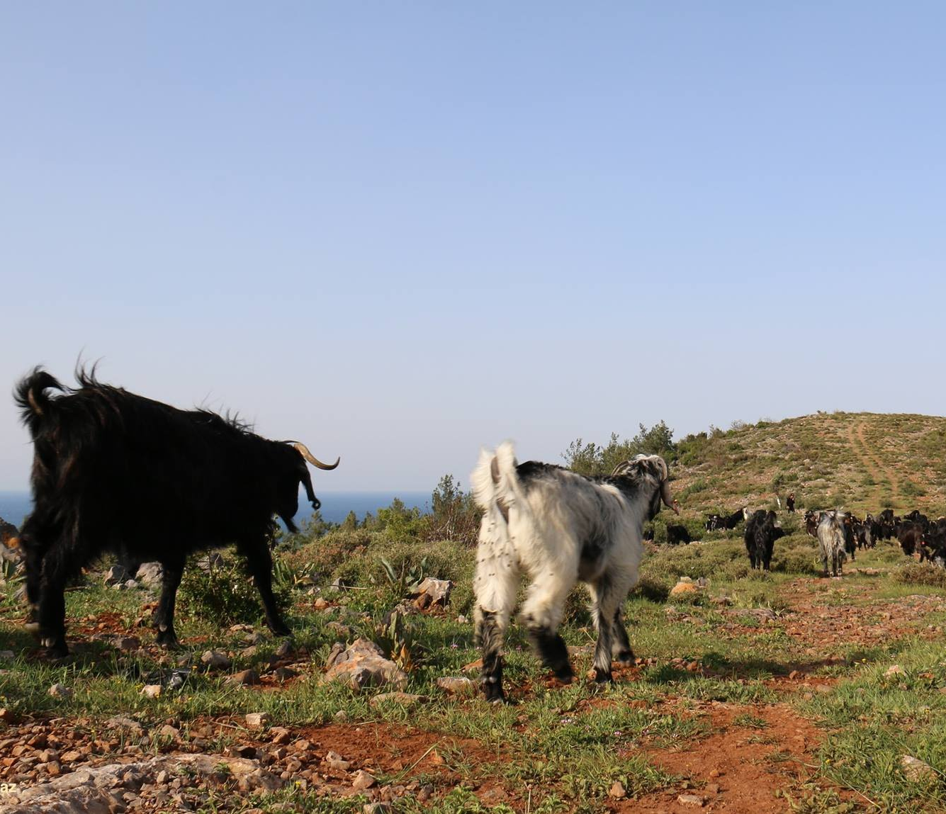


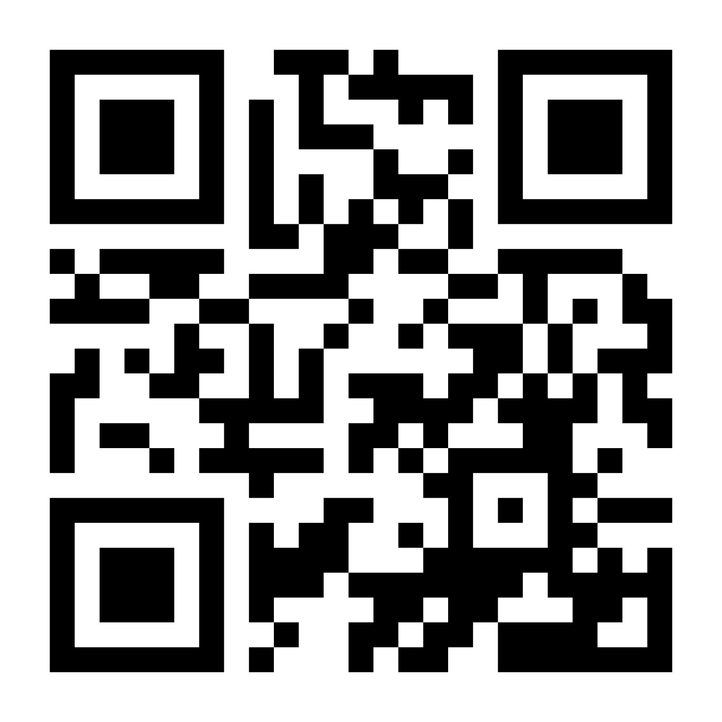
Thank you for attending!
Contact us:
iyrp@iyrp.info
More information:
https://iyrp.info
Türkiye
@ Engin Yilmaz
Notes:
Thank you for joining us to celebrate the International Year of Rangelands and Pastoralists! We encourage everyone to connect with us and learn more!

