Slide 1

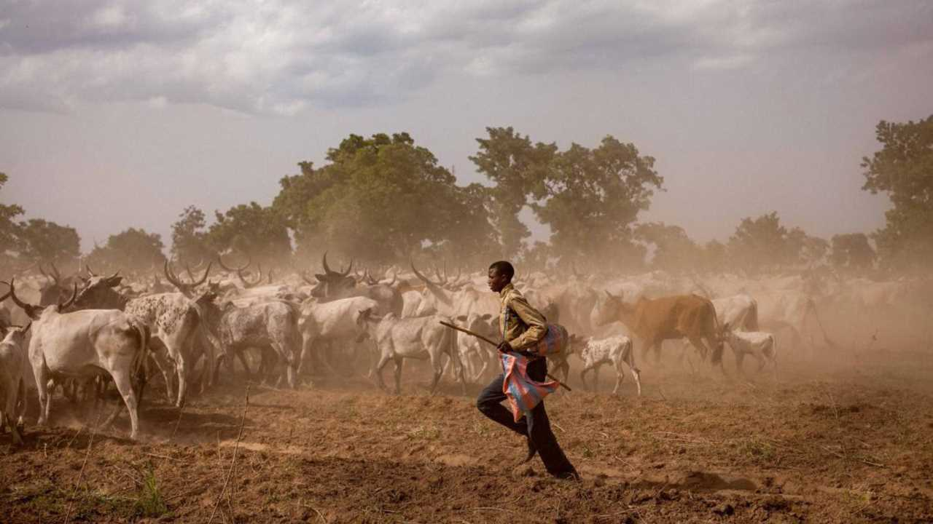


Films on Pastoralism and Biodiversity Conservation
UN International Year of
Rangelands and Pastoralists
2026
Togo
@Giles Coulon
https://iyrp.info
Notes:
The films in this compilation total 96 minutes and can be show as one set 1.5h for films and 30 min for discussion or shown as two sets of films (two ~50 min film events with time for discussion). Or some films can be removed to fit a shorter time length.
Welcome everyone and Happy International Year of Rangelands and Pastoralists! The Global Alliance for Rangelands & Pastoralists (GA4RP) invites everyone to celebrate the IYRP with us. The Global Alliance is the group that worked with the Government of Mongolia over the past decade to promote and support the designation of the UN 2026 International Year of Rangelands and Pastoralists (IYRP). The IYRP aims to raise awareness of the vital importance of rangelands and pastoralists as their frontline custodians. We recognize the indispensable benefits rangelands provide for supporting the livelihoods and socio-ecological resilience of hundreds of millions of people, conserving bio-cultural diversity, restoring degraded lands, fostering sustainable food systems, and advancing climate action.
A great way to celebrate this monumental year is through greater knowledge and connectivity with our pastoralists and rangeland peoples around the world. This is an opportunity to learn about people and places that do not often receive much attention. To hear their stories, and understand their way of life a little bit better. We think that film is an excellent way to do that.

Slide 2
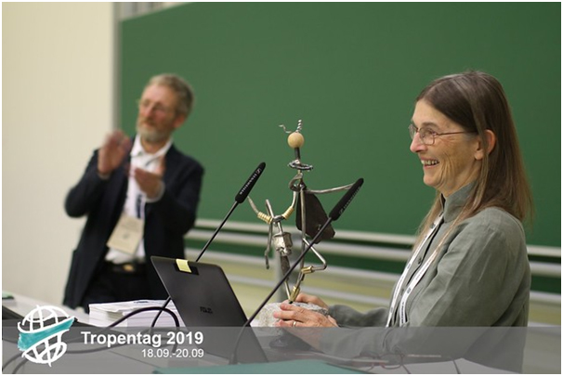
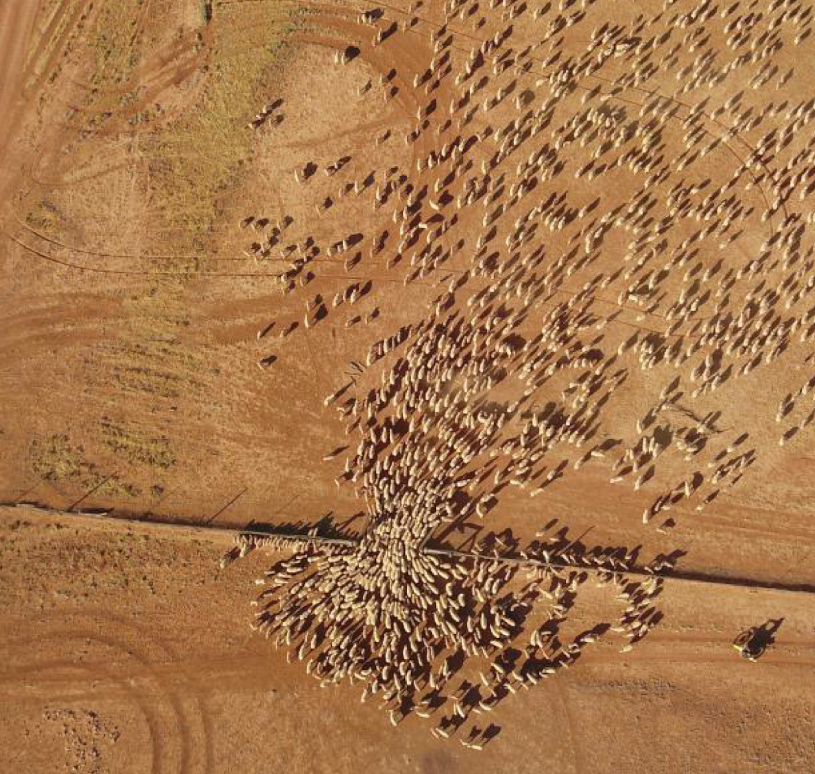
Perspectives on Pastoralism
We are grateful to Ann, who leads by example and is a dedicated, passionate advocate for rangelands and pastoralists.
Film Festival (PPFF)
Started by Dr. Ann Waters-Bayer and Margareta Lelea
3 editions (2019, 2022, 2025)
Using film to inform the general public about rangelands & pastoralists
Film viewings around the world
©Wendy Sheehan
Notes:
Film is an amazing way to convey story and emotion, and create a deeper understanding. Dr Ann Waters Bayer, a rangelands and pastoralists researcher, is a huge proponent of the use of film to share stories of these lands and people and was a co-founder of the Perspectives on Pastoralism Film Festival (PPFF) with Margareta Lelea. The Perspectives on Pastoralism Film Festival has had three editions. And, since the initiation of the PPFF, pastoralism and rangeland film events have taken place around the world. We are continuing that effort in the 2026 IYRP as people around the world celebrate together.

Slide 3
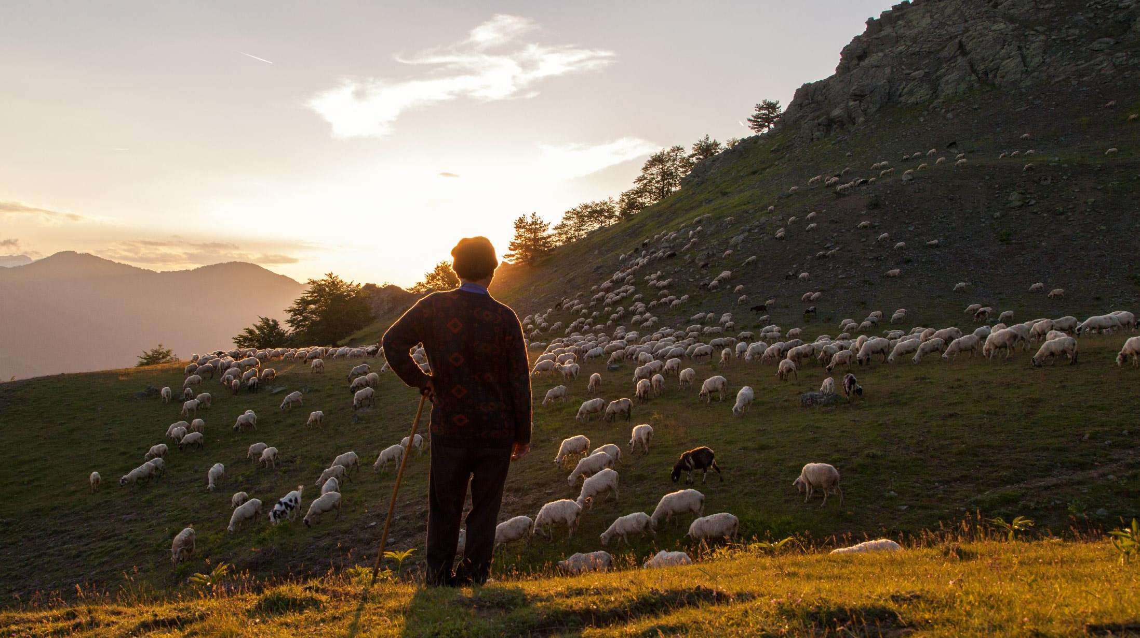

Benefits of ecosystem-appropriate grazing:
Produce food & fibre while maintaining biodiversity
© Stamos Abatis
Notes:
With that, we invite you to all join us on a world tour of rangelands and learn about pastoralism and biodiversity conservation conducted in tandem.

Slide 4
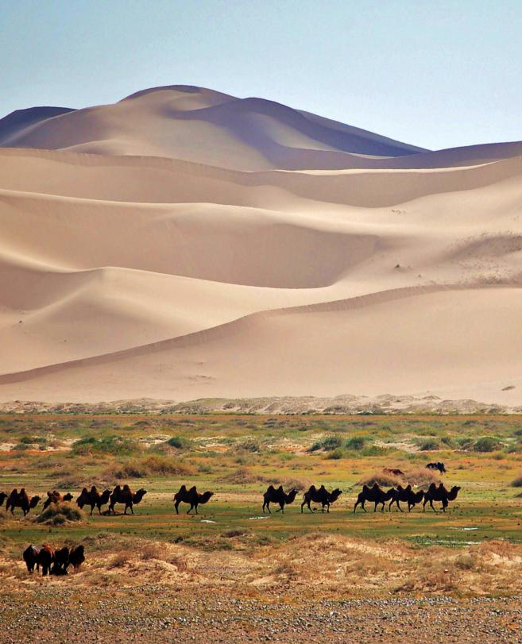
Mongolia
Title: A common right: Mongolia
Film maker: Land Rights Now
Year made: 2016
Length: 6 min
YouTube link
Mongolia
© Marc Foggin

Slide 5
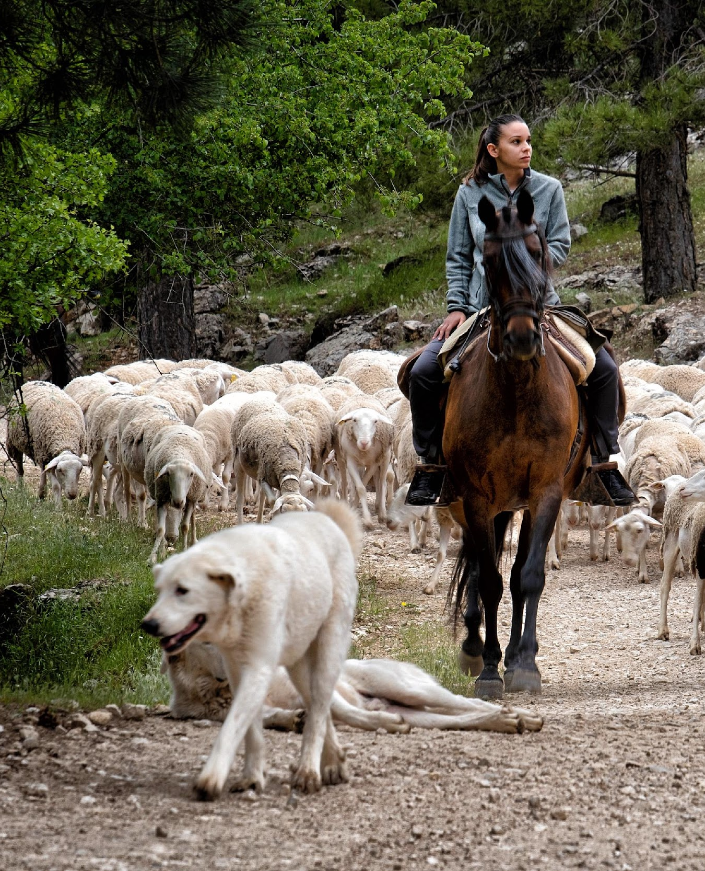
Spain
Title: The path to nature
Film maker: Ellen Windemuth
Year made: 2023
Length: 11 min
YouTube link
Spain
© Katy Gomez Catalina

Slide 6
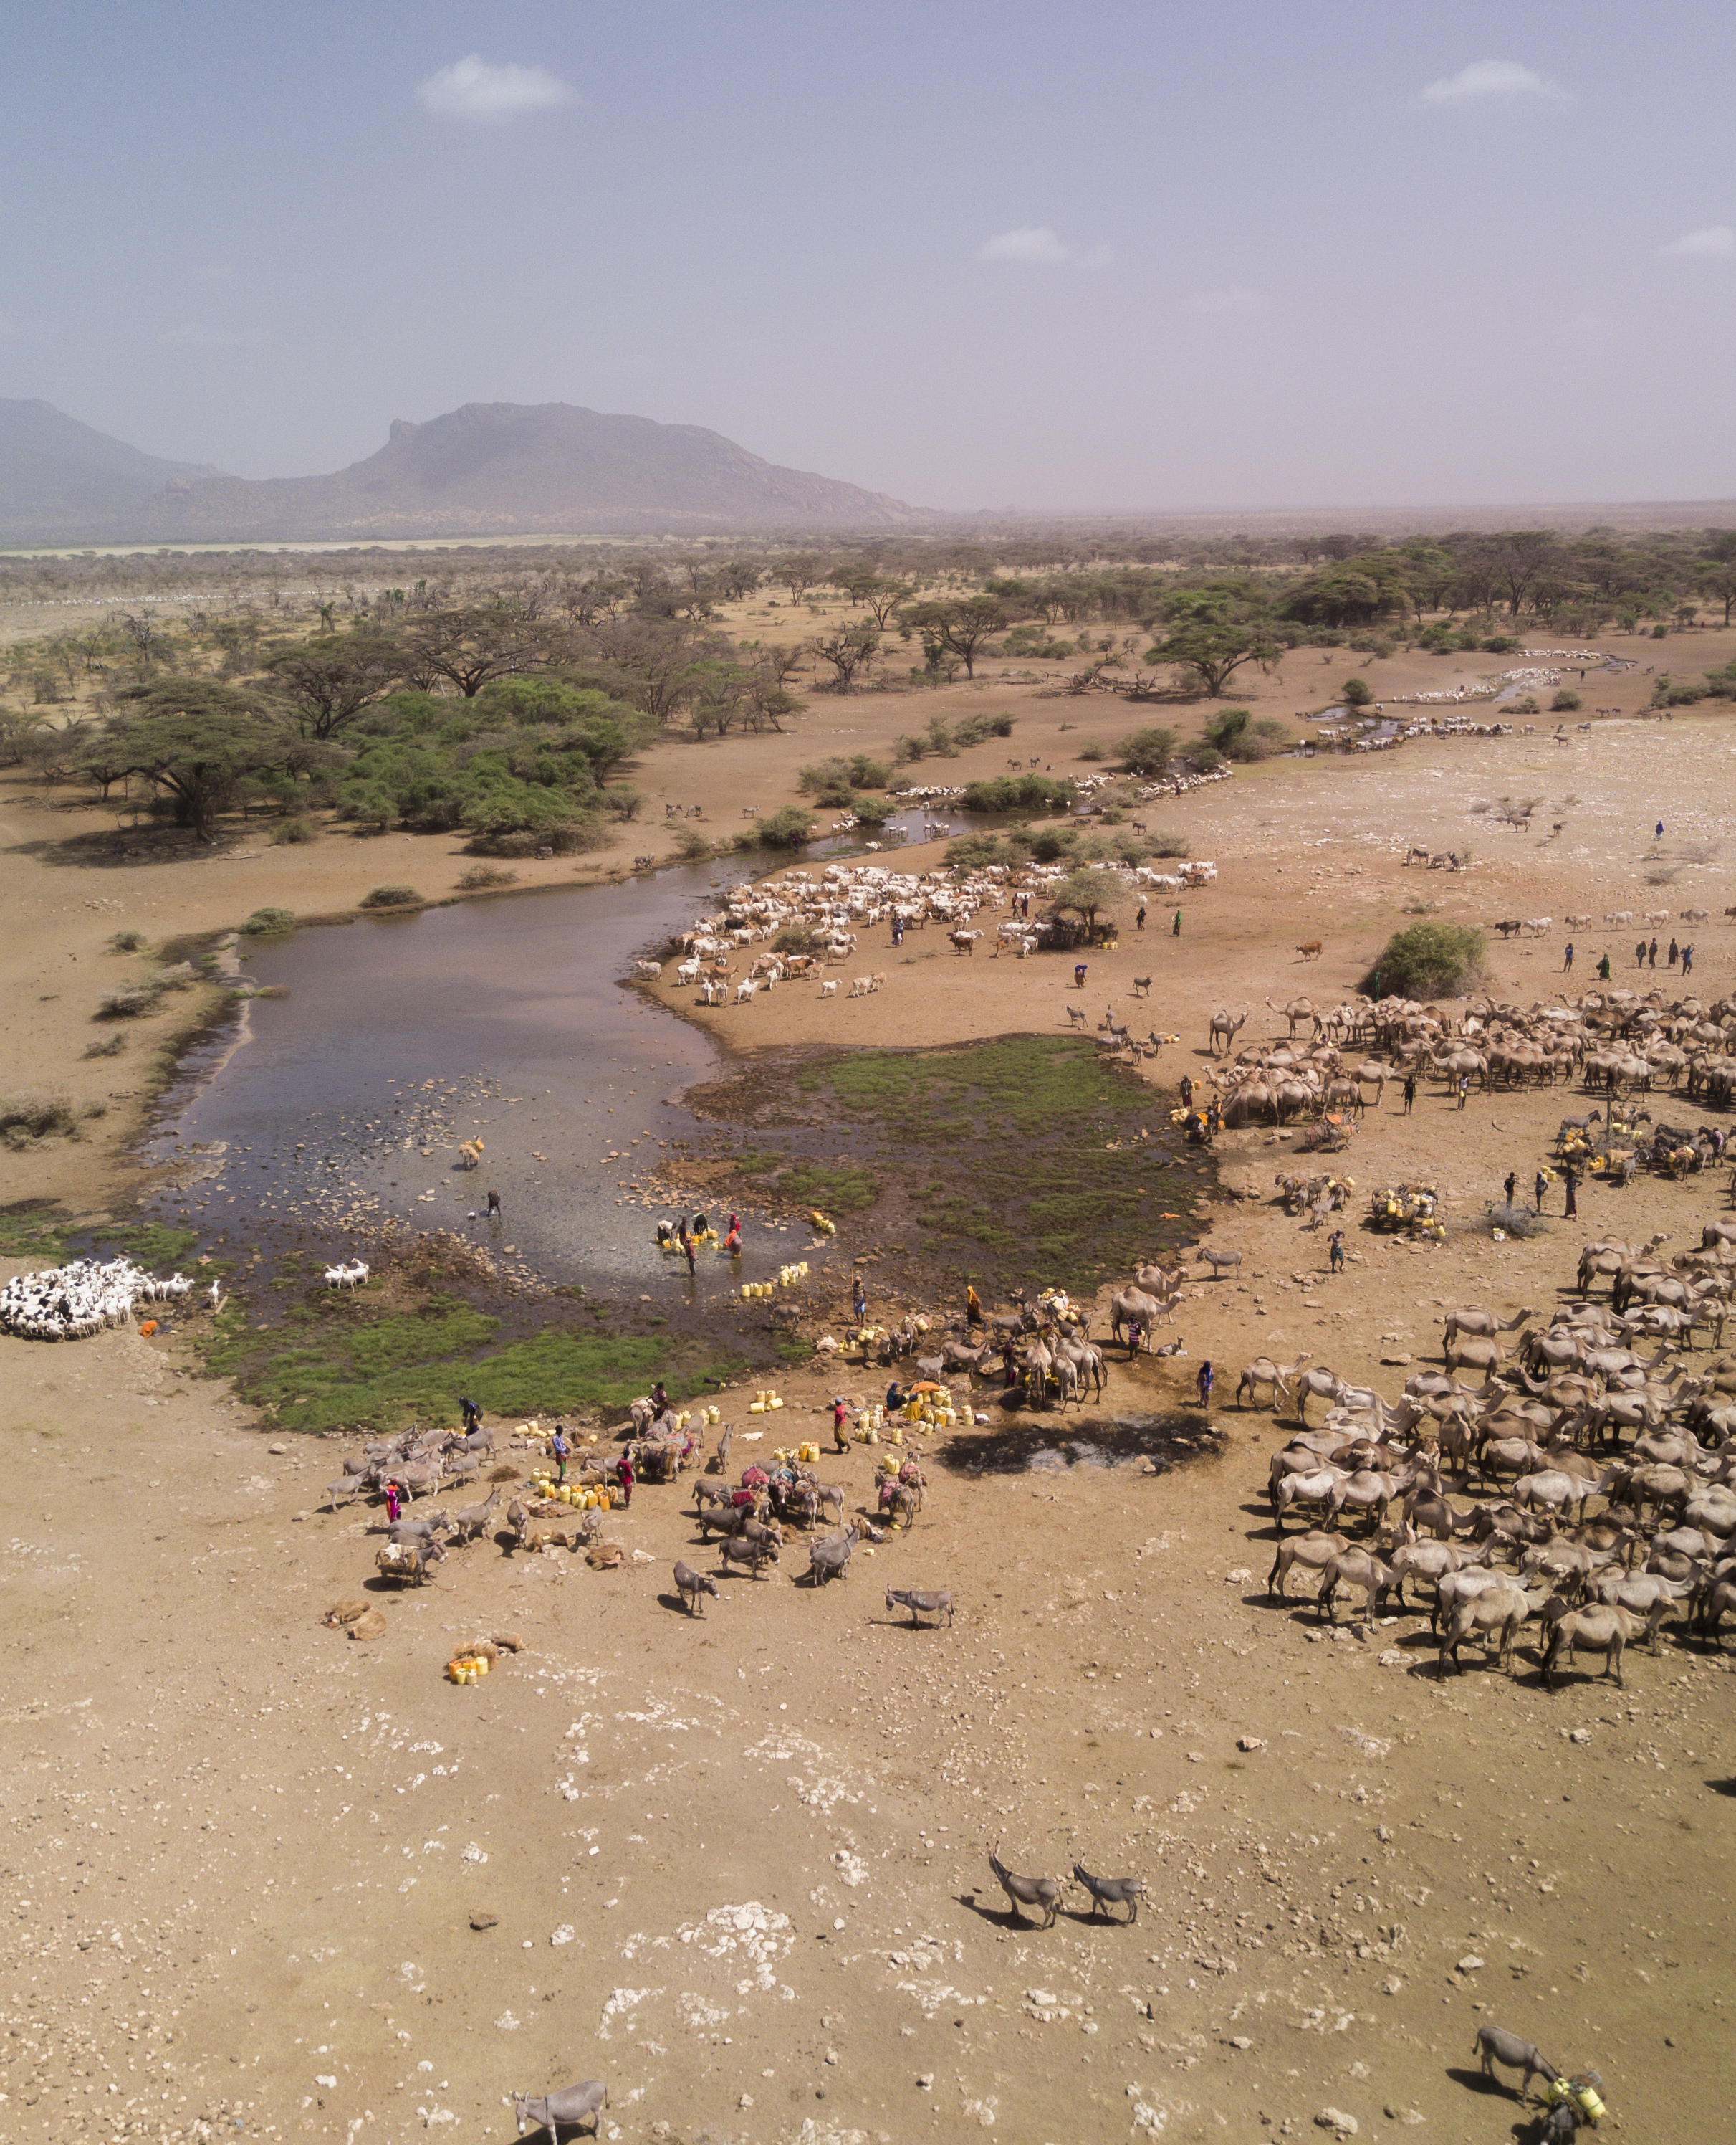
Kenya
Title: Developments on Pastoral Rangeland Contestation and Conflict
Film maker: Victor Avico
Year made: 2024
Length: 6 min
YouTube link
Kenya
© Hans Peter-Liniger

Slide 7
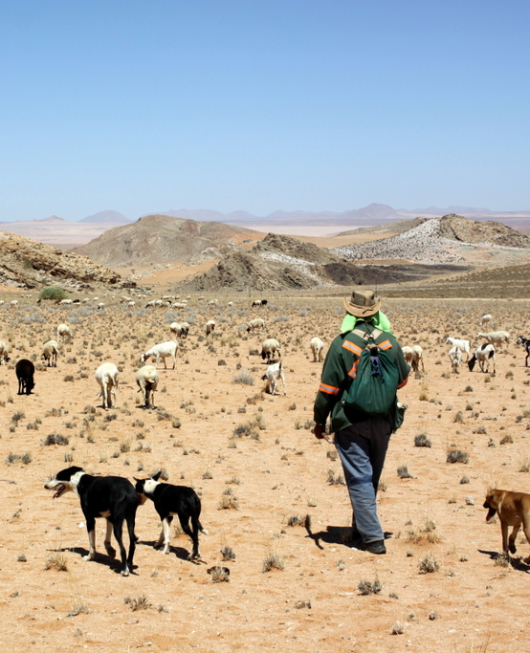
South Africa
Title: Richtersveld Cultural and Botanical Landscape
Film maker: UNESCO TV & Nippon Hoso Kyokai
Year made: 2013
Length: 3 min
YouTube link
South Africa
© Clement Cupido

Slide 8
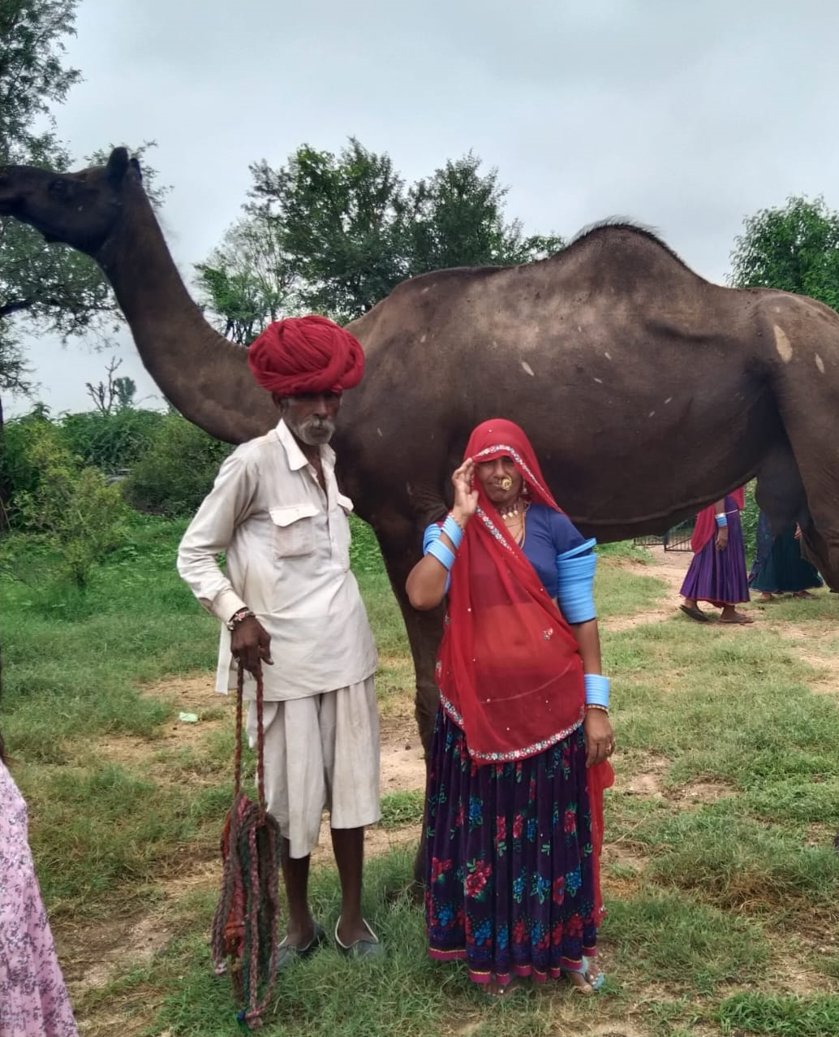
India
Title: The Kumbhalgarh Raika Story
Film maker: Lokhit Pashu & Palak Sansthan
Year made: 2017
Length: 9 min
YouTube link
India
© Ilse Köhler-Rollefson

Slide 9
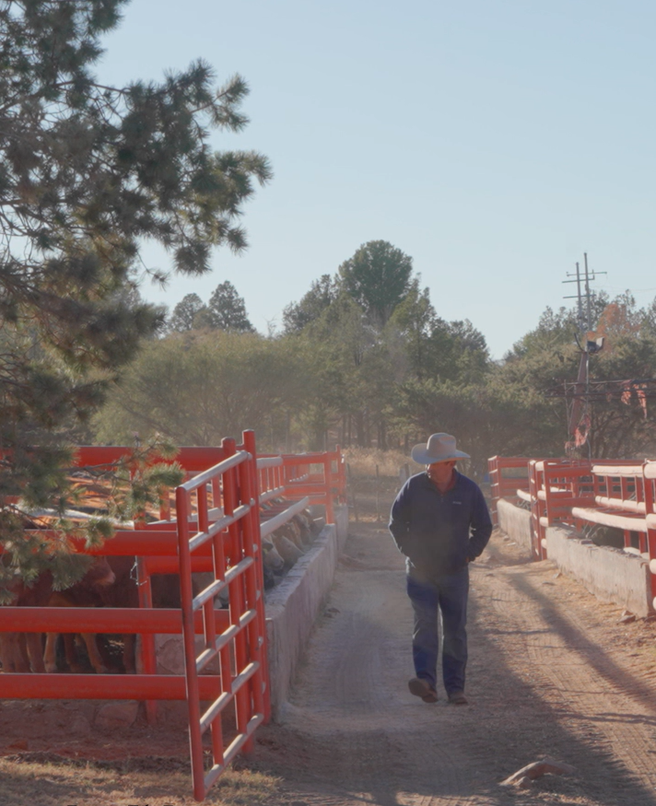
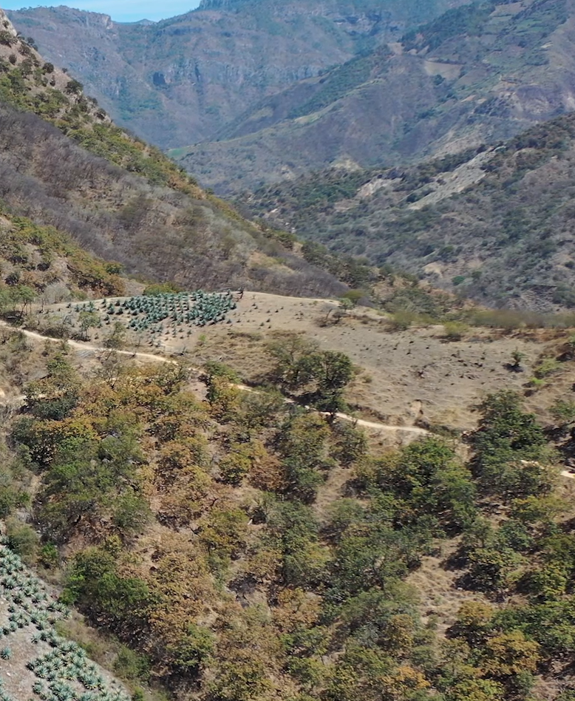
Mexico
Title: The path to nature
Film maker: Alberto Peschard Saenz
Year made: 2025
Length: 11 min
YouTube link
Mexico
©Alberto Peschard Saenz

Slide 10
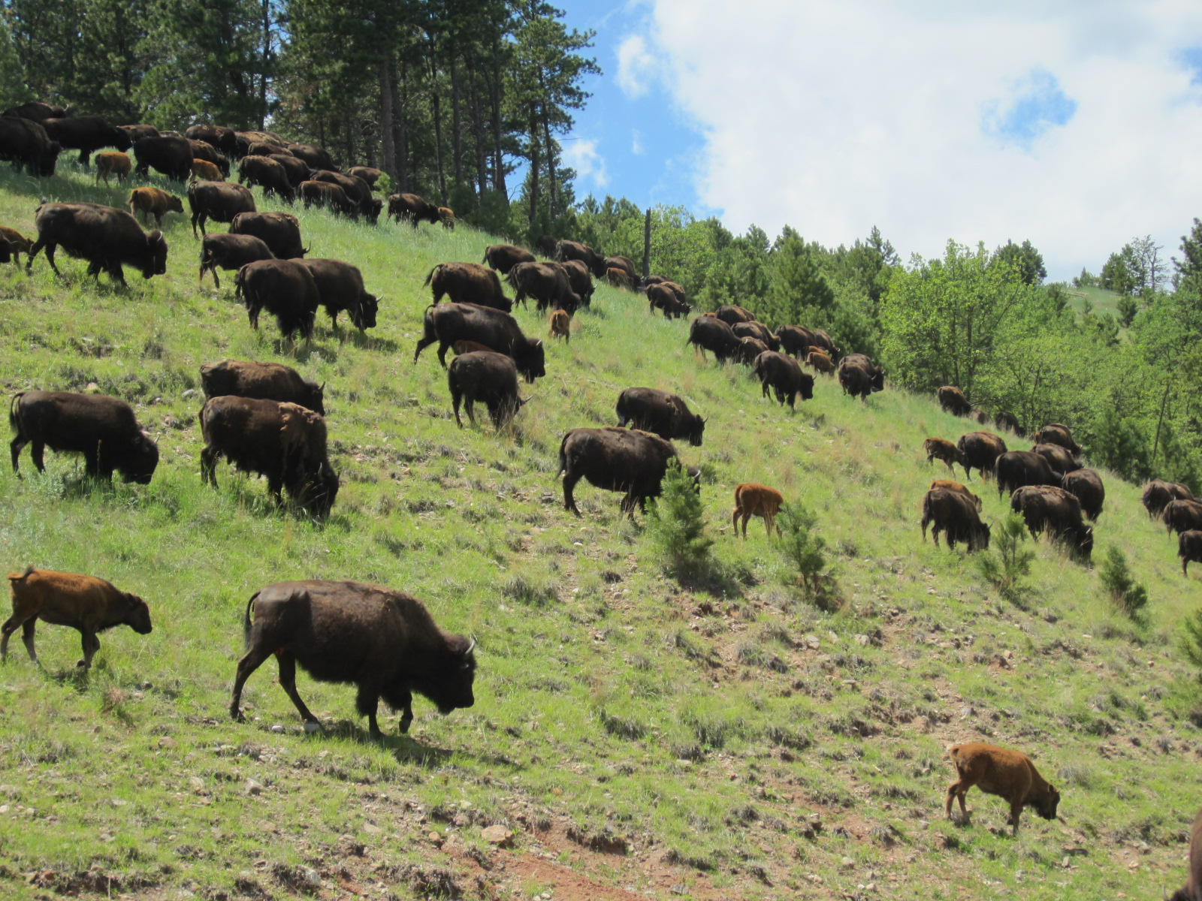
Canada
Title: The Bison Cultural Project in Mînî Rhpa Mâkoche or Banff National Park
Film maker: UBC Studios
Year made: 2023
Length: 15 min
YouTube link
USA
© Lauren Svejcar

Slide 11
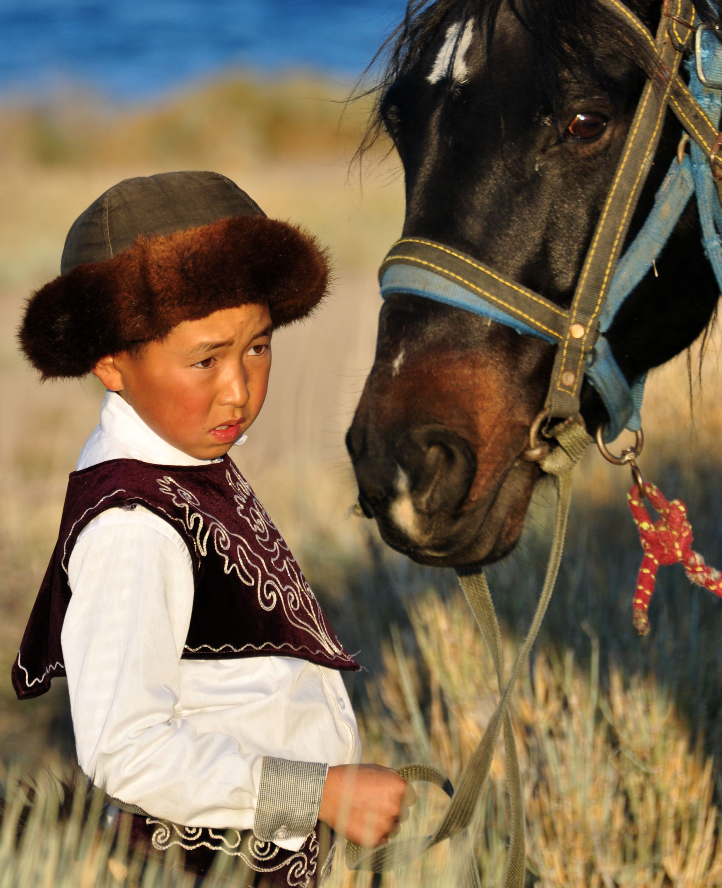
Kyrgyzstan
Title: Home on the Range in Kyrgyzstan
Film maker: International Land Coalition + Mirlan Abdulaev
Year made: 2022
Length: 4 min
YouTube link
Kyrgyzstan
© Marc Foggin

Slide 12
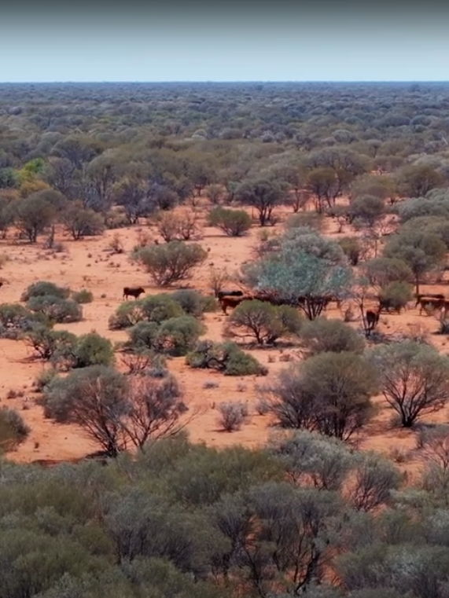
Australia
Title: Technology driving the modern pastoral production system - Challa Station
Film maker: Dragonfly Media & Southern Rangelands Pastoral Alliance
Year made: 2024
Length: 11 min
YouTube link
Australia
© Dragonfly Media

Slide 13
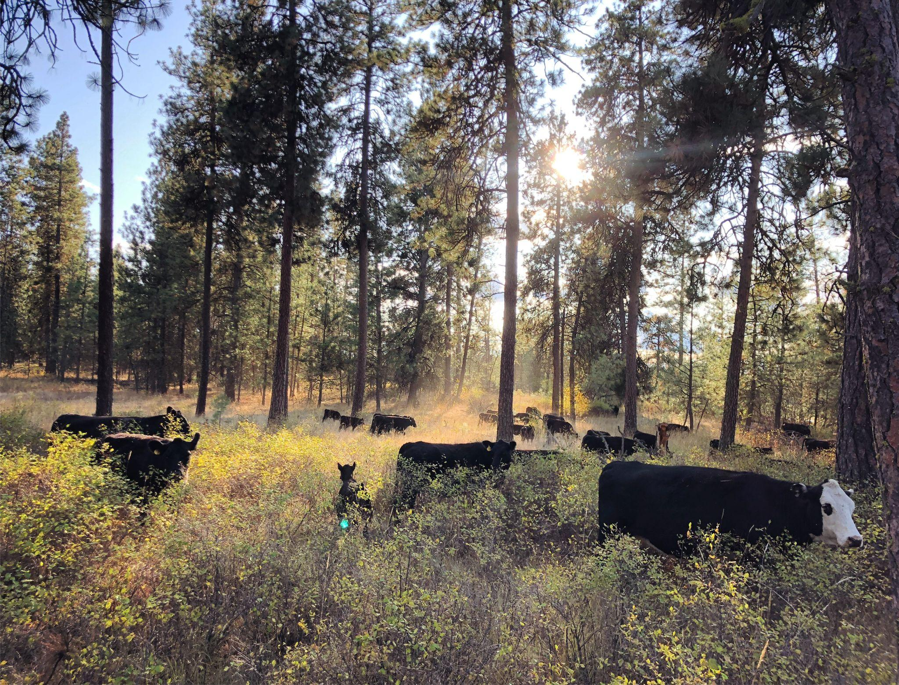
USA
Title: Changing a Landscape to a Lifescape: the Humboldt Ranch
Film maker: Abbey Kinion
Year made: 2022
Length: 12 min
YouTube link
USA
© Beth Robinette

Slide 14
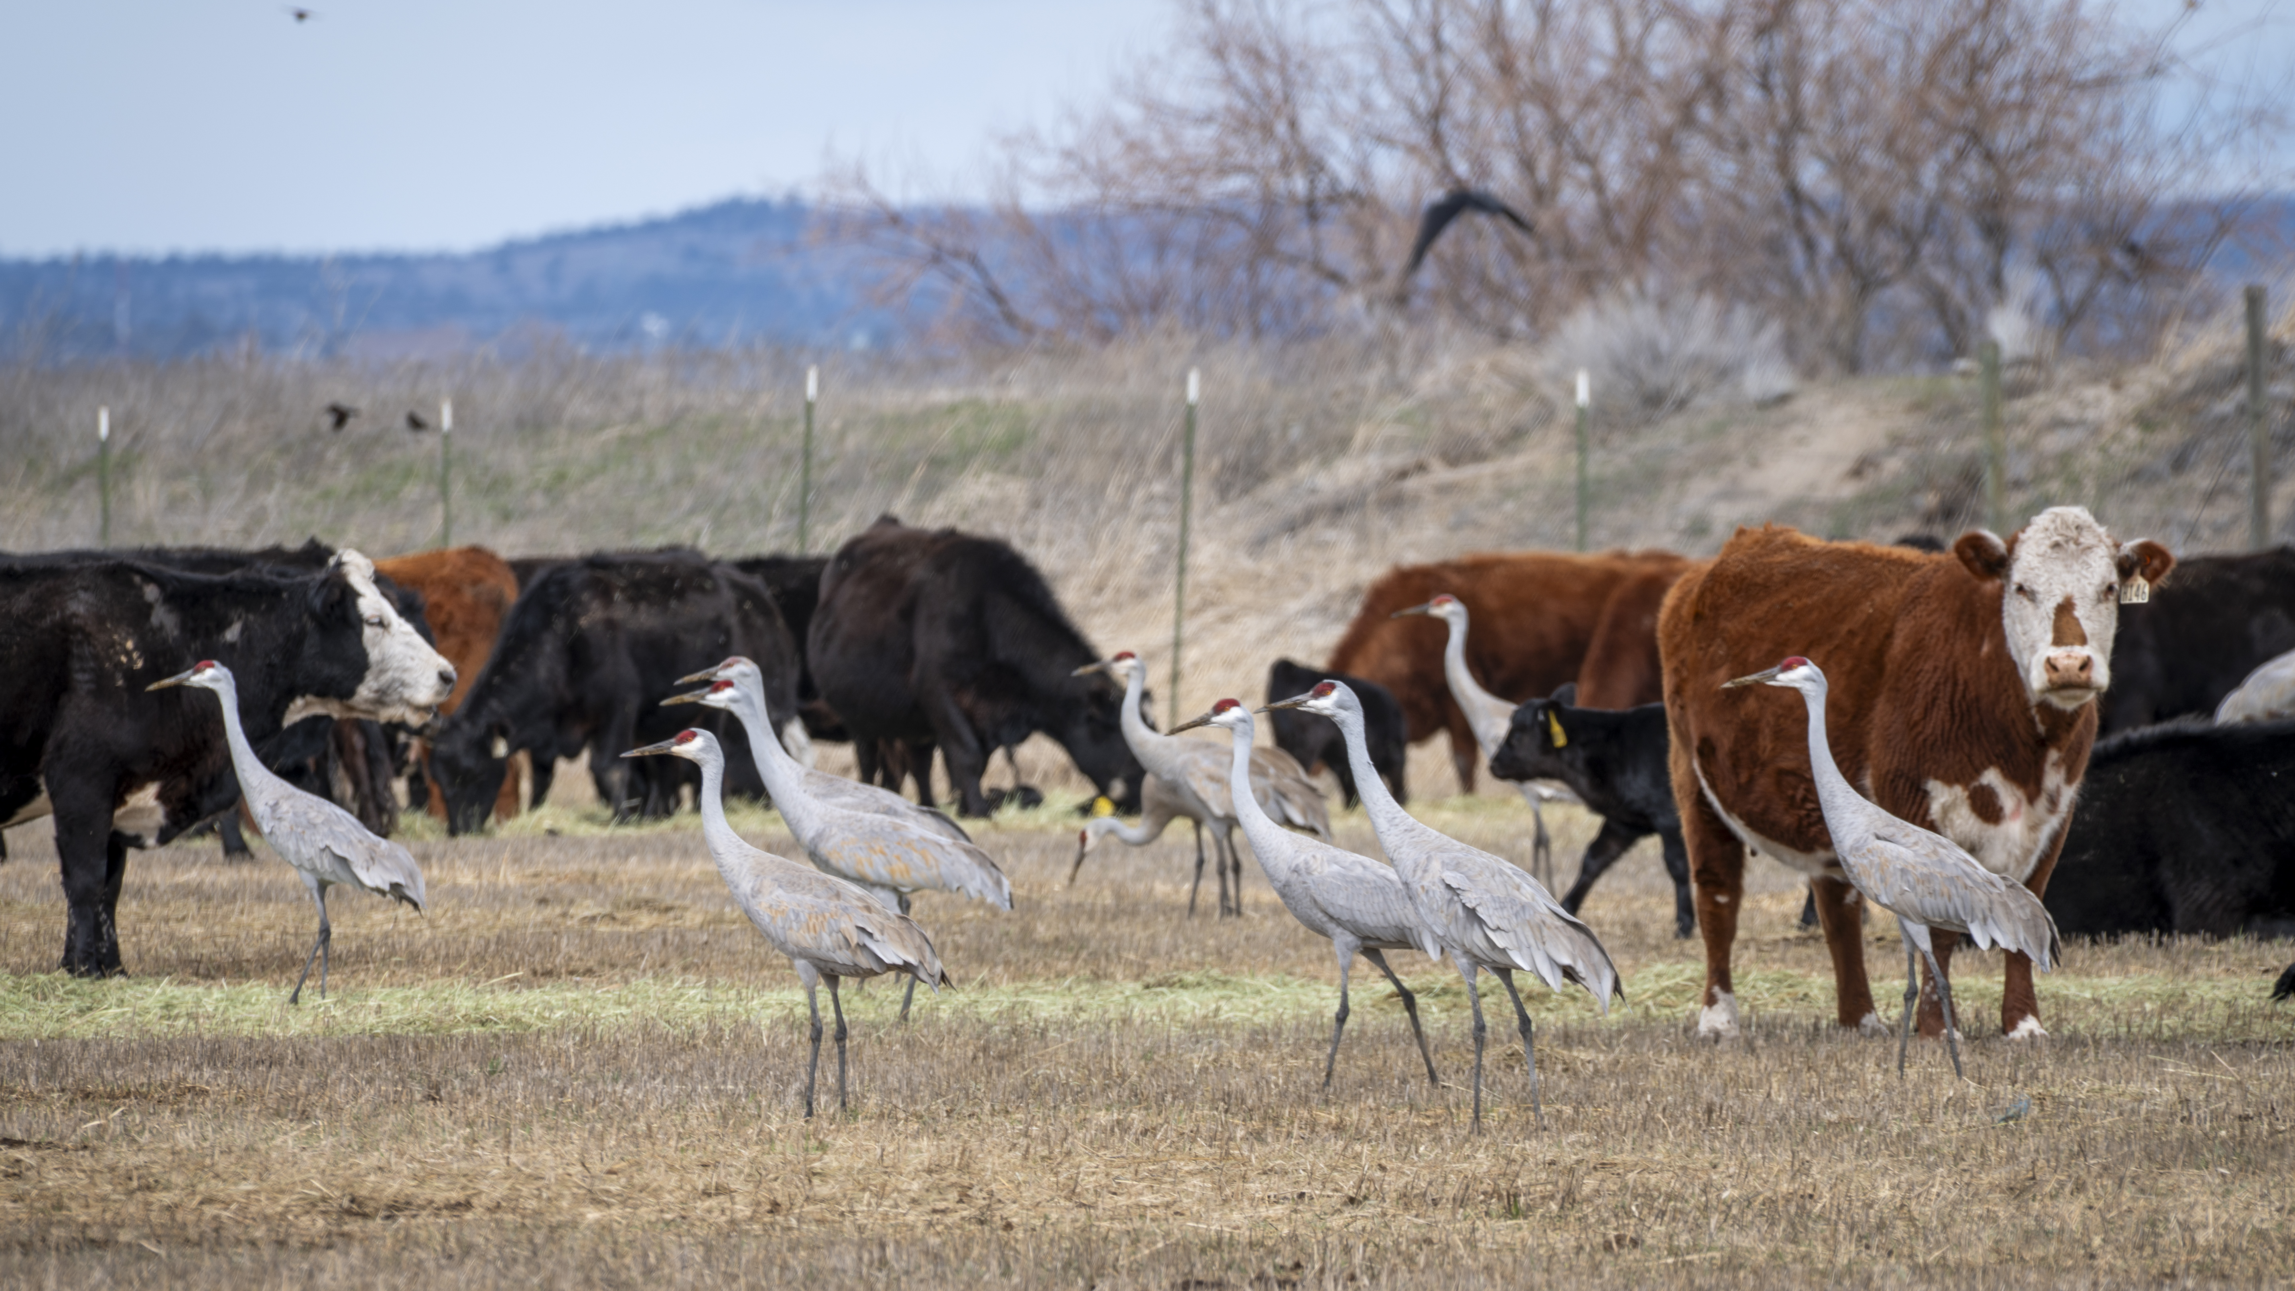
Pastoralism and Biodiversity Conservation:
What are your challenges and opportunities?
USA
© Michael Stauder
Notes:
This is a slide you can use or tailor for whoever is speaking (you could give a bit of information and a photo of their operation or the landscape, if you have time). I usually give them 10 min to talk about their life and livelihood if they do not have a film and then recommend asking the questions below.
Suggested questions for the pastoralist that would be good to share with them beforehand:
What does biodiversity mean to you and your livelihood?
Why is it important to conserve working landscapes?
What are some reflections you have thinking about the films and similarities or differences to other pastoralists in the world?

Slide 15
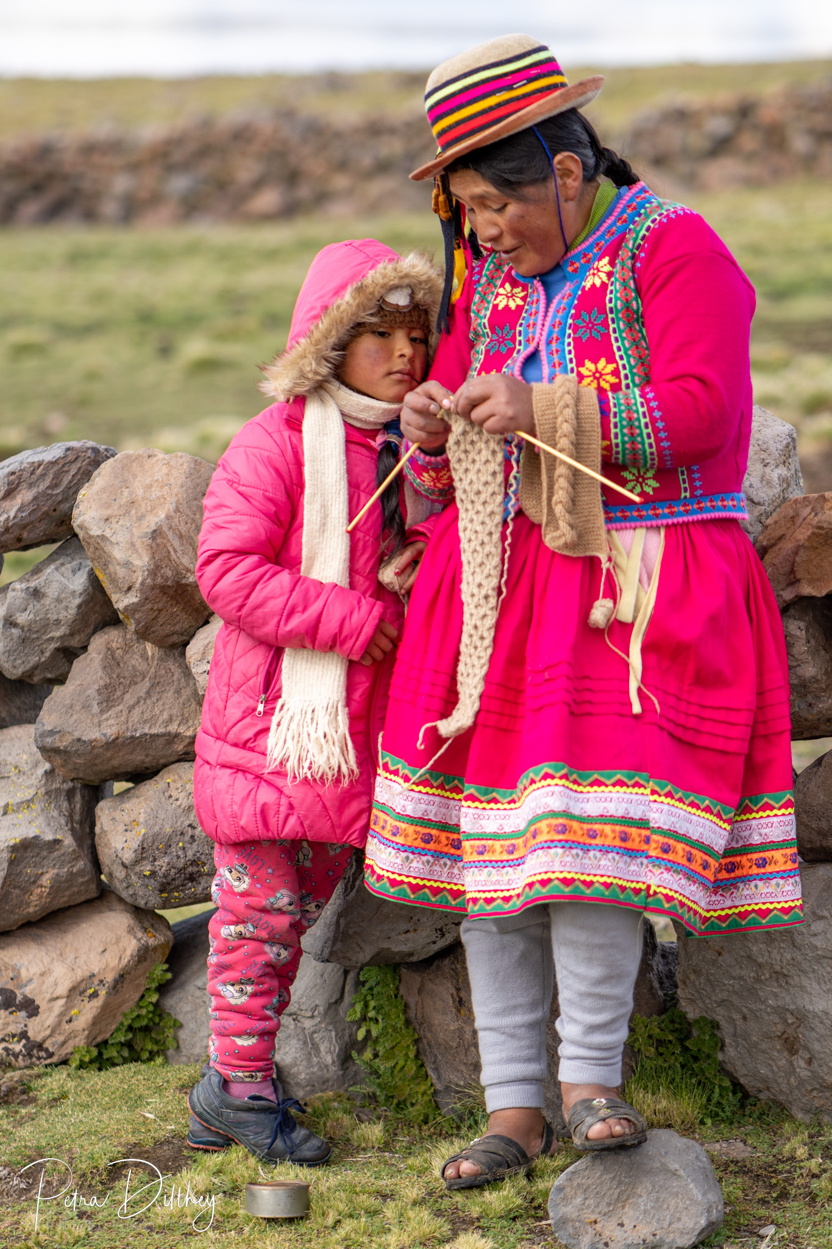
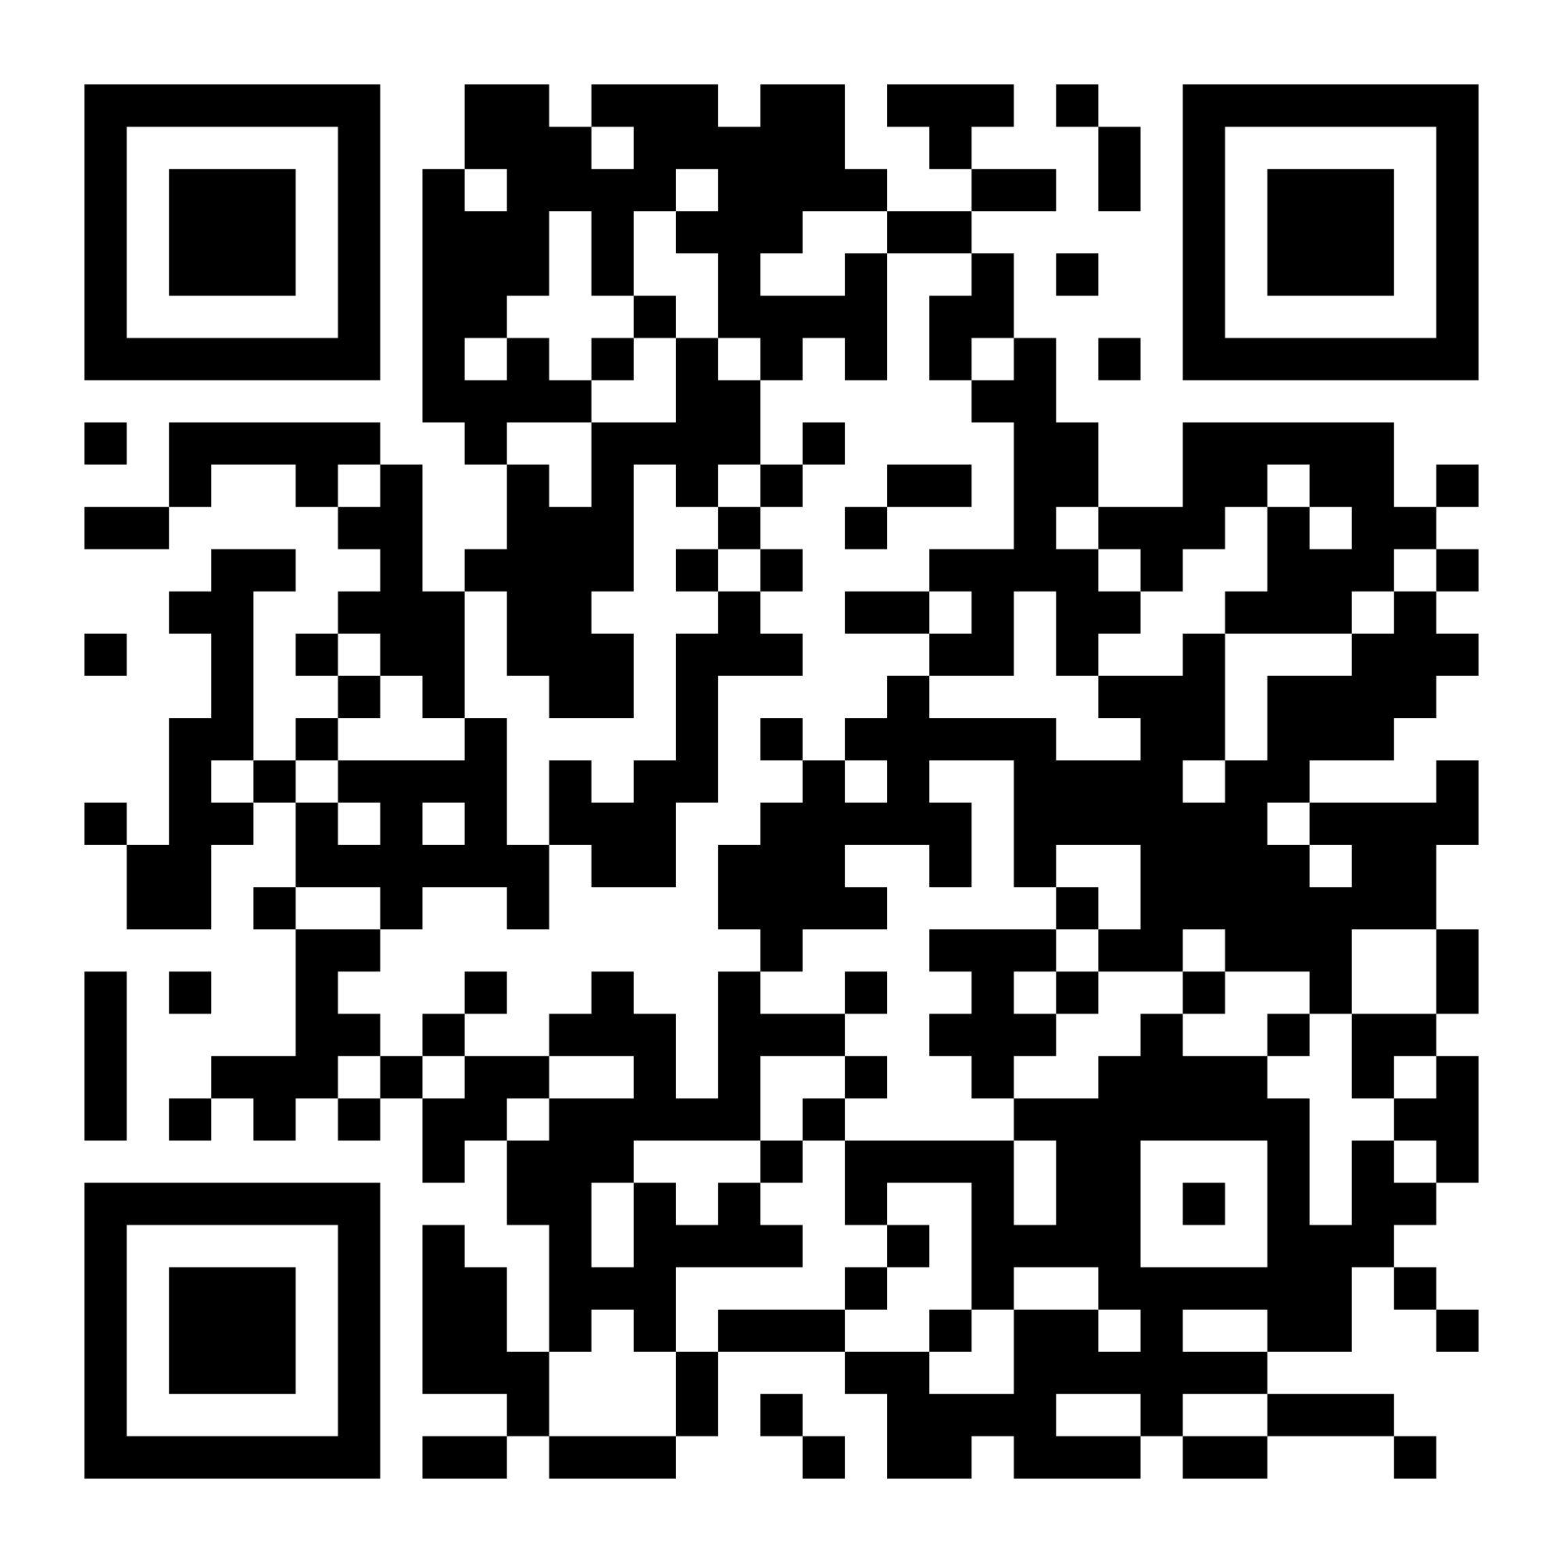
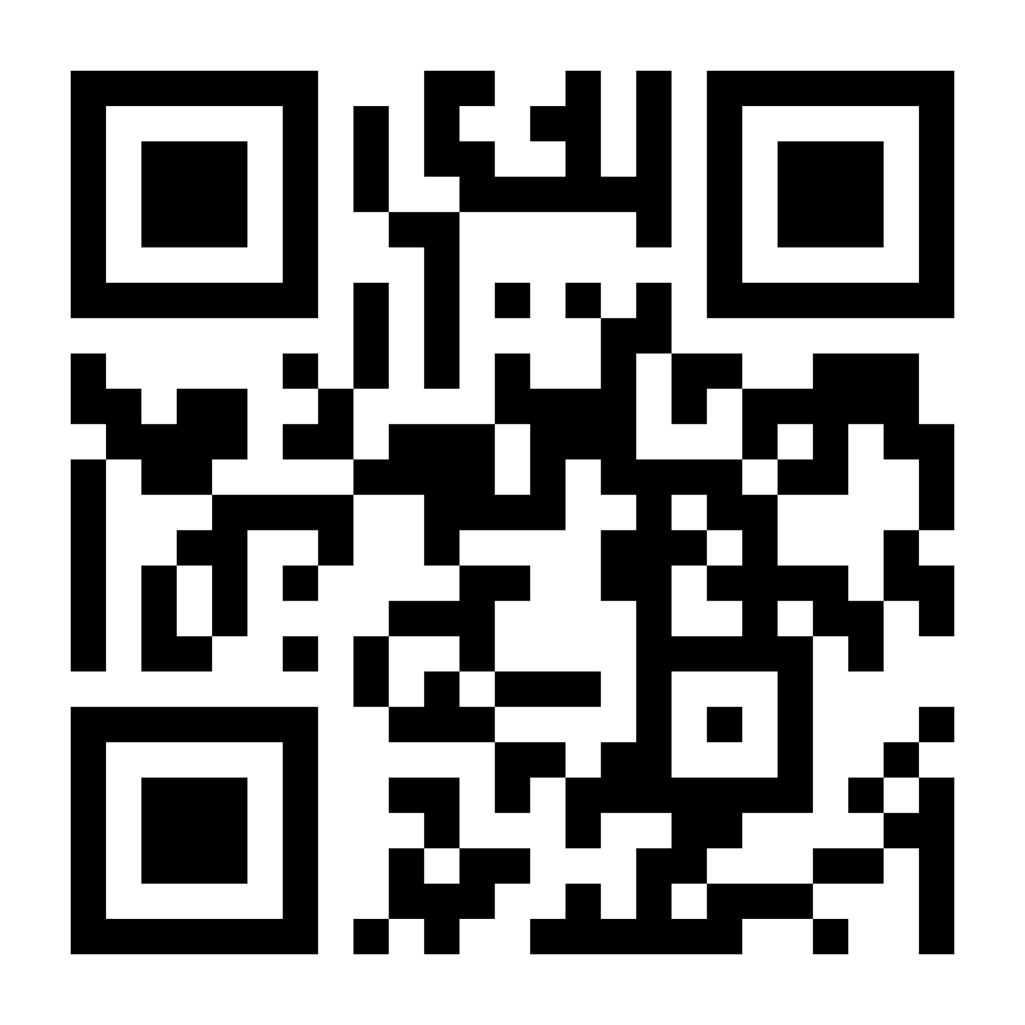
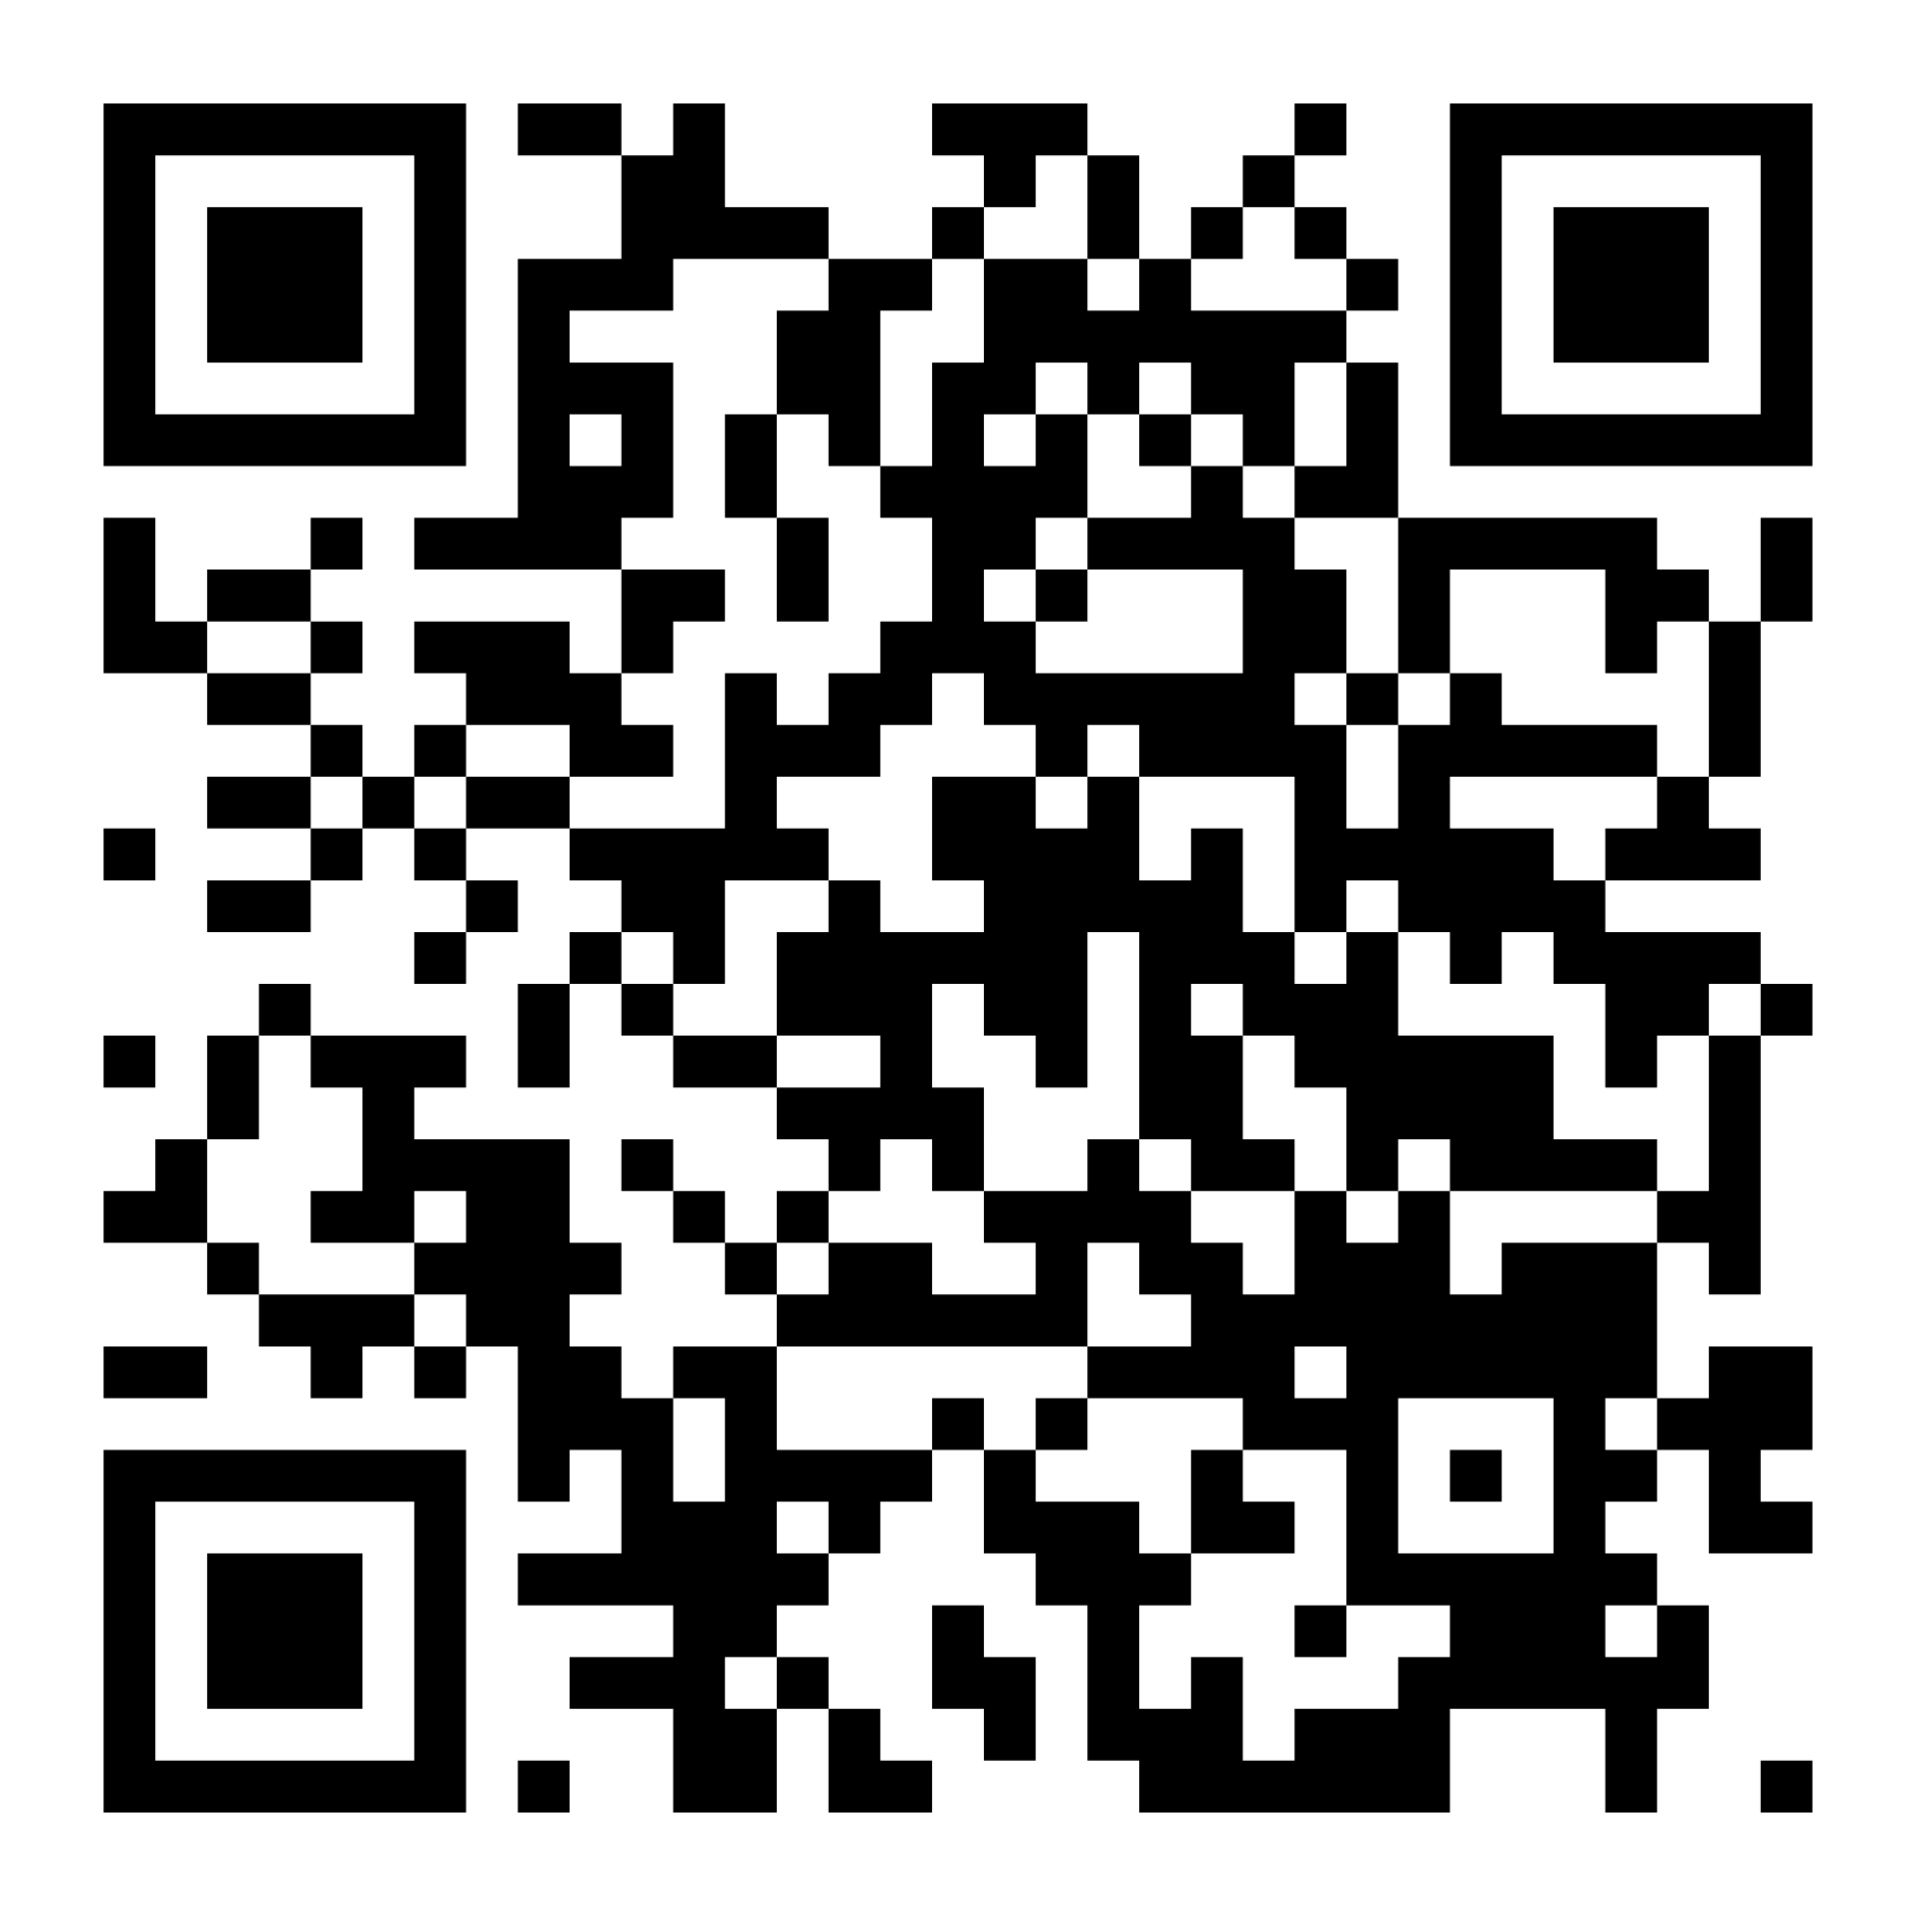
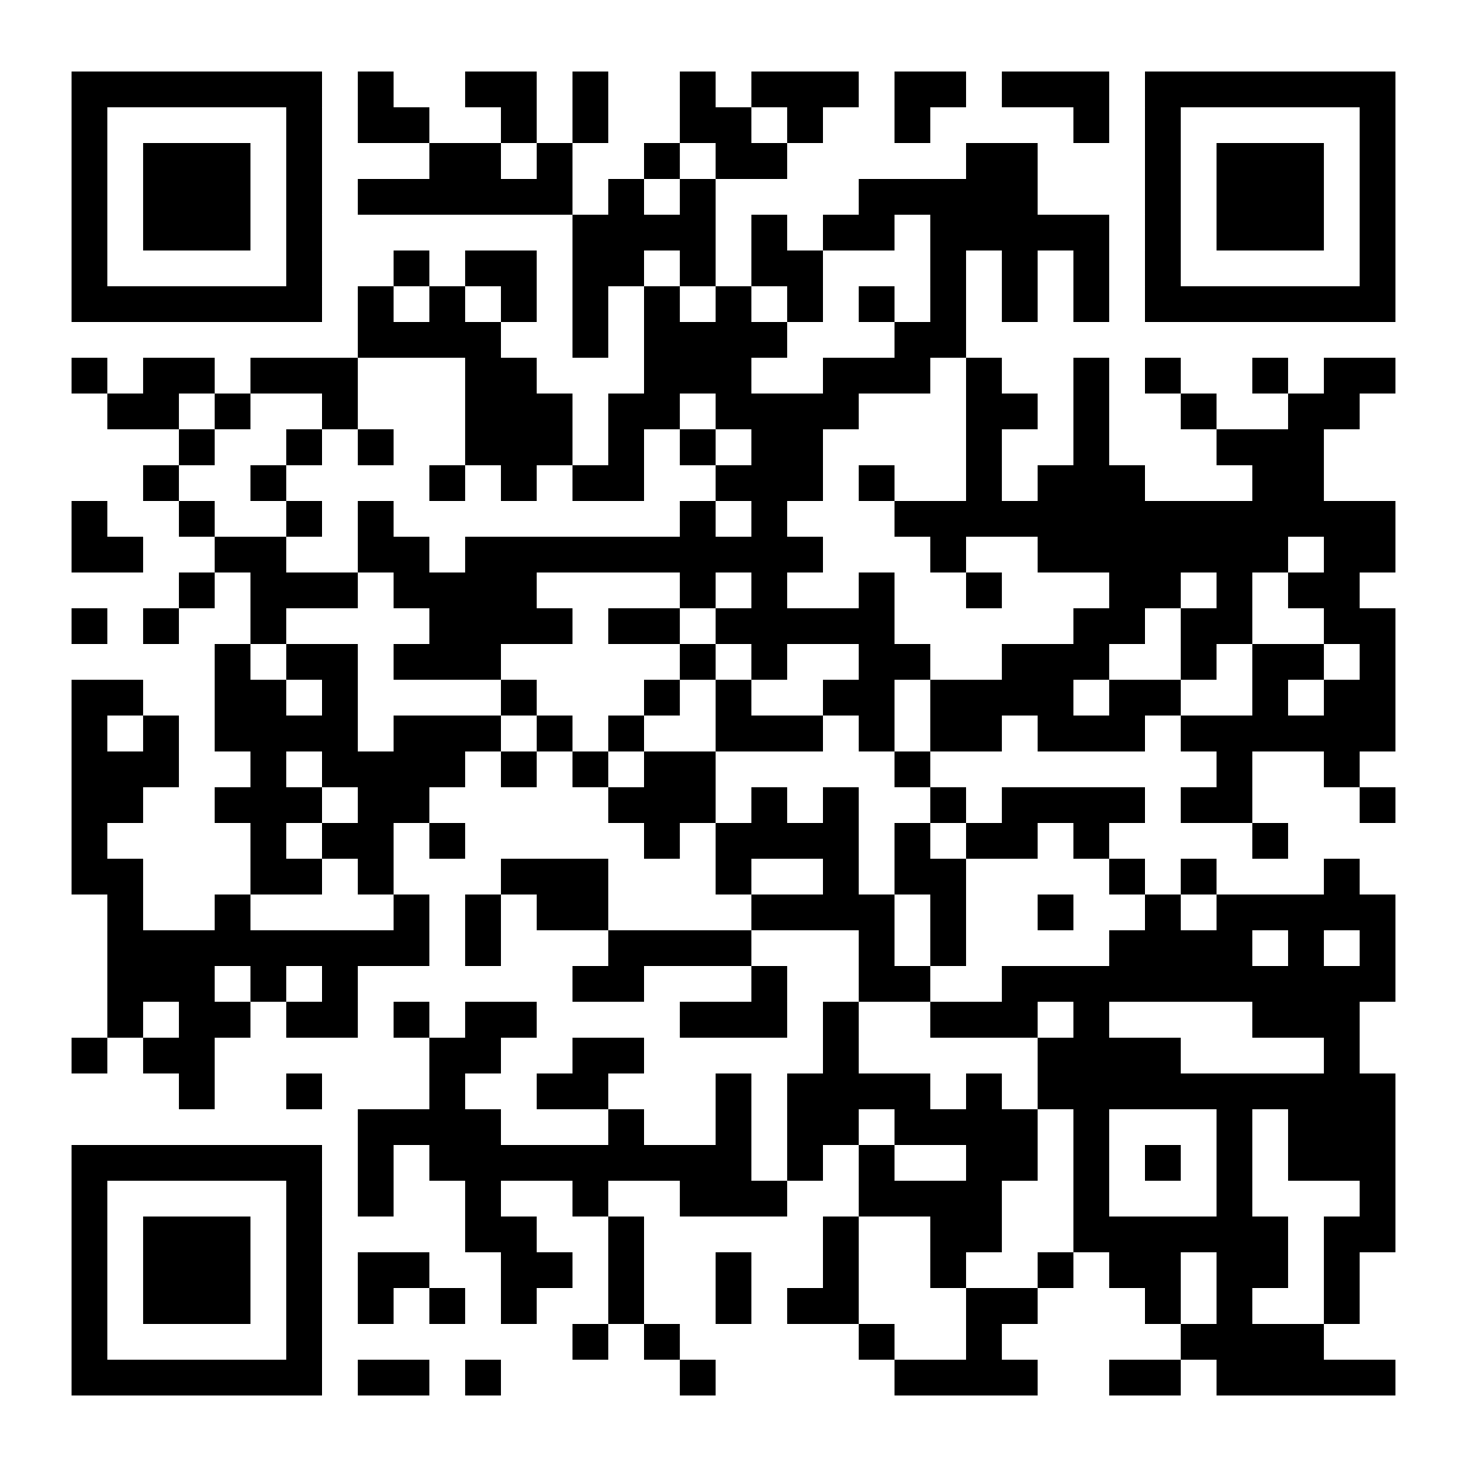
Learn More!
Perspectives on Pastoralism Film Festival
IYRP Regional web pages
Global Alliance for Rangelands & Pastoralists YouTube channel
Global Pastoralism Video Map
Peru
© Petra Dilthey
Notes:
If you are inspired and want to learn more, we encourage you to check out these resources where you can further explore the world of rangelands and see through the eyes of pastoralists.
Depending on your screen and location, you might want to delete the QR codes as they may be too small/too close to work properly. This page could alternatively be printed out and provided as people walk in and out of the viewing room.
Perspectives on Pastoralism Film Festival: https://www.pastoralistfilmfestival.com/
-collection of films on their website: https://www.pastoralistfilmfestival.com/films/
IYRP Regional Pages on website (scroll down to the second half of the iyrp.info website for each of the 11 regional pages with videos and photos featured at the bottom of the regional pages): https://iyrp.info/
IYRP YouTube Channel: https://www.youtube.com/@GA4RP_IYRP2026/featured
Global Pastoralism film map: https://umap.openstreetmap.fr/en/map/videos-on-pastoralism_1355465#2/25.003879/-15.356471

Slide 16
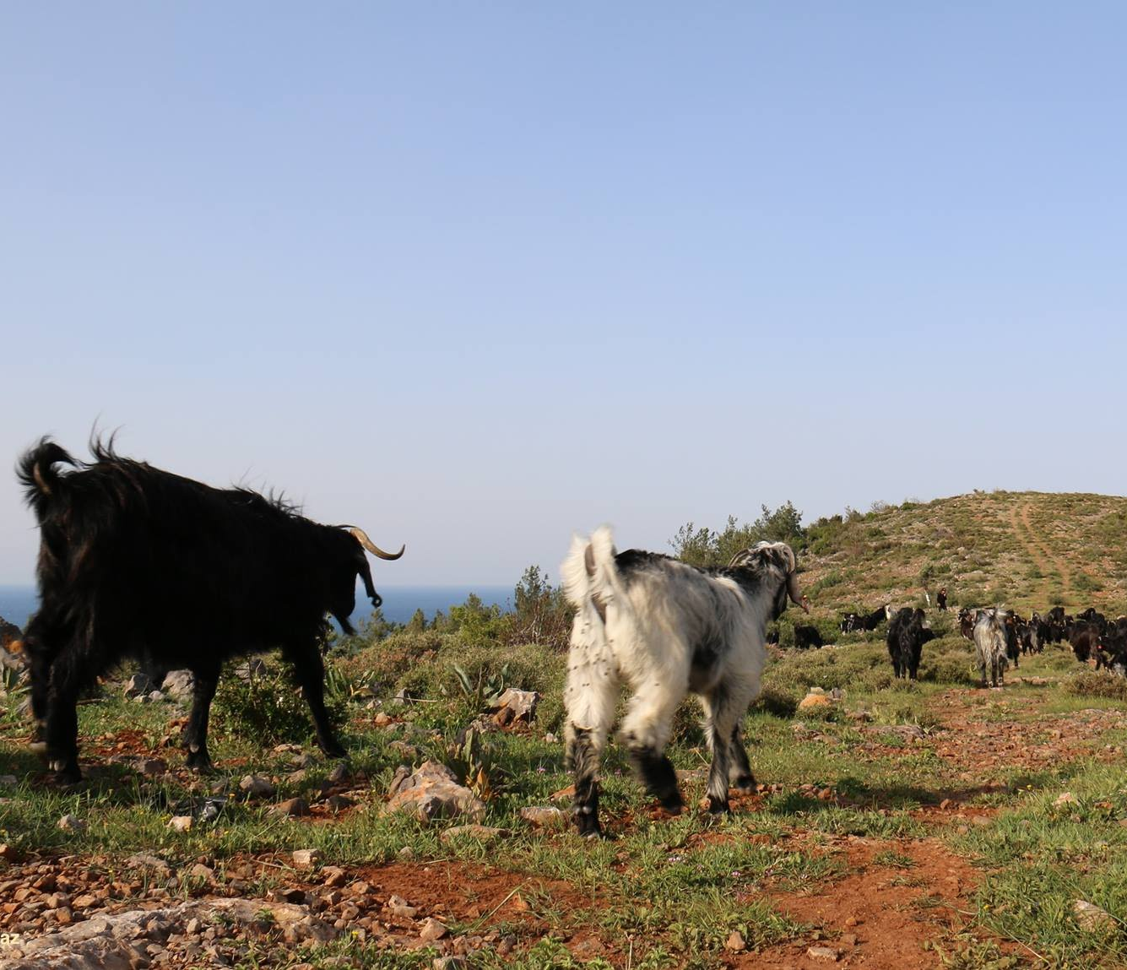


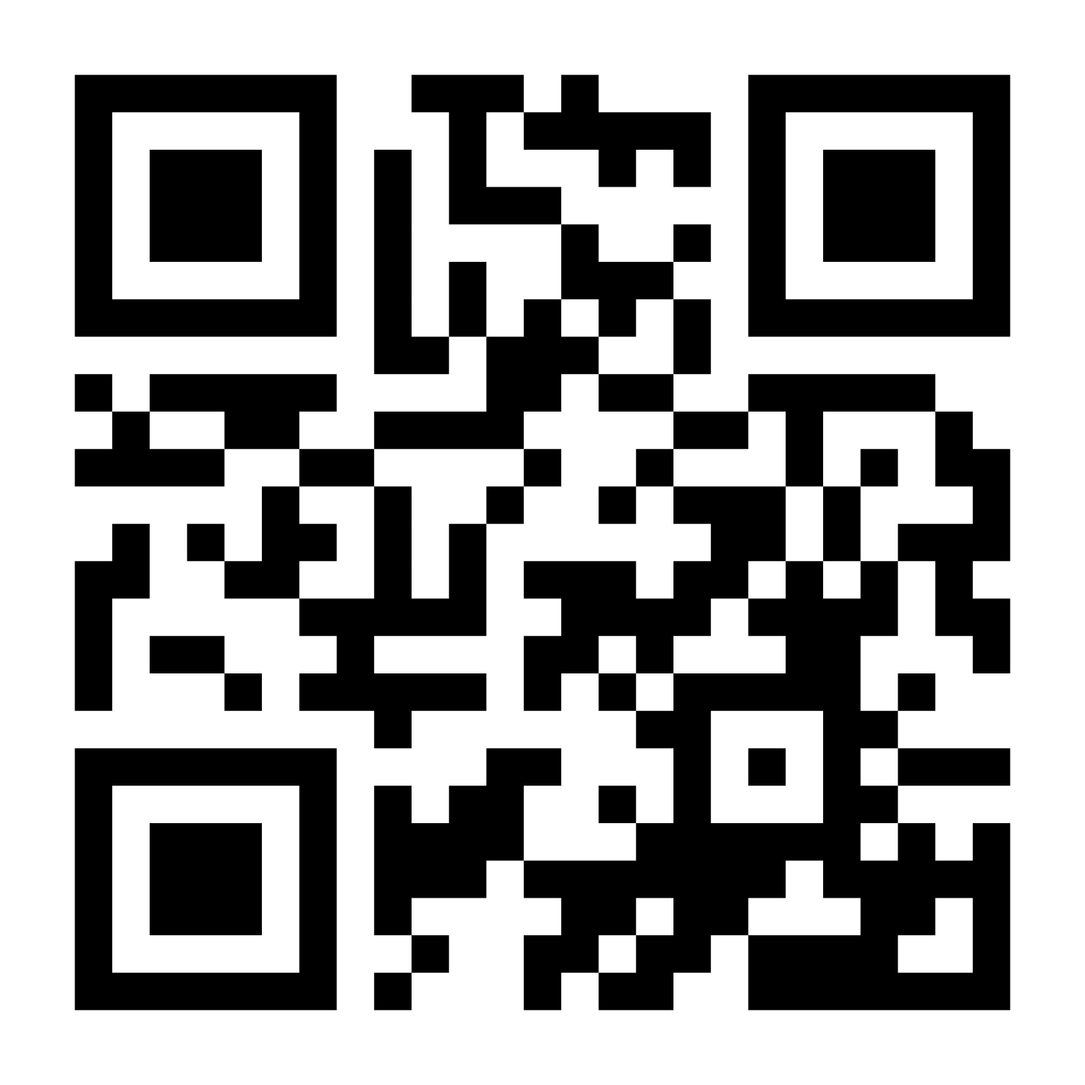
Thank you for attending!
Contact us:
iyrp@iyrp.info
More information:
https://iyrp.info
Türkiye
@ Engin Yilmaz
Notes:
Thank you for joining us to celebrate the International Year of Rangelands and Pastoralists! We encourage everyone to connect with us and learn more!

