Slide 1

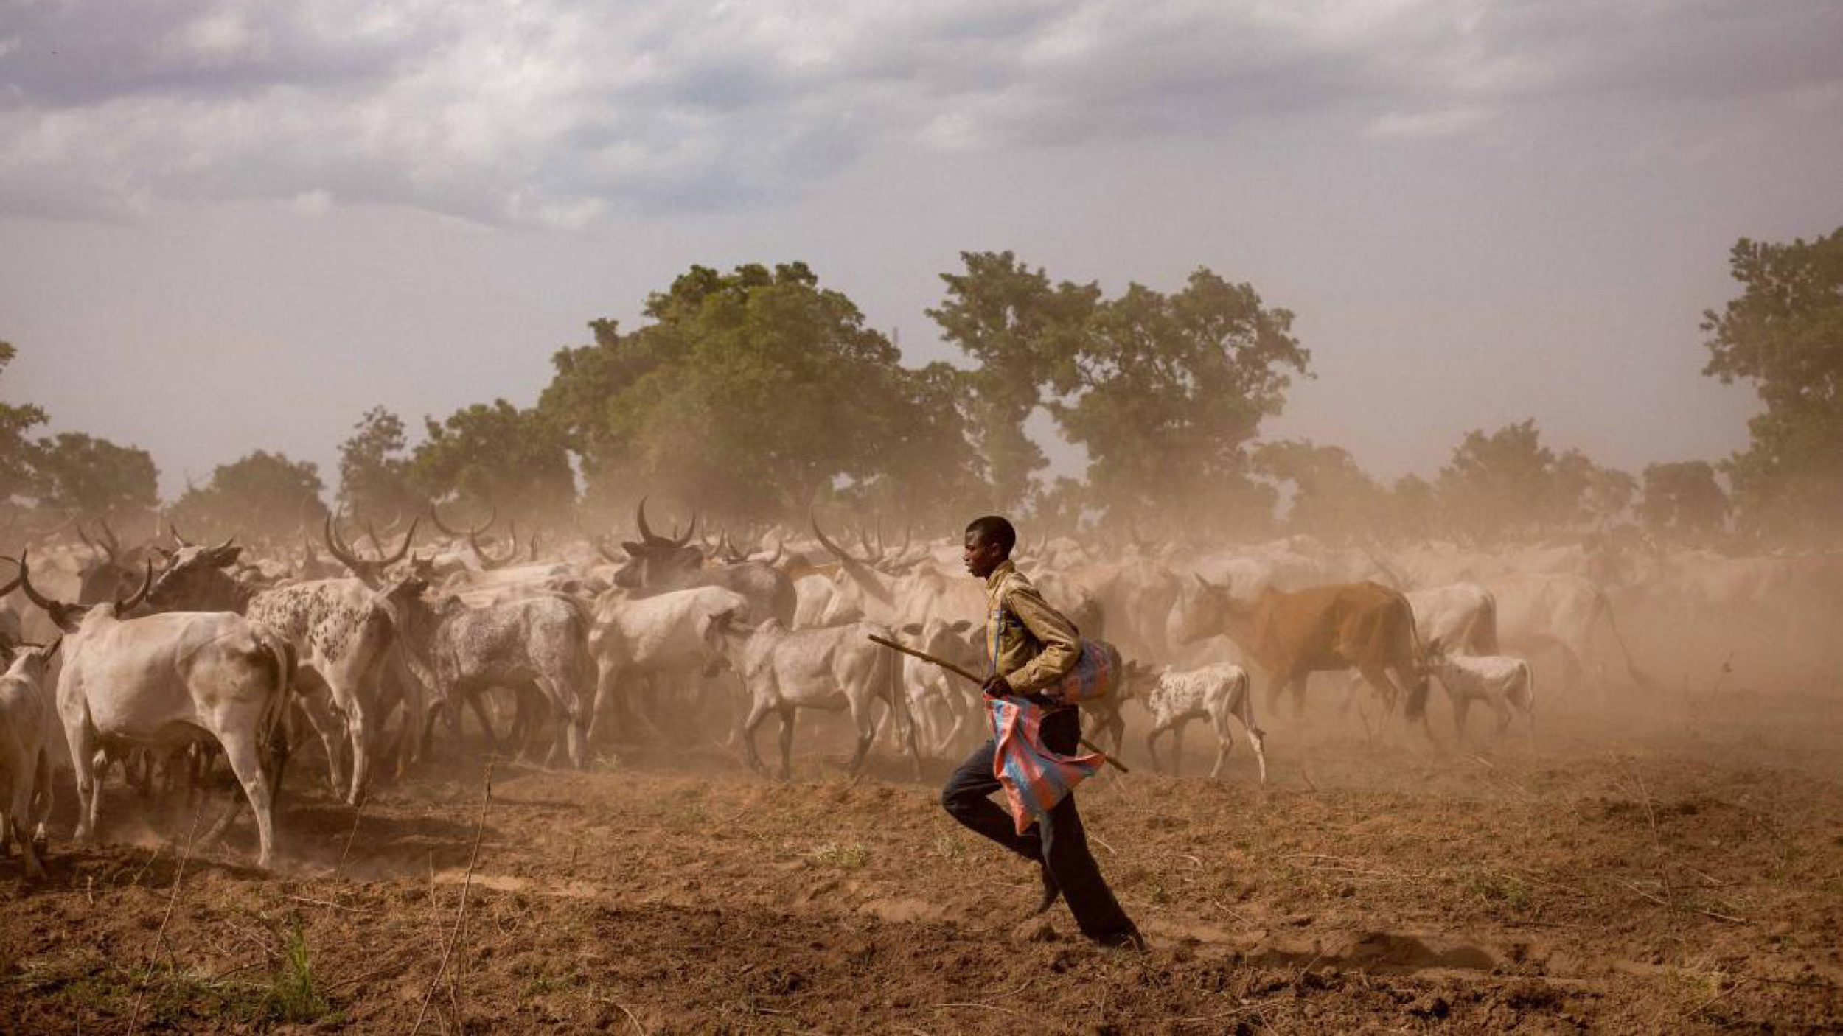



International Year of
Rangelands and Pastoralists
Engin Yılmaz
Co-chair of European RISG
Director of Yolda Initiative & Coordinator of AMNC

Slide 2
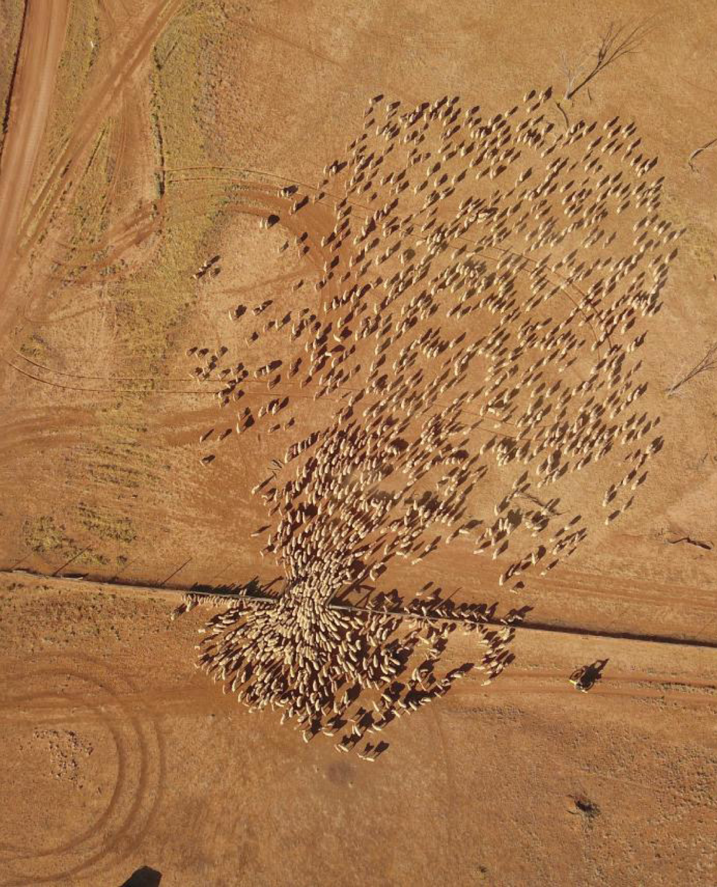
WHY AN IYRP?
To increase worldwide understanding of importance of rangelands & pastoralists for food security, biodiversity and climate crises, economic resilience and culture
To inform decision-making at all levels, calling for enlightened policy to benefit current & future generations
To mobilise people worldwide to address today’s challenges and to grasp new opportunities in rangelands & pastoralism
© Wendy Sheehan

Slide 3
MILESTONES PASSED ON LONG ROAD TO IYRP
2002: Dana Declaration on Mobile Peoples and Conservation
IRC/IGC 2008 Mongolia: idea arose
IRC 2011 Argentina: Resolutions calling for IY of Rangelands and Global Rangelands Assessment
UN Environmental Assembly (UNEA-2) 2016: Resolution on promoting rangelands & pastoralism (R&P) and call for gap analysis
IRC 2016 Canada: Agreement on action plan to promote IYRP and form “International Steering Group” (ISG)
2018–19: UNEP-funded R&P gap analysis
UNEA-4 2019: Africa Group resolution for R&P
Aug 2019: Mongolian Government proposed IYRP to FAO COAG; ISG became International Support Group to Mongolian team

Slide 4
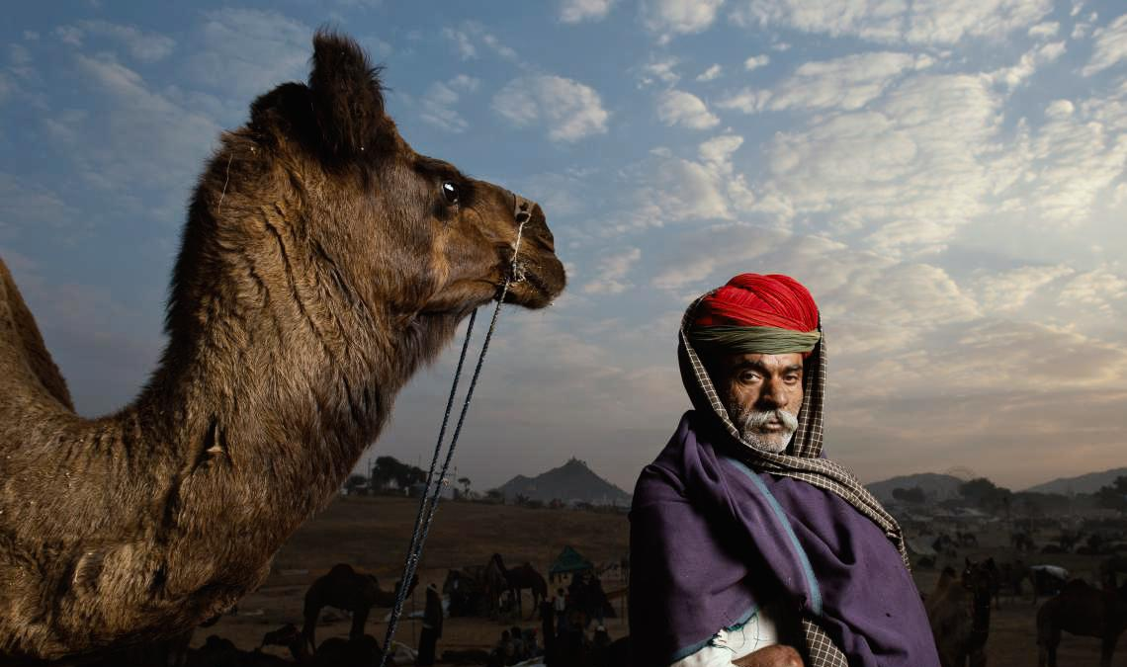
PROCESS FOR APPROVAL AS UN INTERNATIONAL YEAR
© Kalyan Varma

Slide 5
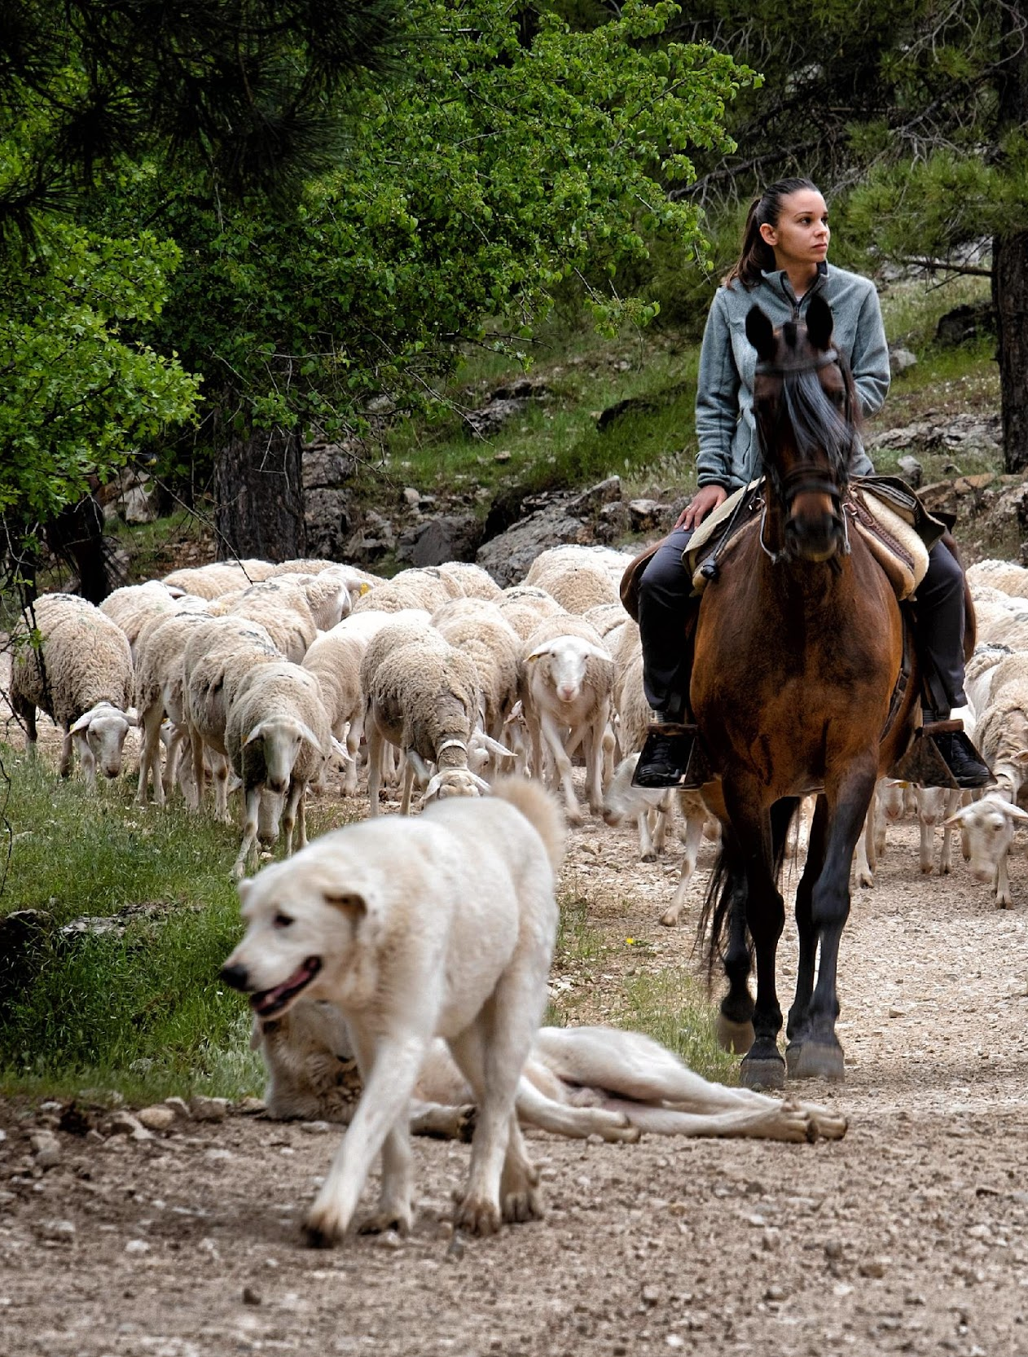


Oct 2020: FAO Committee on Agriculture (COAG) endorsed Mongolian Government’s proposal for IYRP in 2026
Dec 2020: FAO Council endorsed the proposal
June 2021: FAO Conference endorsed the proposal
Final step in the process:
The Director General of FAO has officially transmitted the Proposal to the UN Secretary General. The Government of Mongolia is working on processing the Proposal through the appropriate channels for the 76th UN General Assembly (UNGA).
© Katy Gomez Catalina

Slide 6
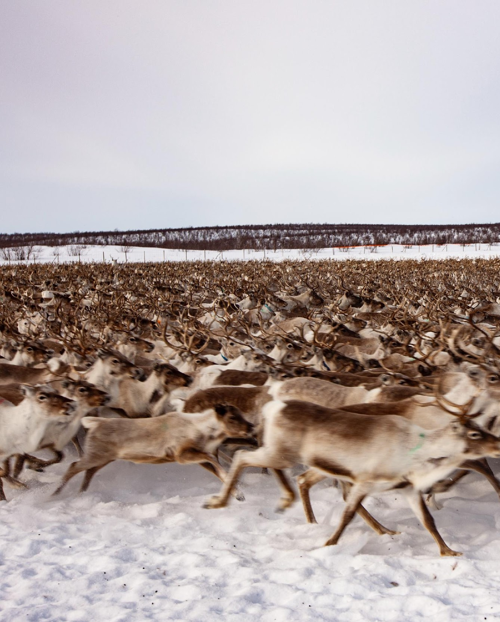
STATUS OF SUPPORT FOR IYRP
35 governments plus the EU member countries
298 organisations
The IUCN WCC, in September 2021 in Marseille, passed the Resolution 9 “Protecting and Restoring Endangered Grasslands and Savannah Ecosystems”, which includes a paragraph requesting IUCN to seek support from Member States for the IYRP.
© Lawrence Hislop

Slide 7
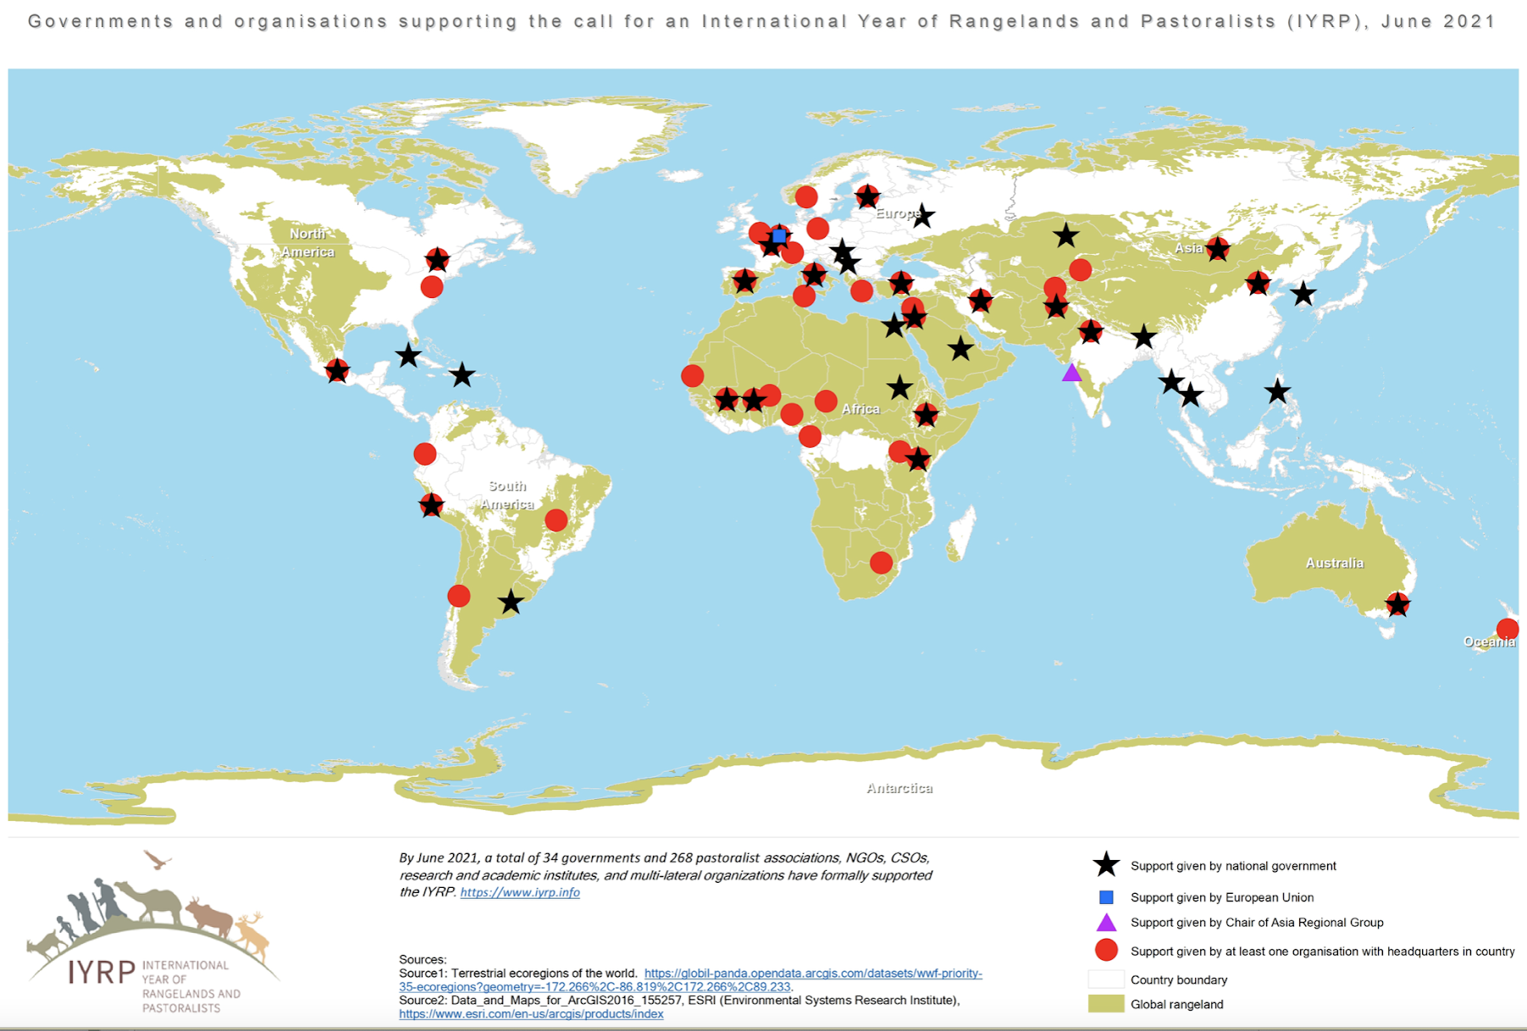

Slide 8
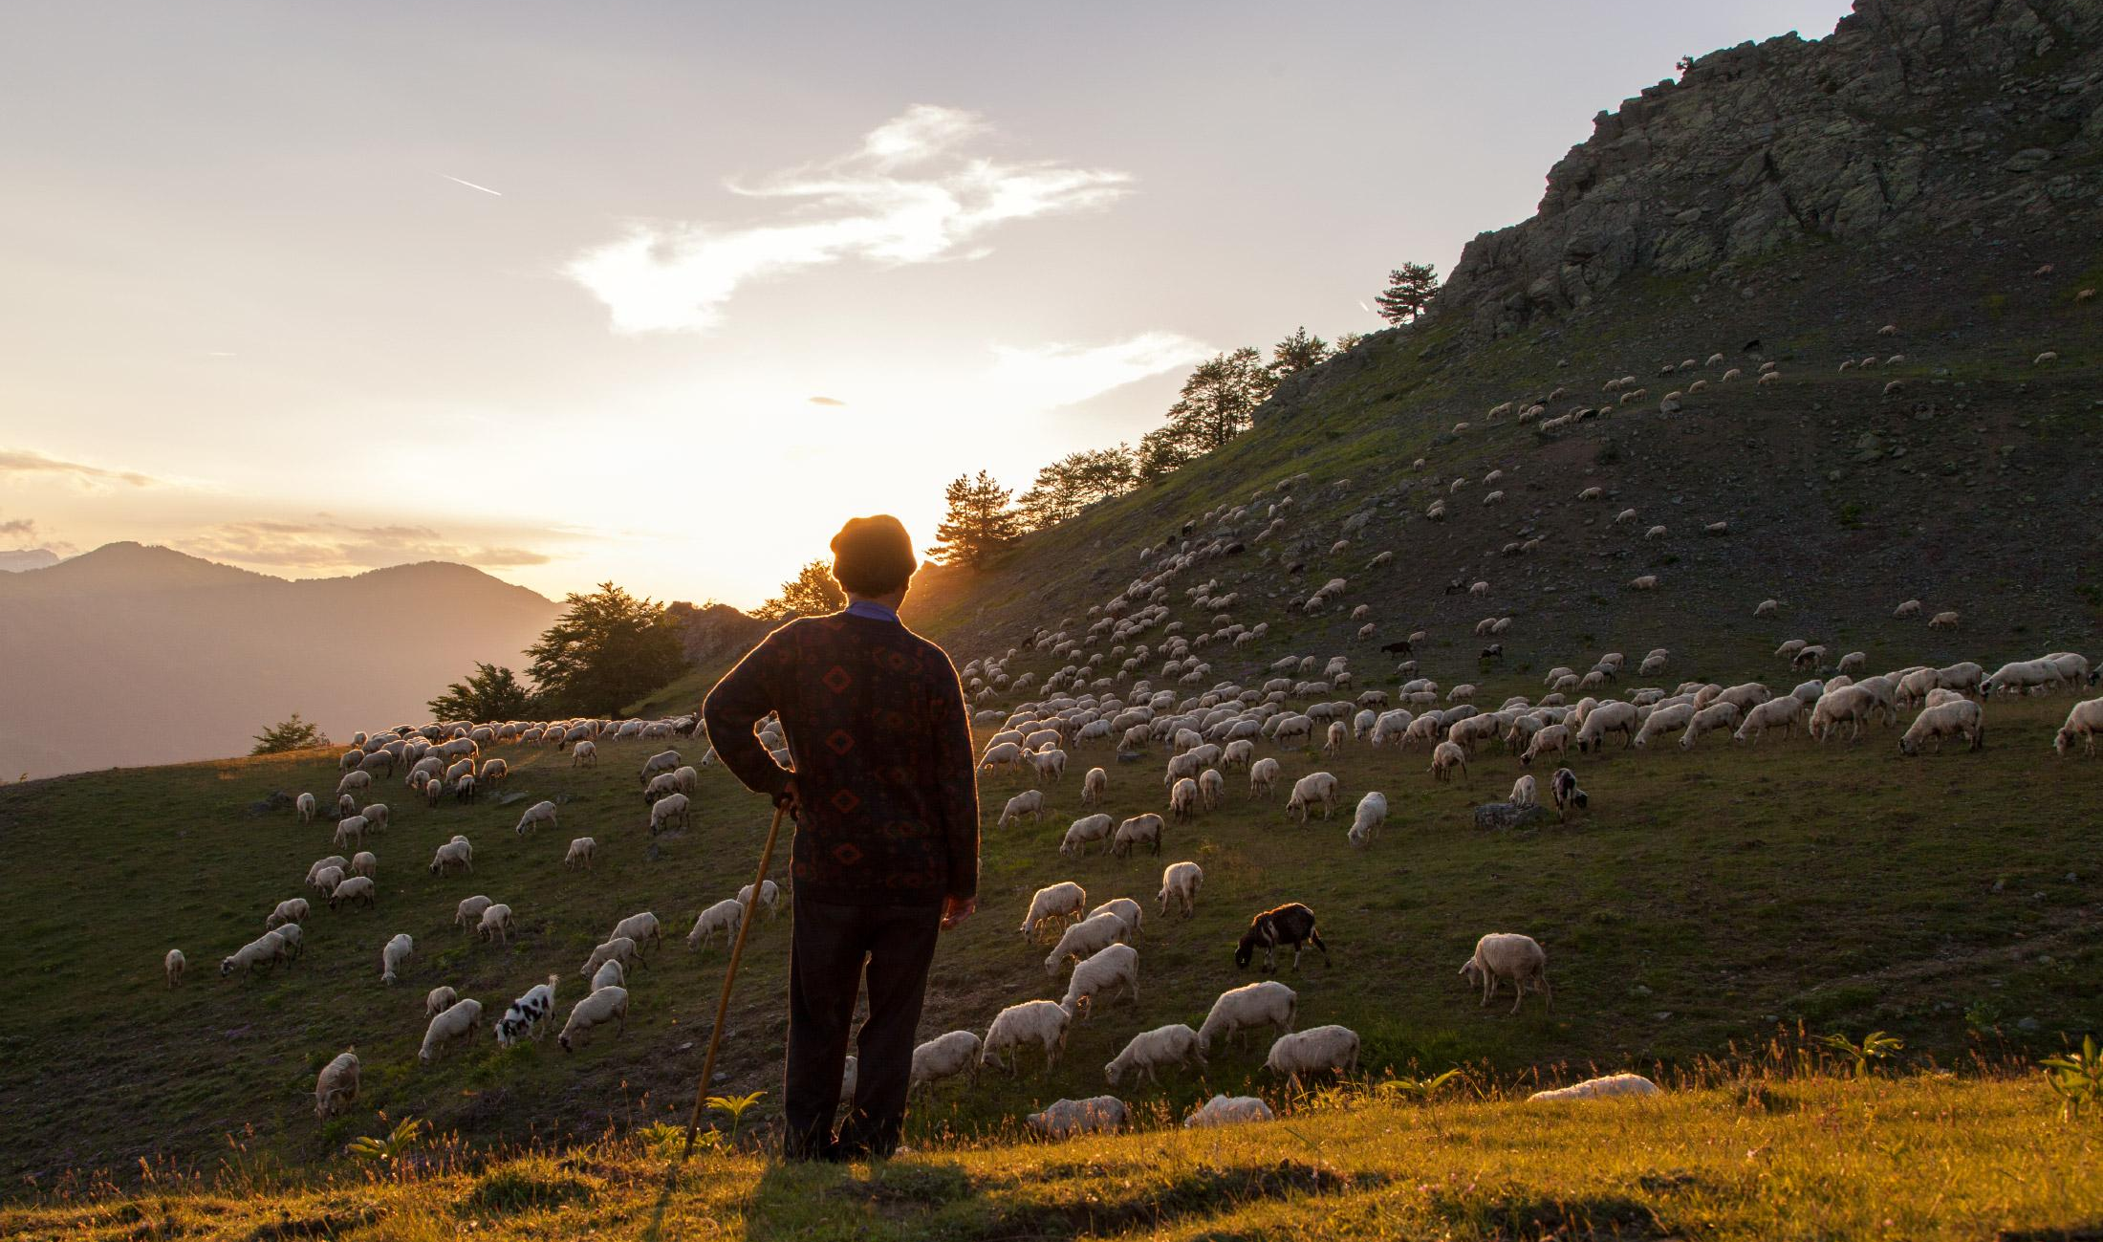
REGIONAL IYRP SUPPORT GROUPS (RISGS)
© Stamos Abatis

Slide 9
Multi-stakeholder RISGs being created to generate more support and partnership:
  expand network of supporting organisations and governments in the 11 regions
  work with Government of Mongolia and IYRP International Support Group to plan and implement IYRP activities in these regions
Arctic, Australasia / Oceania, Central Asia & Mongolia, East Asia, Eastern & Southern Africa, Europe, North Africa & Middle East, North America, South America, South Asia, West & Central Africa
* Central role for pastoralist organisations in these activities

Slide 10
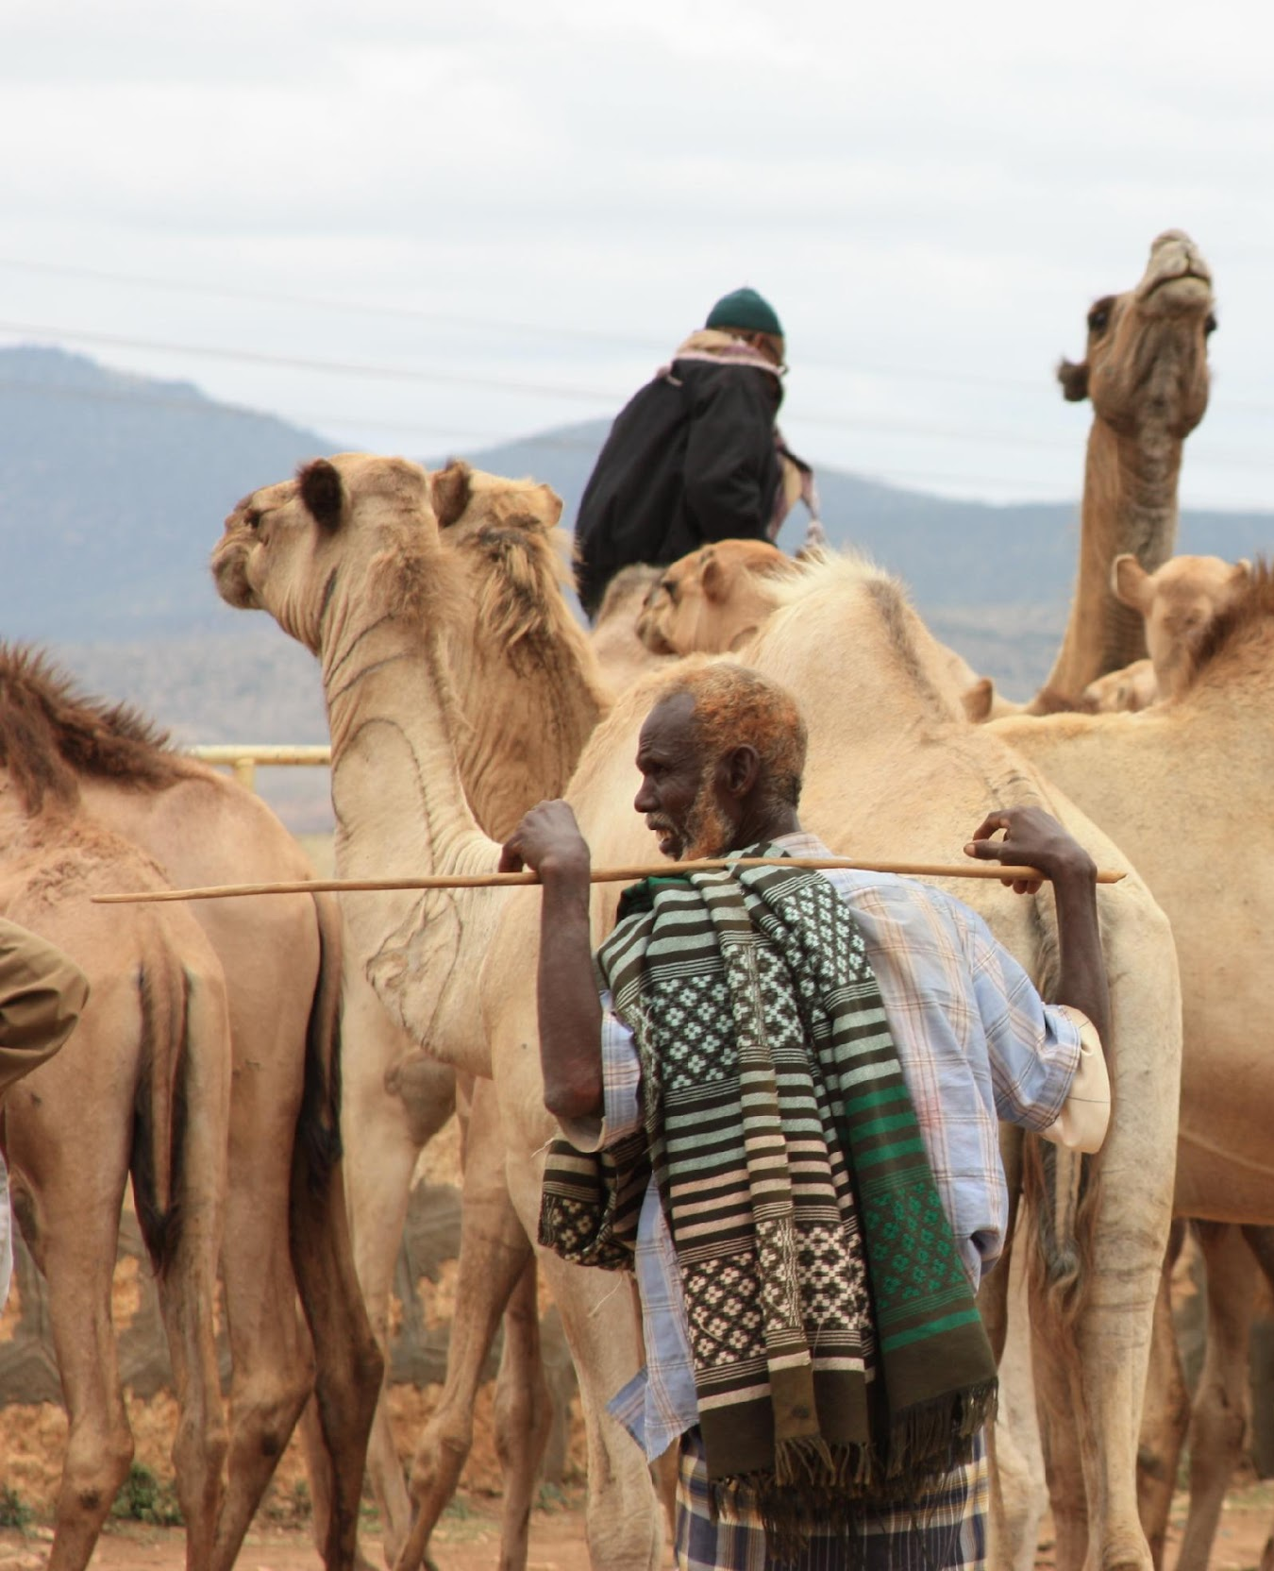
PRIORITY ACTIONS!
ISG AND RISGS TO CONTINUE GENERATING SUPPORT
Convince governments in each country and region to support IYRP
  Approach Ministries of Agriculture and Foreign Affairs (in time for UNGA)
  Invite governments to co-sponsor with Mongolia
Raise attention at international meetings, e.g. side events, and inserting R&P into official resolutions
For UNGA, highly visual “online booth” (www.iyrp.info) and social media campaign (tweets) targeted at Embassies in New York
© Nena Terrell

Slide 11
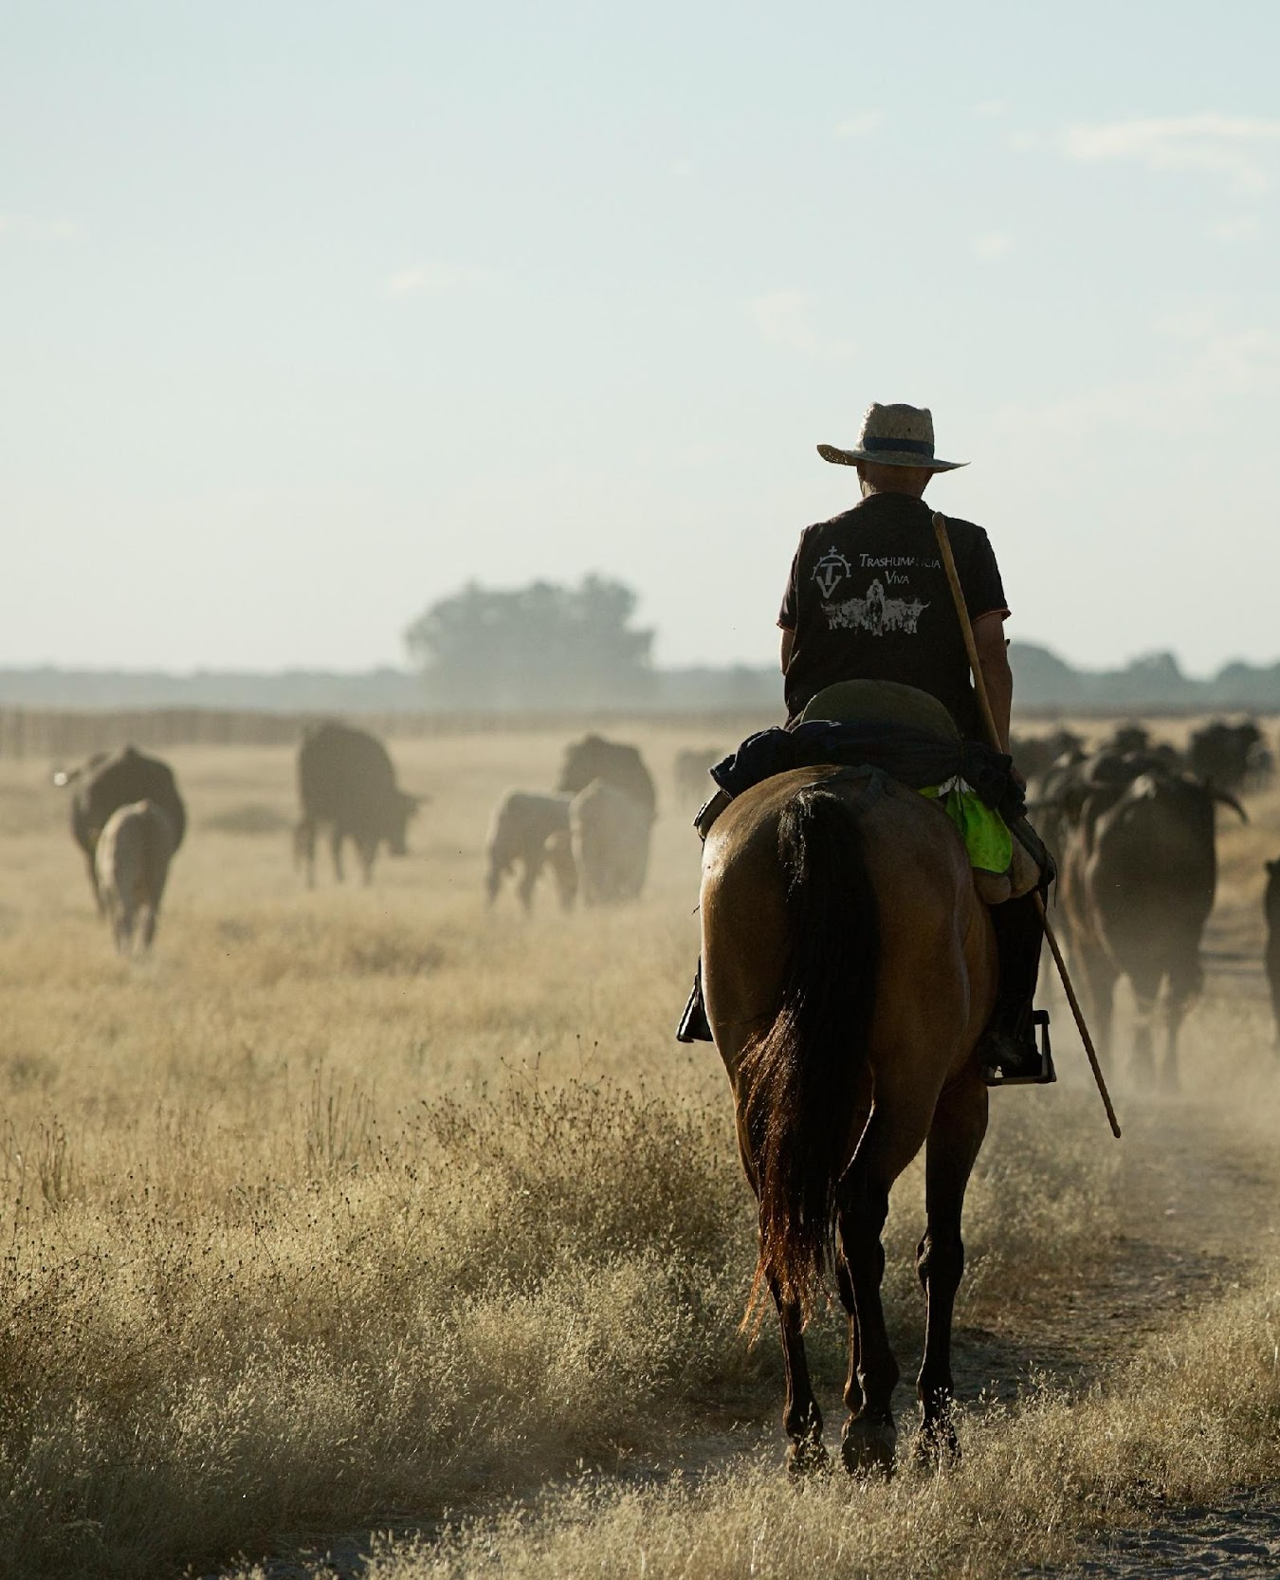
GENERATE SUPPORT AMONG NON-GOVERNMENTAL PARTNERS
Recognise common interests & combine efforts
of rangelands & pastoralism communities of practice & science
Use our personal and professional networks
find supporting partner organizations involved with:
    Sustainable Development Goals (SDGs) by 2030
    UN Decade of Family Farming
    (2019–28)
    UN Decade on Ecosystem Restoration (2021–30)
    Others
© Antolin Avuzela

Slide 12
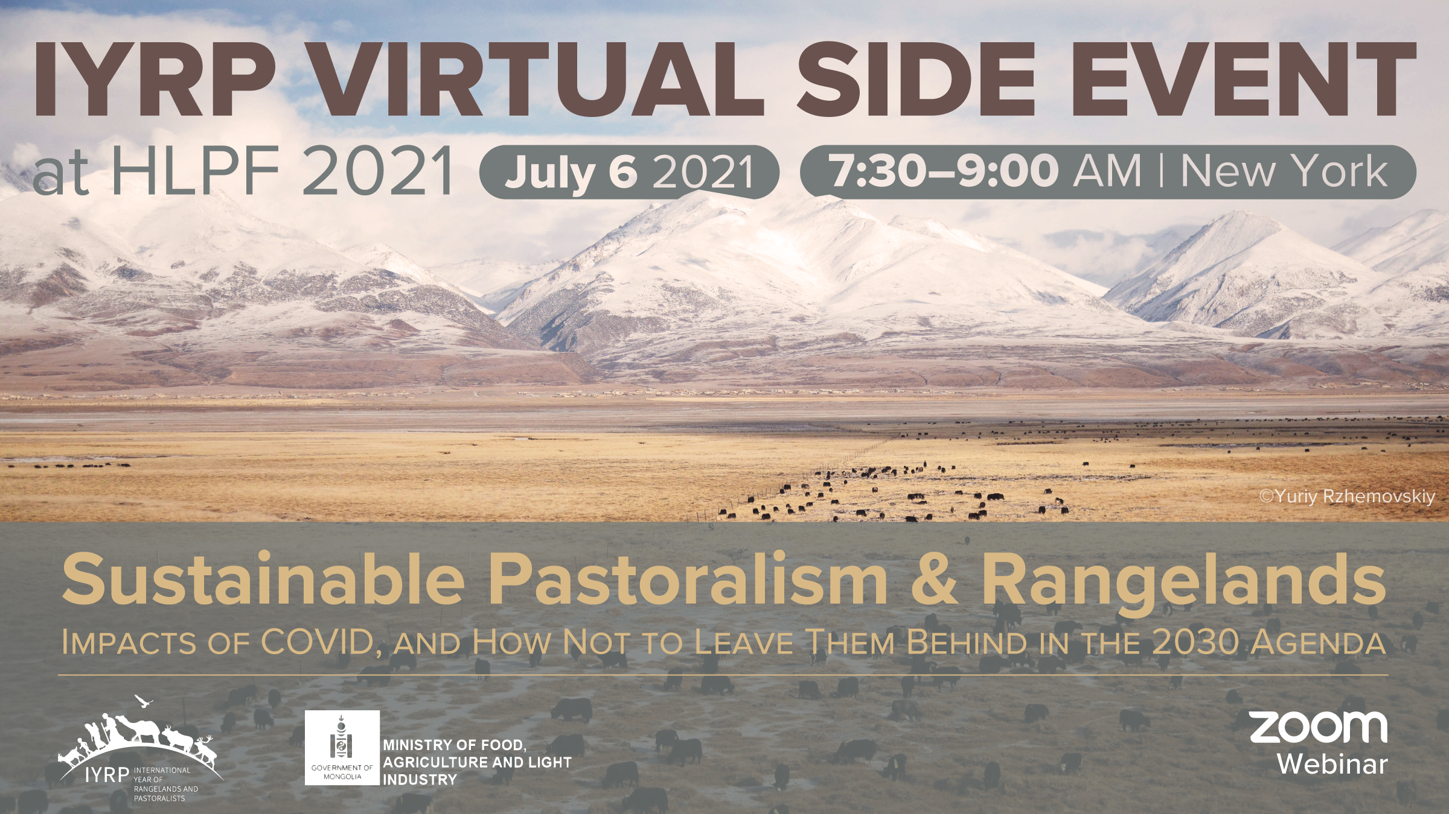

Slide 13
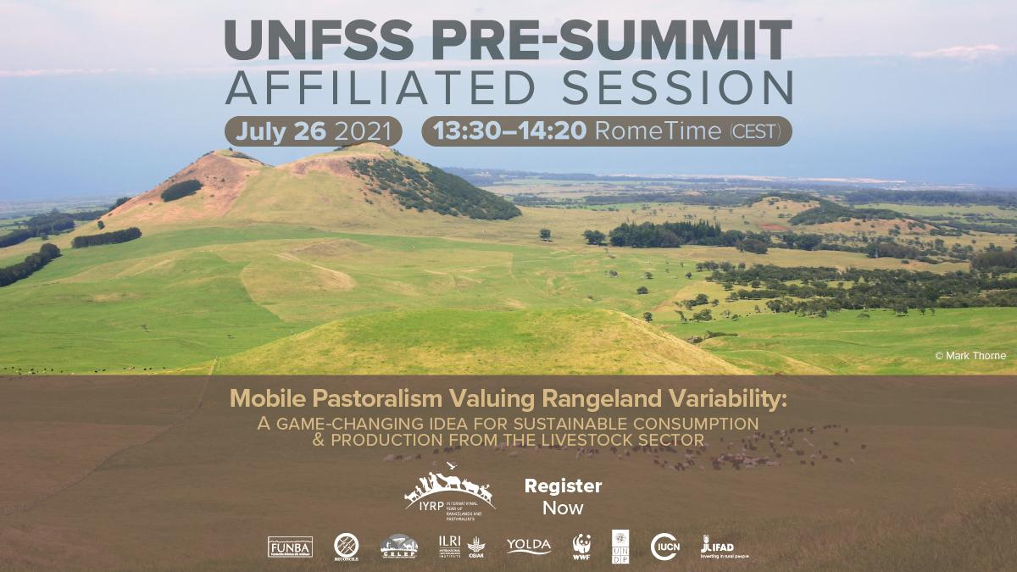

Slide 14
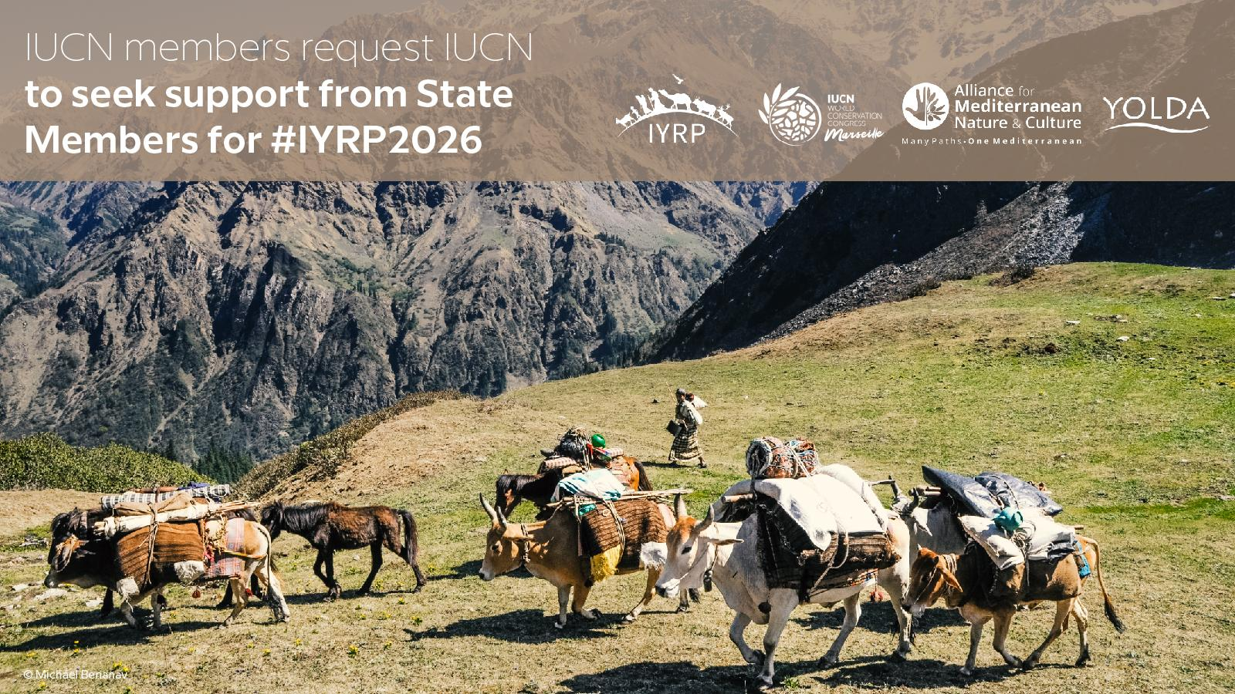

Slide 15
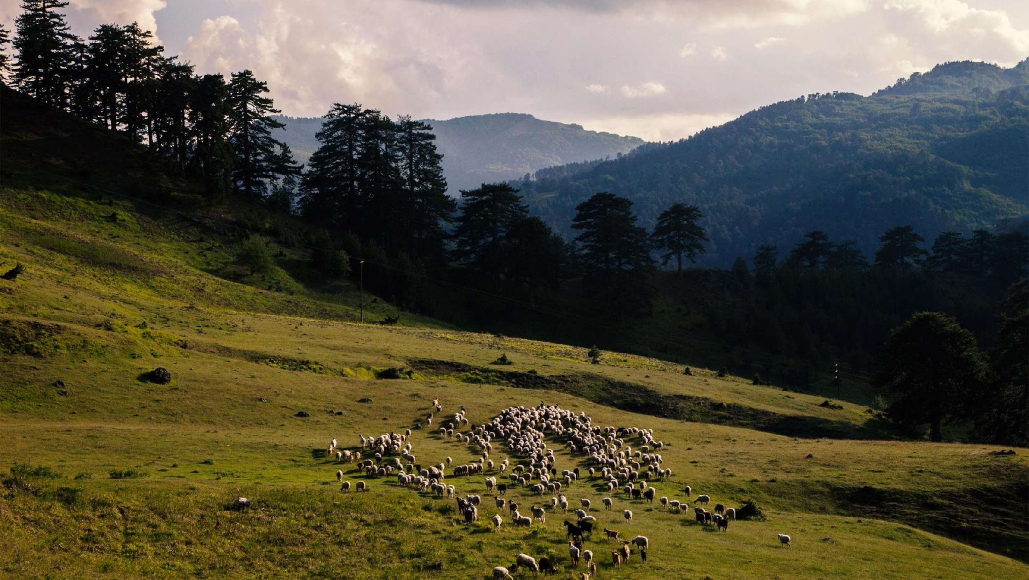
EUROPEAN RISG
© Stamos Abatis

Slide 16
MEMBERSHIP
45 members
Members from 16 countries
Member organisations from France:
CORAM - Collectif des Races Locales de Massif / ESN
National Federation for the Defense of Pastoralism in France
Confédération paysanne
Association Française de pastoralisme
Fédération des alpages de l'Isère
Centre Départemental de l'Elevage Ovin
INRAE
© Wendy Sheehan

Slide 17
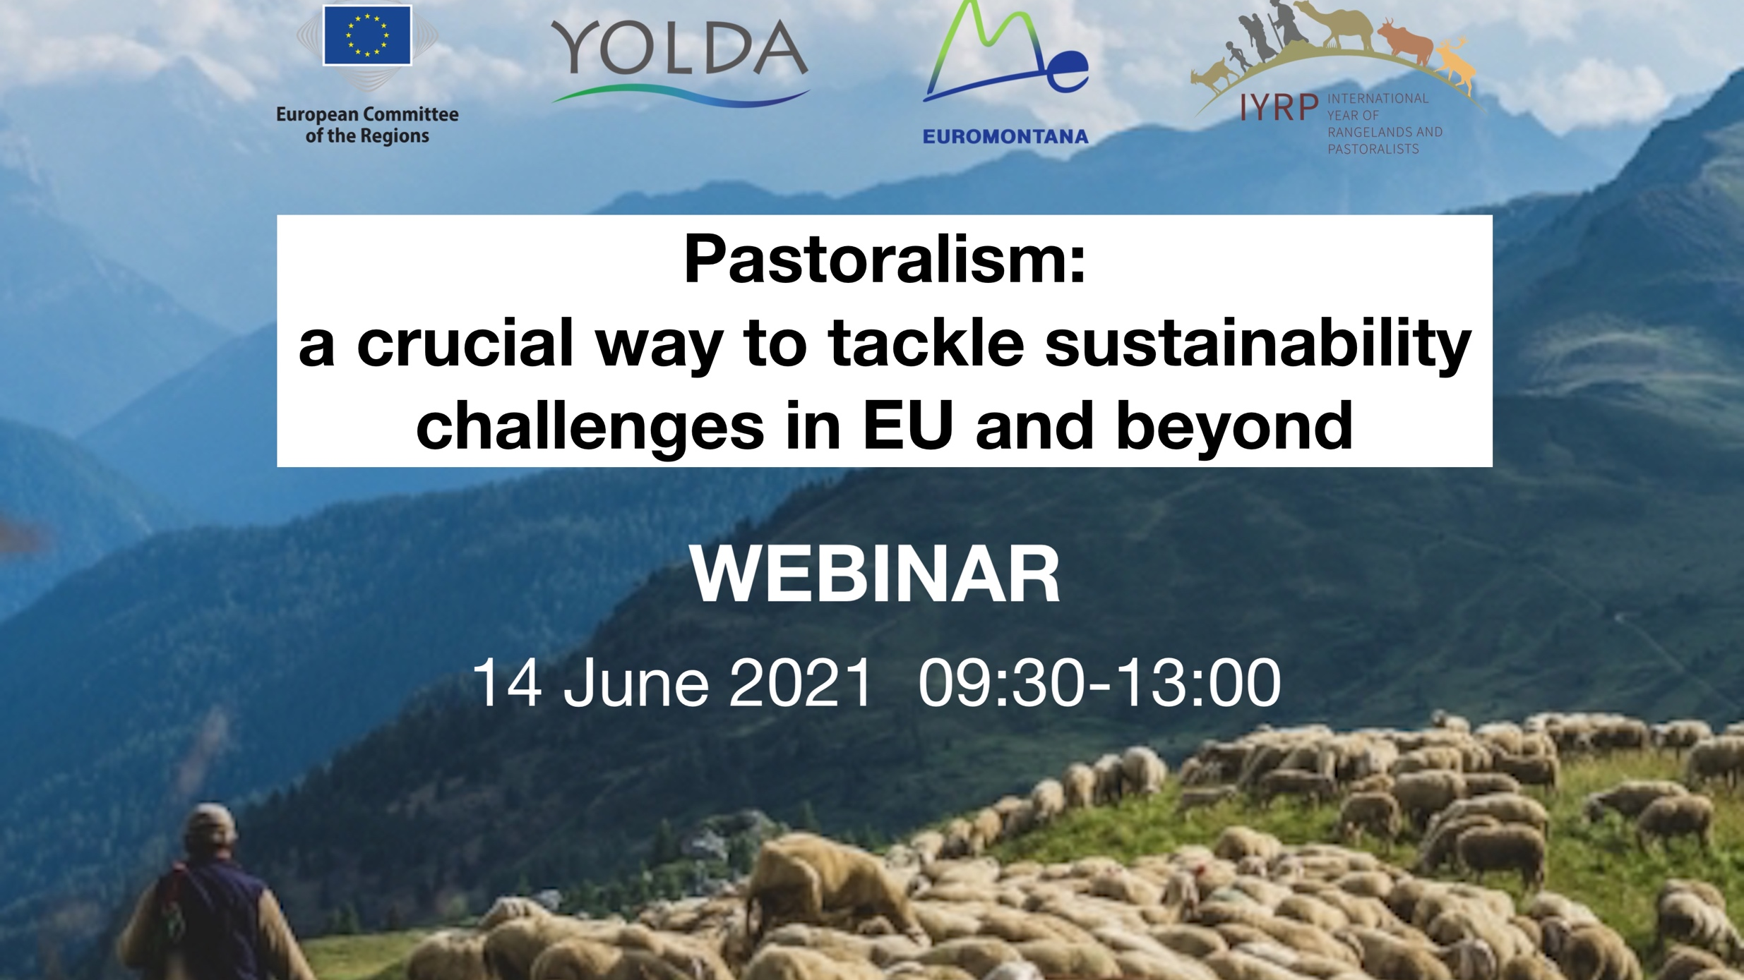

Slide 18
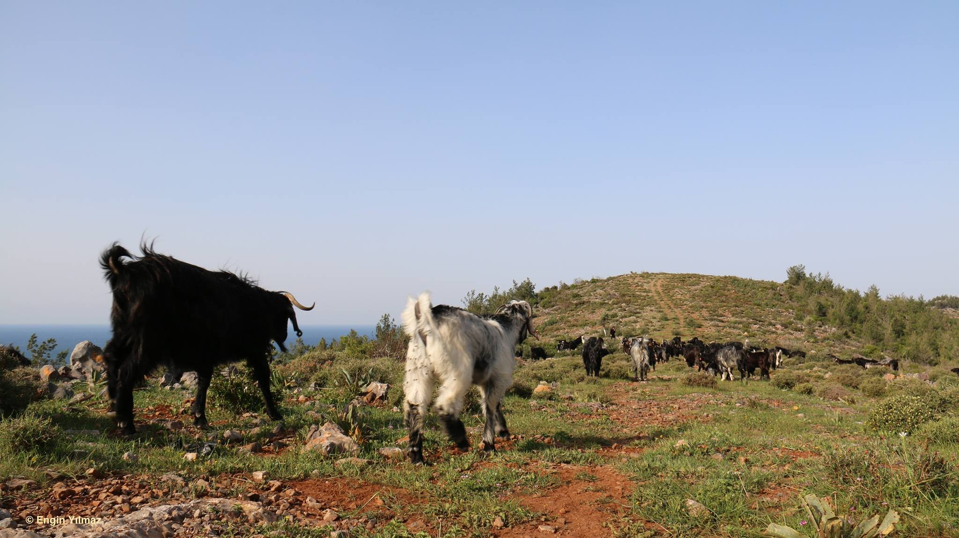
REGIONAL
ACTION PLANS

Slide 19
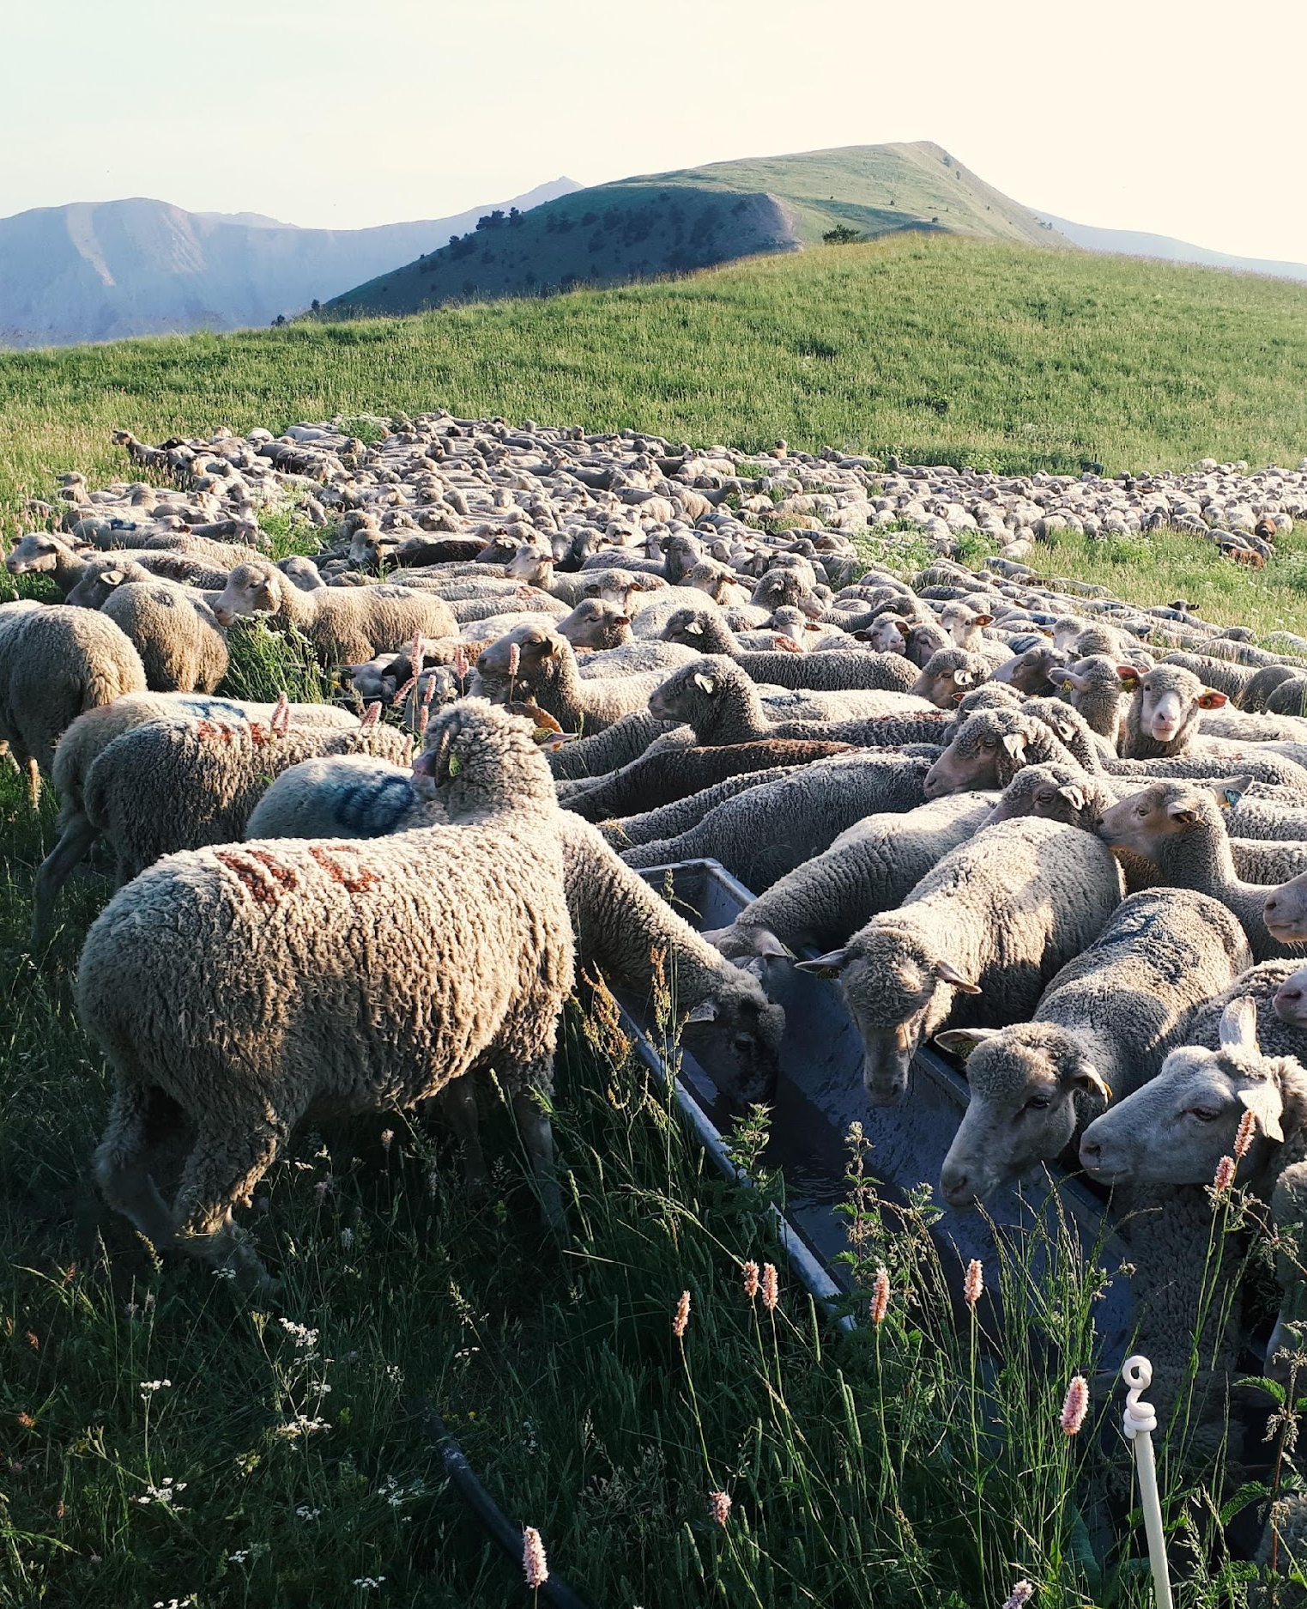
The main objectives of the IYRP :
  to increase awareness and recognition of the importance of rangelands and pastoralists to environmental, social and economic goals; and
  to increase understanding and knowledge for healthy rangelands and sustainable pastoralism.
Accordingly each RISG will prepare action plans considering three phases
  Preparatory phase (2021–2025): some activities to be done in 2026 require prior planning and preparation, research, etc.; moreover, many awareness-raising, learning and policy-influencing activities related to rangelands and pastoralists would need to take place already before 2026
  The International Year (IY) (2026)
  Post IY follow-up (2026 and beyond): some activities (particularly research and evaluation) may be done after 2026.
© Jacky Collieux

Slide 20
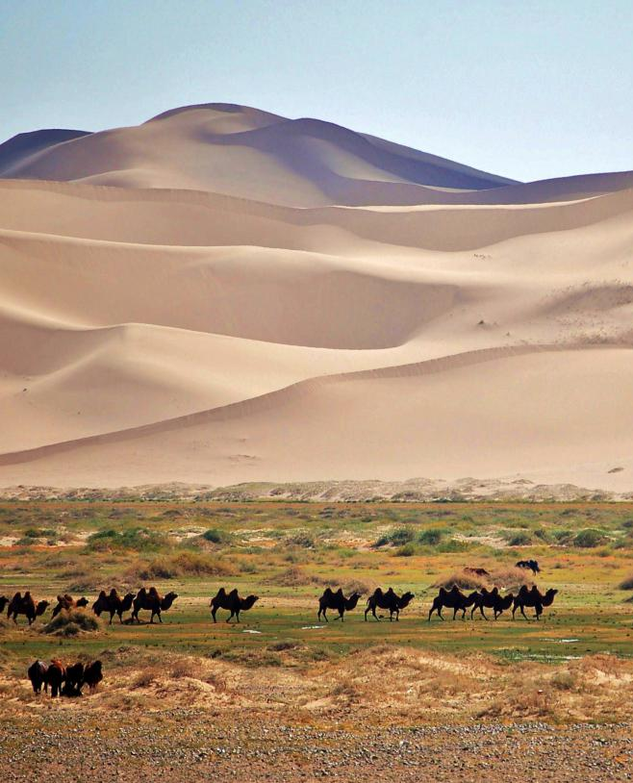
Purpose of regional action plans
To spearhead regional/multi-country activities
To help coordinate national activities across the region
To contribute to global activities
© Marc Foggin

Slide 21
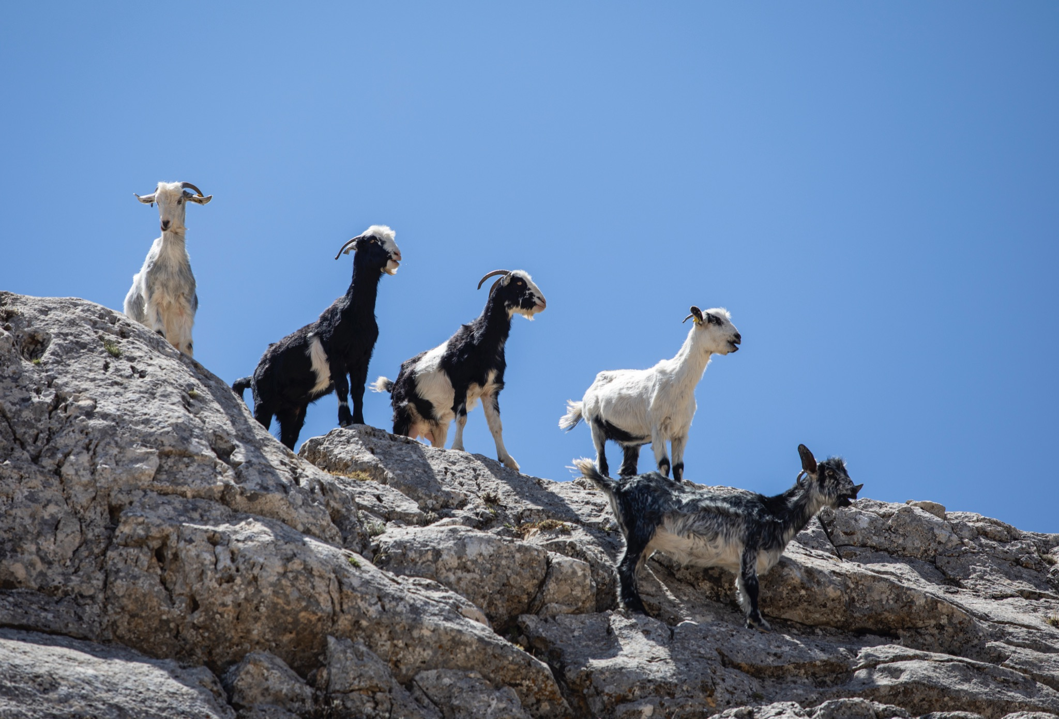
IYRP
FOR NATURE, FOR CLIMATE, FOR SOCIETY, AND FOR LIFE
CONTACTS:
www.iyrp.info
@iyrp2026
www.yolda.org.tr
yolda@yolda.org.tr
@yoldainitiative
www.mednatureculture.org
info@mednatureculture.org
@mednatureculture
© Cem Türkel

Slide 22
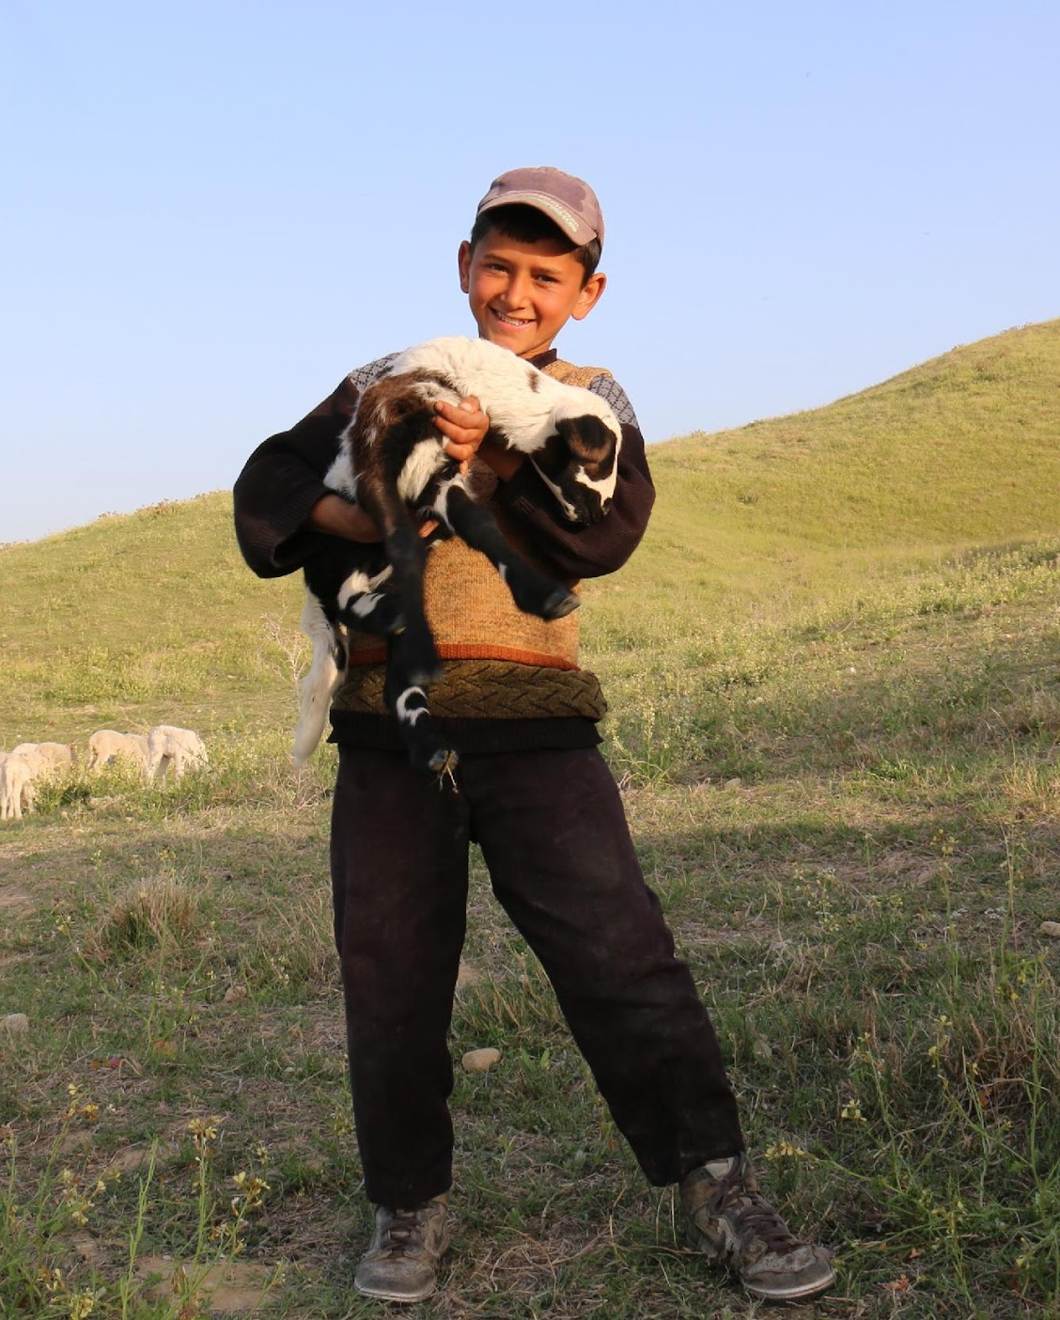



MERCI!
Engin Yılmaz
engin@yolda.org.tr
© Engin Yılmaz

