Slide 1

Review of North American and Global Donor Organizations
Supporting Dry Land Development, Research and Outreach to Tackle Climate Change Impacts –
Opportunities for New Collaborations
Brien E [Ben] Norton – Utah State University
Robert Washington-Allen – University of Nevada, Reno
William A. Payne – University of Nevada, Reno

Slide 2
Global Donor Organizations Supporting Rangeland Development, Research and Outreach
Brien E [Ben] Norton
Emeritus Associate Professor
Department of Wildland Resources
College of Natural Resources
Utah State University
Logan, Utah, USA

Slide 3
Funding for Climate Change projects is through International Agencies
These Agencies can be divided into two groups:
Old, Established Agencies, many of them are banks.
  These Agencies have adopted Climate Change as part of their portfolios
Agencies designed specifically to support the environment.
Most of these Agencies had an original focus on Climate Change.
Climate Change projects are usually a combination of
adaptation and mitigation measures.
  The following lists are not exhaustive

Slide 4
Many International Agencies Work to Reduce Climate Change Impacts:
But Climate Change was not their original concern.
The 12 Principal and Oldest Agencies, listed in order of their establishment, are:
WB World Bank [IBRD & IDA] [est. 1944, Bretton Woods, NH; based Washington, D.C.]
FAO Food and Agriculture Organization [est. 1945, Quebec City, Canada; based in Rome]
USAID* United States Agency for International Development [est. 1961, Washington D.C.]
UNDP United Nations Development Programme [est. 1965, New York]
ADB Asian Development Bank [est. 1966, Manila, Philippines]
CAF Development Bank of Latin America [est. 1968, Caracas, Venezuela; 17 member countries]
UNEP United Nations Environment Programme. [est. Stockholm 1972; based in Nairobi, Kenya]
BOAD West African Development Bank [est. 1973, Lome, Togo; 8 W African countries]
IFAD International Fund for Agricultural Development [est. 1977, Rome; based in Rome]
DBSA* Development Bank of Southern Africa [est. 1983, Johannesburg, S.A.; serves SADC]
EBRD European Bank for Reconstruction and Development [est. 1991, London; based in London]
AfDB African Development Bank [est. 2014, Abidjan, Ivory Coast]

Slide 5
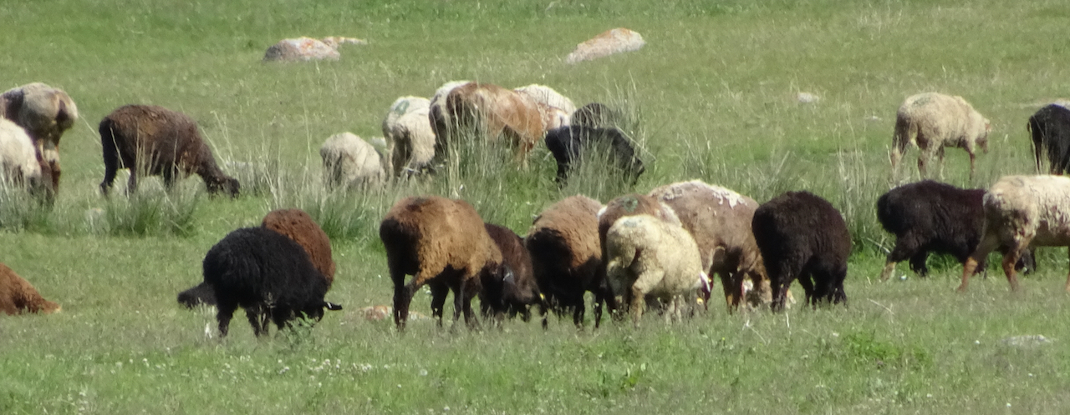
8 International Agencies that Specifically Address Environmental Issues
Listed in order of their year of establishment
IUCN International Union for Conservation of Nature [est.1948, Fontainebleau, Fr.; based in Gland, Switzerland]
UNEP United Nations Environment Programme [est. 1972, Nairobi, Kenya; based in Nairobi]
IPCC Interagency Panel on Climate Change [est. 1988 by UNEP & World Meteorological Org.; Geneva, Switzerland]
  COP Conference of the Parties (e.g., COP26 in Glasgow 2021): Reports and recommendations
GEF Global Environment Facility [est. 1992, Rio de Janeiro, Earth Summit; based in Washington, D.C.]
CBD Convention on Biological Diversity [est. 1992, Rio de Janeiro, Earth Summit; based in Montreal, Canada]
UNFCCC United Nations Framework for Convention on Climate Change [est. 1992, Rio de Janeiro; Bonn, Germany]
UNCCD United Nations Convention to Combat Desertification [est. 1994, Paris, France; based in Bonn, Germany]
GCF Green Climate Fund [est. 2010, Mexico; based in Incheon, South Korea]

Slide 6
All the Agencies and Banks listed above are INTERNATIONAL, composed of member countries
UN agencies receive $$ donations directly or indirectly from up to 189 UN member countries
The principal donors are USA, European countries, Canada, Japan and Australia
One exception is USAID, which is an Agency of the U.S. government
Another exception is DBSA which is wholly owned by the Republic of South Africa, and serves the Southern African Development Community (SADC)

Slide 7
Who are the Primary Donors that IYRP members should focus on? 1
FAO Food and Agriculture Organization
IFAD International Fund for Agricultural Development
WB World Bank – 2 components
  IBRD International Bank for Reconstruction & Development for Middle Income Countries (GNI per capita $4,000 - $12,500)
  IDA International Development Association for poorest countries (GNI per capita <$4,000)
Programme of Climate Change adaptation and mitigation though Strategic Framework to provide sustainability & food security for small-holder farmers.
Investments targeted at poorer and most climate-affected people whose livelihoods depend on agriculture and natural resources, especially women and indigenous people.
New Climate Change Action Plan (22 June 2021), a major provider of climate finance for developing countries, through IBRD and IDA supporting adaptation to Climate Change; mobilizing private capital for climate action; support for protection of natural resources & biodiversity.

Slide 8
Who are the Primary Donors that IYRP members should focus on? 2
UNEP UN Environment Programme
IUCN International Union for Conservation of Nature
UNCCD UN Convention on Combating Desertification
UNEP has a core Environment Fund (EF) that is main provider of funds for specific projects in GEF, GCF and European Commission. Two-pronged attack on atmospheric GHG.
  Reduce CO² emissions
  Increase mitigation & Carbon capture
Approach to Climate Change is to assess risks to biodiversity and offer practical nature-based solutions centered on better conservation, management & restoration of the world’s ecosystems.
Committed to bottom-up approach, encouraging participation by local people in combating desertification and land degradation.

Slide 9
Who are the Primary Donors that IYRP members should focus on? 3
GEF Global Environment Facility [1992]
  LDCF Least Developed Country Fund
  SCCF Special Climate Change Fund
GCF Green Climate Fund [2010]
First global source of funds for climate adaptation. Goal is adaptation to enhance adaptive capacity, strengthen resilience and reduce vulnerability to Climate Change. GEF serves as the Financial Mechanism to UNFCCC. Since 2001, $15billion spent on 440 projects in 130 countries.
Established in 2010 within UNFCCC and has been particularly active since 2015 Paris Accords as a Financing Mechanism for CC projects under UNFCCC. Currently the world’s largest climate fund investing in climate-resistant development. Aims to achieve maximum impact in developing world, supporting paradigm shifts in both mitigation and adaptation; help vulnerable societies adapt to unavoidable impacts of CC.

Slide 10
How does the funding process work?
Member Countries donate $millions to specific UN agencies and banks, such as
  WB World Bank, IDA International Development Association
  GEF Global Environment Facility
  UNEP UN Environment Programme
  GCF Green Climate Fund
Number of member countries varies from agency to agency, for example:
  ADB 68 countries, AfDB 81 countries, CAF 17 countries, EBRD 71 countries
An individual country can access agency resources only if it is a member country of the agency or bank
Some UN entities serve as the “Financial Mechanism” for distributing and monitoring funds:
  WB World Bank
  UNFCCC UN Framework for Convention on Climate Change
  CBD Convention on Biological Diversity
Other agencies approve projects and provide money for those projects, for example:
  GEF Global Environment Facility
  GCF Green Climate Fund

Slide 11
Access to international funding agencies is initiated by national governments and home government departments.
National governments identify projects and work with an international agency for assistance with project design and funding.

Slide 12
Remember: Projects are initiated by governments, working with UN agencies and/or international banks
UN agencies and banks work only through national governments and their departments
National governments often have representatives within UN Agencies
who serve as the points of contact between UN and the country
UN Agencies often have in-country offices that facilitate liaison between the UN agency & host country, e.g., FAO

Slide 13
As an individual IYRP member, how do you go about becoming involved in a development project, research or outreach project?
There are basically two pathways:
  1. Respond to a government announcement outlining a potential project and inviting interested parties to submit a proposal.
  The national government may respond to a prospectus advertised by an international Agency.
2. Get to know individuals in government or make strategic contacts with government personnel or personnel working for an international agency.
Number 2 is probably the most effective way to secure participation in a UN agency- funded or bank-funded project!

Slide 14
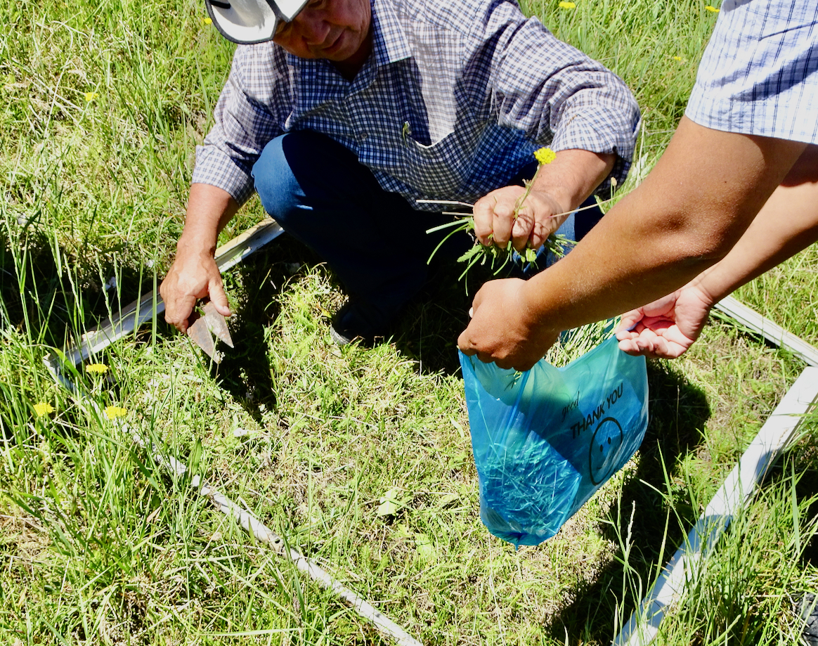
As a researcher, what can you expect?
Most global agency-funded projects do not have a specific research theme or component.
However, questions arise in design and implementation of projects that call for research approaches to gather information or support assumptions.
For example: In a rangeland setting, Carbon sequestration is greatly enhanced by promoting perennial grasses.
  Plant production needs to be measured and monitored to show project impact or success.

Slide 15
Two very important UN agencies in terms of climate change and project opportunities:
Global Environmental Facility [GEF]
  Established 1991 before the Rio Earth Summit of 1992
  >40 countries contribute to GEF Trust Fund administered by the World Bank
  Since 2001, $15billion spent in 130 countries on 440 projects
  Serves as Financial Mechanism for 5 environmental conventions, including
    Convention on Biological Diversity
    UN Convention to Combat Desertification
    UN Framework for Convention on Climate Change
Green Climate Fund [GCF]
  Established 2010, became active 2014, very active after Paris Accords signed
  Newest international agency focused entirely on Climate Change mitigation and adaptation
  Aims to achieve maximum impact in developing world
  Supports paradigm shifts in both mitigation and adaptation (interested in new approaches)
  50% of adaptation funds are targeted for particularly vulnerable countries: LDCs, small islands, & African states
  190 projects currently approved, 16% (31 projects) serve multiple countries.

Slide 16
Personal experience in preparing a proposal for submission to Green Climate Fund:
“Increasing carbon sequestration in Kyrgyzstan by supporting climate investments in forests and rangelands”
Voluntary support as rangeland specialist (BEN) on an FAO proposal-development team.
Proposal focused on four degraded Districts in Kyrgyzstan. Project was approved!
Project implemented by FAO and national forestry agency with GCF funding. $50million.
Project justification: “In Kyrgyzstan, livestock is most important source of income, primary source of nutrition, and a financial safety net for rural poor. Climate change and poor management of natural resources has led to overgrazing…”
From project point of view, forage production and reduced degradation on rangelands is key to project success. Rangeland rehabilitation was a critical component of the proposal.
Go to www.greenclimate.fund and click on projects.

Slide 17
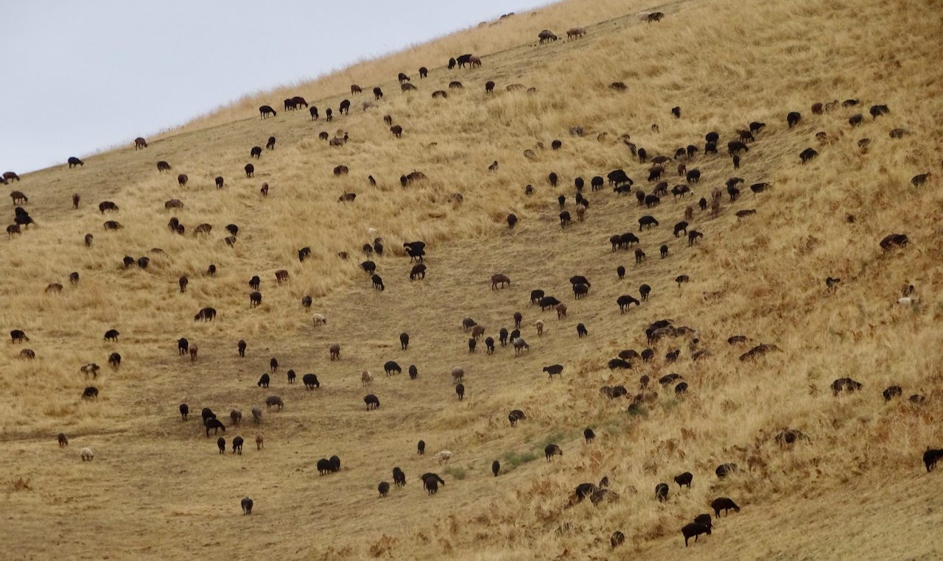
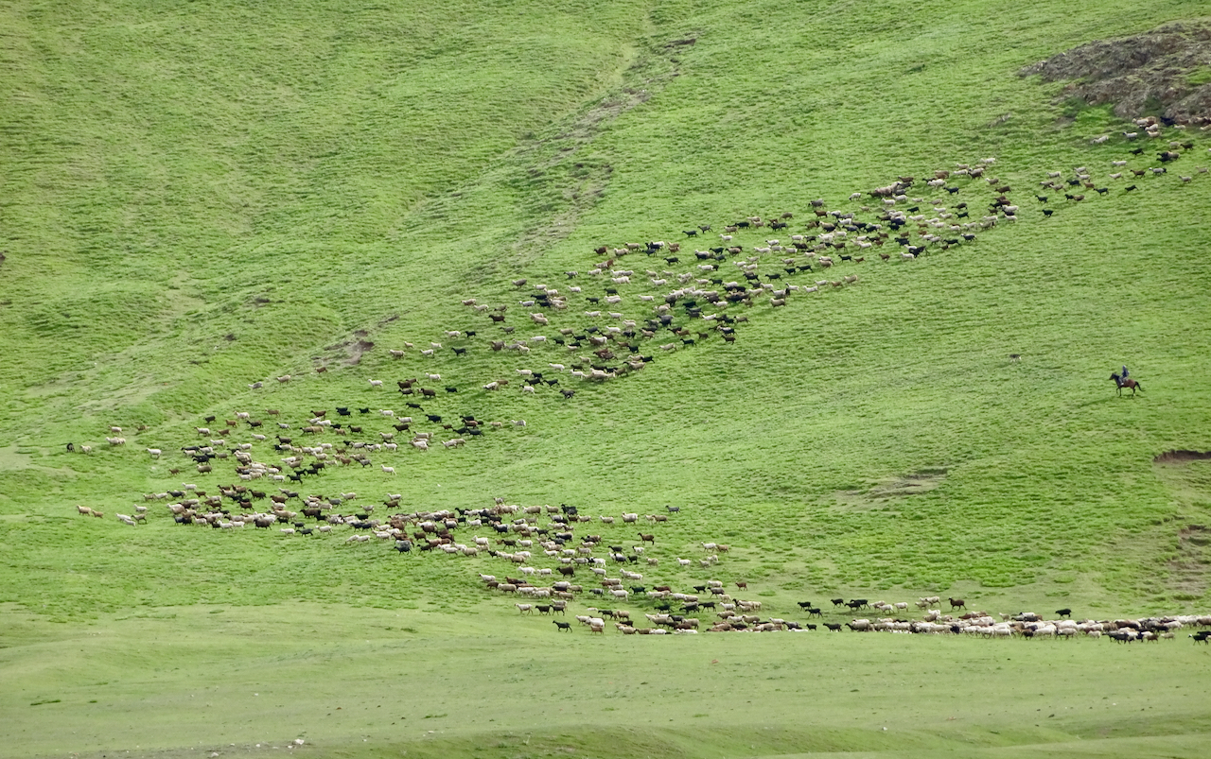
My contribution to the Kyrgyz proposal was to recommend better grazing management: e.g., rotational grazing with long rest periods

Slide 18
Personal Experience of Domestic Funding for Remote Sensing Research in
Drylands including Savanna and Forest Ecosystems: A survey of opportunities
By
Dr. Robert A. Washington-Allen
Associate Professor of Agriculture
Dept. of Agriculture, Veterinary, and Rangeland Sciences
University of Nevada, Reno
&
Dr. William Payne
Dean and Professor
College of Agriculture, Biotechnology, and Natural Resources
University of Nevada, Reno

Slide 19
External Funds
US Environmental Protection Agency (EPA):
Science-To-Achieve-Results (STAR), Retrospective Ecological Risk Assessment of Rangeland Health Using Multitemporal Satellite Imagery, Utah State University, $350,000, 1998-2001
Engaging the community and creating young scientists to restore nutrient impacted Baker Creek, $64,678, 2016-2018
Department of Energy (DOE):
1) Global Water Cycle Pilot project, ORNL, $900,000, 2001-2003 (Whitewater Watershed, Kansas)
DOE-Petroleum Environmental Research Forum (PERF):
Remote sensing and GIS technologies for determining the ecological risks to flora and fauna from the spatial effects of petroleum industry land use activities, : Remote Sensing of the Tallgrass Prairie Preserve, Oklahoma
2. Hyperspectral remote sensing technology to discriminate petroleum industry impacts to desert plants (Investigation of a diesel spill on the Jornada LTER)
USA National Science Foundation
1. NSF Biocomplexity Dynamics of Coupled Natural and Human Systems, National Science Foundation Project Number: BCS-030846, University of Virginia, Comparative Stability & Resiliency of Ecosystems: Five Centuries of Human Interactions with the Environment on the Eastern Shore of Virginia , $1,977,437
2. Research Experience for Undergraduates (REU) EAR- 1004874, Ecohydrology of a Tropical Montane Cloud Forest, $557,606
3. Integrative Graduate Education and Research Traineeship (IGERT): Applied Biodiversity Science Bridging Ecology, Culture, and Governance for Effective Conservation: (Faculty Associate), Texas A&M University, $3,000,00
4. RAPID, (Award# 2141804, AWD-01-00003287 / GR13953) Addressing the wind and water erosion knowledge gap in Drylands: Fire as a driver in cheatgrass invaded Sagebrush Steppe, $50,000, 08/01/2021 – 07/31/2022

Slide 20
External Funds
Bureau of Educational and Cultural Affairs of the United States Department of State: Mainstreaming Use of GIS and Remote Sensing in Environmental Assessment and Sustainable Development in Mozambique, University of Virginia, $100K, 2005
National Bobwhite Conservation Initiative (NBCI)
Dept. of Forestry, Wildlife & Fisheries, University of Tennessee, "Then And Now": Long Term Land-Use Changes Impact Bobwhites, $19,713, March 1, 2016 – October 31, 2016
USDA US Forest Service:
1) Resource Planning Act 1974 Assessment:
Ecological Footprint of Livestock Herbivory on Rangeland Productivity, $116,000, 2008-2011
2) The Texas A&M Forest Service: Mapping Extent and Percent Tree Mortality due to an Extreme Record Drought in Texas in 2011 $19,975, 2012 - 2013
3) USDA US Forest Service (Award #AWD-01-00002384), Remote Sensing Applications for Assessing Targeted Grazing Strategies to Reduce Fine Fuels from Annual Grasses in Nevada, $782,739, September 2019 to August 2024
Administrative Department of Science, Technology, and Innovation of Colombia (COLCIENCIAS)
Water Quality and Sustainability of Andean Paramos: Drinking Water for Millions of People in Latin America, $162,000, PIs: D. Riveros-Iregui (University of Nebraska-Lincoln), 2012
National Space Administration (NASA)
University of Virginia, Hydrologic and Nutrient Controls on the Structure and Function of Southern African Savannas: a Multi-scale Approach , $900,000, PI: H.H. Shugart, 2005-2007

Slide 21
Department of Defense (DoD) Strategic Environmental Research and Development Program (SERDP)
Emerging and Contemporary Technologies in Remote Sensing for Ecosystem Assessment and Change Detection on Military Reservations, ORNL, $4,000,000 ($900,000 to PI), 1998-2001
SERDP Ecosystem Management Program (SEMP) Carbon & Nitrogen Dynamics in Ft. Benning, Georgia, $880,000, 1999 – 2003
RSim Road simulation and population growth across the State of Georgia
USDA Cooperative Research & Extension Services (CSREES)
1) 1890 Institution Teaching and Research Capacity Building Grants Program, Enhancing the Capacity of Urban Forestry Graduate Program at Southern University and A&M College, Texas A&M University, $60,000, 2008-2011
2) Food and Agricultural Sciences National Needs Graduate and Postgraduate Fellowship (NNF), A Graduate Program in Forest Resources: Developing Integrated Expertise in Forest Resource, Management, Conservation, and Restoration, Texas A&M University, $362,290, 2010-2013
3) Agricultural Genome to Phenome Initiative (AG2PI), GPS collars as precision agriculture tools for managing extensive rangeland production systems, $20,000, 11/29/2021 – 11/28/2022
USDA NRCS Funds to the US Army Corps of Engineers to Harris County, TX Soil & Water Conservation District,
Can Chinese Tallow Distribution be reduced to < 5% canopy cover within Greens Bayou Wetlands Mitigation Bank? $11,761 to University of Tennessee and $90,000 total to Texas A&M University, 2011 - 2014
Texas Wheat Producers Board
Texas A&M University, Improved Root and Foliar Biomass for Drought Tolerant Cultivars. $212,142, 2011-2012
USAID Small Ruminant CRSP: Historical analysis of land use/land cover change on the Bolivian Altiplano: A remote sensing perspective, Utah State University, $40,000, 1992-1994

Slide 22
Internal Funds
USDA National Institute of Food & Agriculture. (NIFA)
Texas A&M University, Expanding South Plains Winter Canola.
Instructional Enhancement/Equipment Fee (IEEF), Texas A&M University, Beowulf Cluster Computing for Education, $60,000, 2008-2009
Southeastern Conference (SEC) Faculty Travel Grant, University of Tennessee, Knoxville The Use of Advanced Remote Sensing Technologies for Plant Phenomics, $1,000, 2014 – 2015
University of Tennessee, Knoxville Teaching and Learning Center Teaching for Impact Grant, Dynamic 3-D Topographic Sandbox, $500, Fall 2016
5) Multistate Project (Award #NEV00769) Development of Precision Agricultural Production Methods for Grain Sorghum Yield and Quality Using Variable-Rate Irrigation, $150,450, 07/01/2020-06/30/2023
6) Hatch Grant (Award #NEV00764), Spatial Paleo And Contemporary Reconstruction of Dryland Carbon Dynamics Using Remote Sensing and Dendrochronologies, $150,000, July 2019 – October 2022

Slide 23
University of Nevada, Reno Internal Sources to find Funding Opportunities
Research Notes – HIGHLY RECOMMENDED!!!! This list service is managed by the Research and Innovation office and provides a list of current research opportunities and other important announcements to UNR subscribers. Visit https://www.unr.edu/research-innovation/research-hub and click on the link to subscribe!
InfoEd SPIN – located within InfoEd, described as the world’s largest database of funding opportunities. The system allows you to set your own parameters based on research focus areas as well as a preferred notification schedule.
PIVOT - Pivot is a database of funding opportunities from national, international and local sponsors. This tool will also allow you to locate potential research collaborators. https://www.unr.edu/research-innovation/research-hub/grant-funding-database

Slide 24
External Sources to find
Funding Opportunities
Grants.gov – Contains grant opportunities from various American government agencies.
The Foundation Center – database of prospective foundation funders. https://candid.org/find-funding

Slide 25
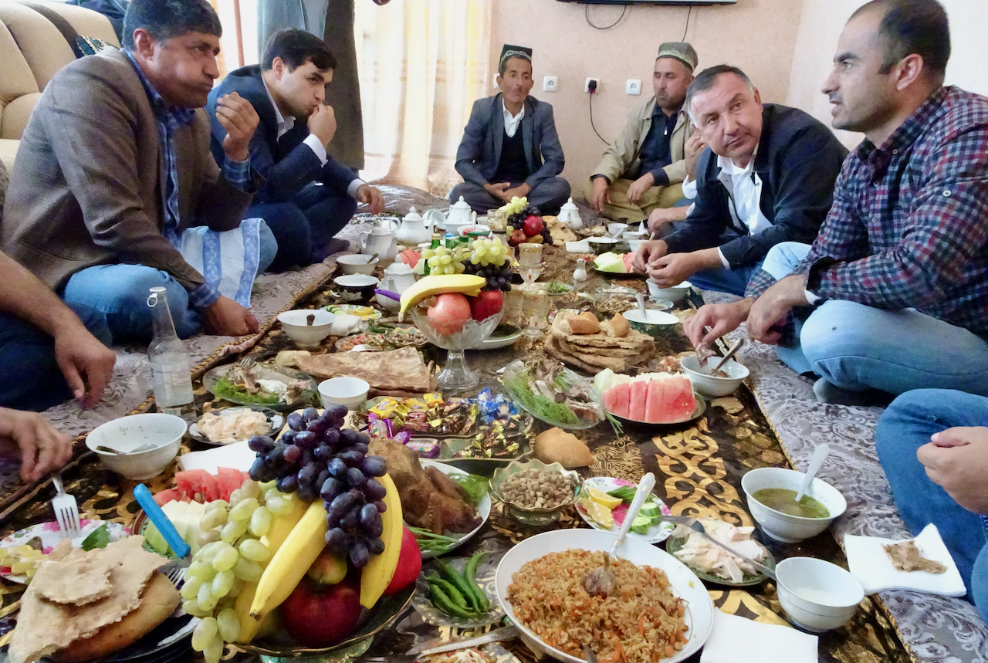
Typical lunch for VIP visitors in a poor village in Tajikistan, Central Asia

